Slide 1
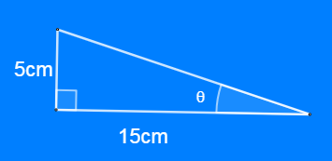
Trigonometry: Missing Angles
Silent
Teacher
Intelligent Practice
Narration
Your Turn
Example
For more videos visit mrbartonmaths.com/videos

Slide 2
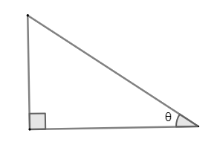
Worked Example
Your Turn
8cm
8cm
4cm
4cm
@fortyninecubed

Slide 3
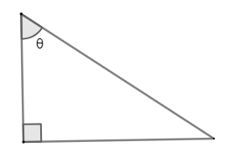
Worked Example
Your Turn
10 cm
6cm
6cm
8cm
@fortyninecubed

Slide 4
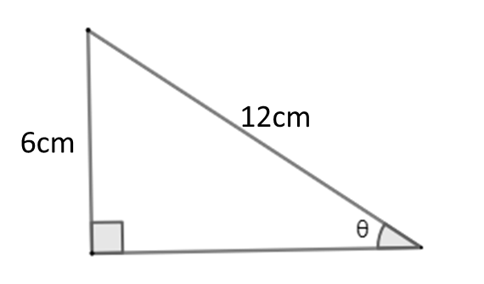
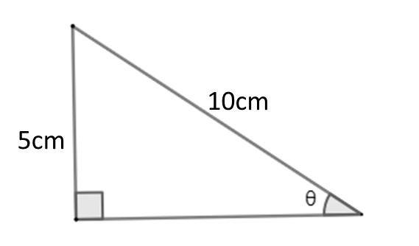
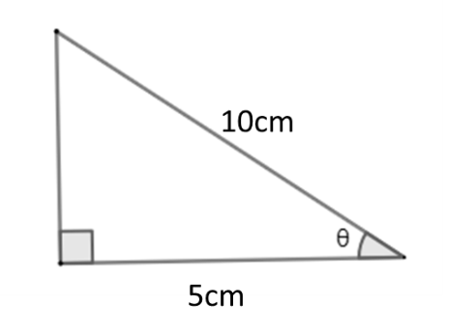
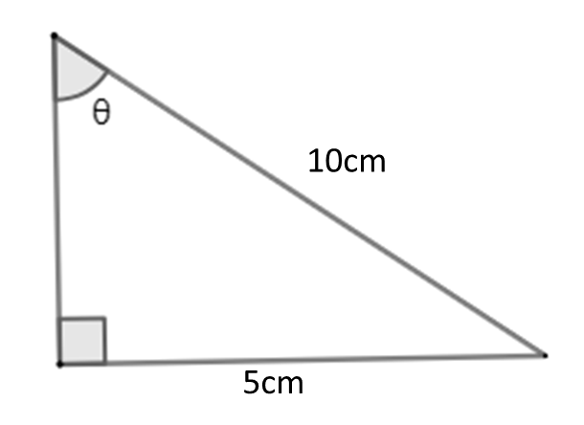
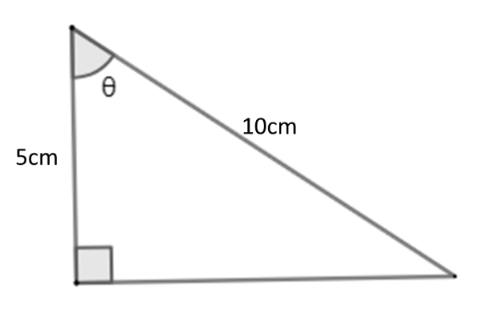
@fortyninecubed

Slide 5
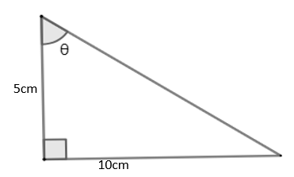
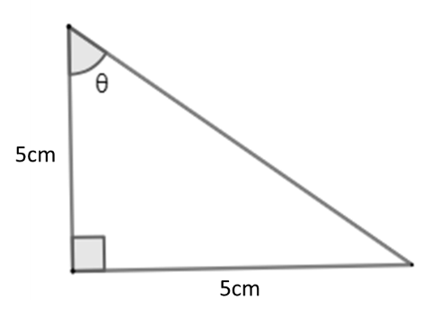
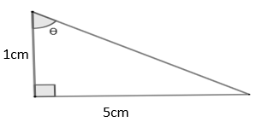
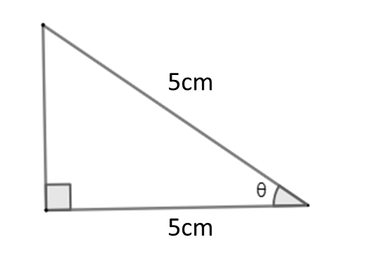
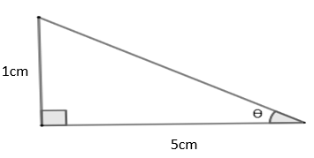
@fortyninecubed

Slide 6
$$θ=30°$$
$$θ=30°$$
$$θ=60°$$
$$θ=30°$$
$$θ=60°$$
@fortyninecubed

Slide 7
$$θ=63.4°$$
$$θ=45°$$
This triangle is impossible – why?
$$θ=78.7°$$
$$θ=0°$$
$$θ=11.3°$$
@fortyninecubed

