Slide 1
Solving Linear Equations: Two fractions
Silent
Teacher
Intelligent Practice
Narration
Your Turn
$$\frac{x+2}{2}+\frac{x+4}{8}=4$$
$$\frac{x+2}{2}+\frac{x+4}{8}=9$$
Example
For more videos visit mrbartonmaths.com/videos

Slide 2
Worked Example
Your Turn
$$\frac{x+2}{2}+\frac{x+4}{5}=6$$
$$\frac{x+2}{2}+\frac{x+4}{6}=6$$
@fortyninecubed

Slide 3


$$\frac{x+2}{2}+\frac{x+4}{3}=4$$
$$\frac{x+2}{2}+\frac{x+4}{8}=4$$
$$\frac{x+2}{2}+\frac{x+4}{8}=9$$
$$\frac{x+2}{6}+\frac{x+4}{8}=9$$
$$\frac{x+2}{6}−\frac{x+4}{8}=9$$
$$\frac{x+2}{6}−\frac{x−4}{8}=9$$
$$\frac{x−2}{6}−\frac{x−4}{8}=9$$
$$\frac{2x−2}{6}−\frac{2x−4}{8}=9$$
$$\frac{4x−2}{6}−\frac{4x−4}{8}=9$$
$$\frac{4x−4}{8}−\frac{4x−2}{6}=9$$
$$\frac{4x−4}{8}−\frac{4x−2}{6}=1$$
$$\frac{4x−4}{8}−\frac{4x−2}{6}=\frac{1}{2}$$
Solve:
@fortyninecubed

Slide 4

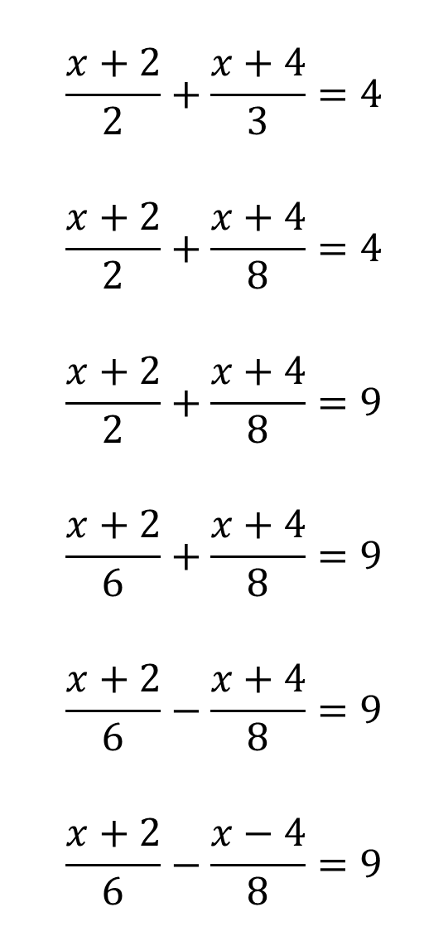

$$\frac{x+2}{2}+\frac{x+4}{3}=4$$
$$\frac{x+2}{2}+\frac{x+4}{8}=4$$
$$\frac{x+2}{2}+\frac{x+4}{8}=9$$
$$\frac{x+2}{6}+\frac{x+4}{8}=9$$
$$\frac{x+2}{6}−\frac{x+4}{8}=9$$
$$\frac{x+2}{6}−\frac{x−4}{8}=9$$
$$\frac{x−2}{6}−\frac{x−4}{8}=9$$
$$\frac{2x−2}{6}−\frac{2x−4}{8}=9$$
$$\frac{4x−2}{6}−\frac{4x−4}{8}=9$$
$$\frac{4x−4}{8}−\frac{4x−2}{6}=9$$
$$\frac{4x−4}{8}−\frac{4x−2}{6}=1$$
$$\frac{4x−4}{8}−\frac{4x−2}{6}=\frac{1}{2}$$
$$x=212$$
$$x=106$$
$$x=53$$
$$x=−55$$
$$x=−7$$
$$x=−4$$
$$x=2$$
$$x=4$$
$$x=12$$
$$x=28$$
$$x=220$$
$$x=196$$

