Slide 1
Mixed bases 1
Silent
Teacher
Intelligent Practice
Narration
Your Turn
$$3^{x}=27$$
$$4^{x}=64$$
$$5^{x}=\frac{1}{125}$$
Example
For more videos visit mrbartonmaths.com/videos

Slide 2
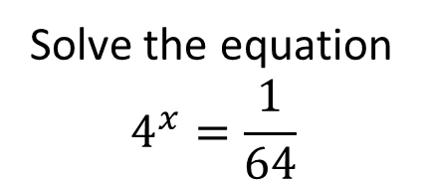
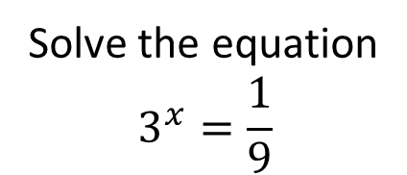
Worked Example
Your Turn
Solve the equation
$$3^{x}=\frac{1}{9}$$
Solve the equation
$$4^{x}=\frac{1}{64}$$
@mrbartonmaths

Slide 3
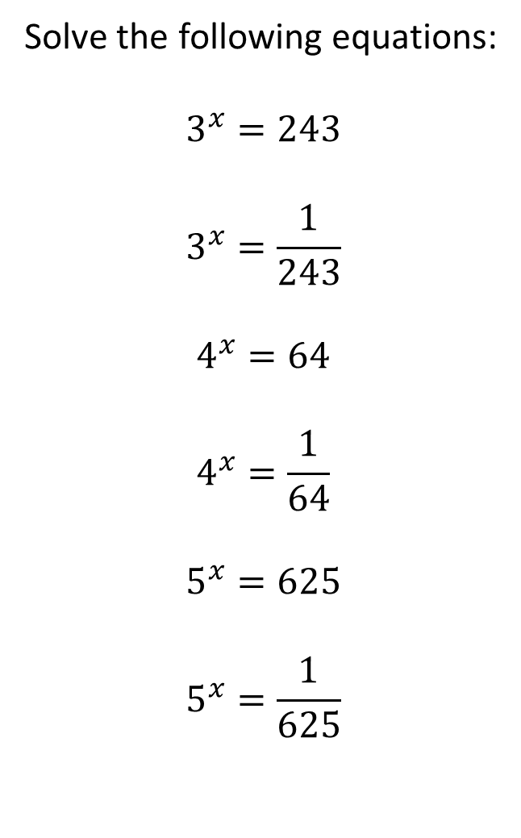
Solve the following equations:
$$3^{x}=243$$
$$3^{x}=\frac{1}{243}$$
$$4^{x}=64$$
$$4^{x}=\frac{1}{64}$$
$$5^{x}=625$$
$$5^{x}=\frac{1}{625}$$
@mrbartonmaths

Slide 4
Solve the following equations:
$$3^{x}=243$$
$$3^{x}=\frac{1}{243}$$
$$4^{x}=64$$
$$4^{x}=\frac{1}{64}$$
$$5^{x}=625$$
$$5^{x}=\frac{1}{625}$$
$$x=5$$
$$x=−5$$
$$x=3$$
$$x=−3$$
$$x=4$$
$$x=−4$$
@mrbartonmaths

