Slide 1
Powers and Indices: Mixed bases 2
Silent
Teacher
Intelligent Practice
Narration
Your Turn
$${\left(\frac{1}{3}\right)}^{x}=81$$
$${\left(\frac{1}{3}\right)}^{x}=\frac{1}{27}$$
$${\left(\frac{1}{4}\right)}^{x}=64$$
Example
For more videos visit mrbartonmaths.com/videos

Slide 2
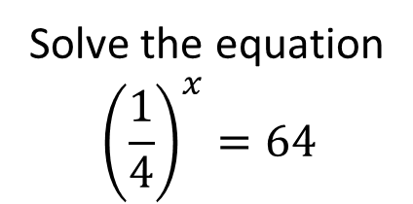
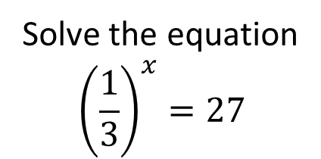
Worked Example
Your Turn
Solve the equation
$${\left(\frac{1}{3}\right)}^{x}=27$$
Solve the equation
$${\left(\frac{1}{4}\right)}^{x}=64$$

Slide 3

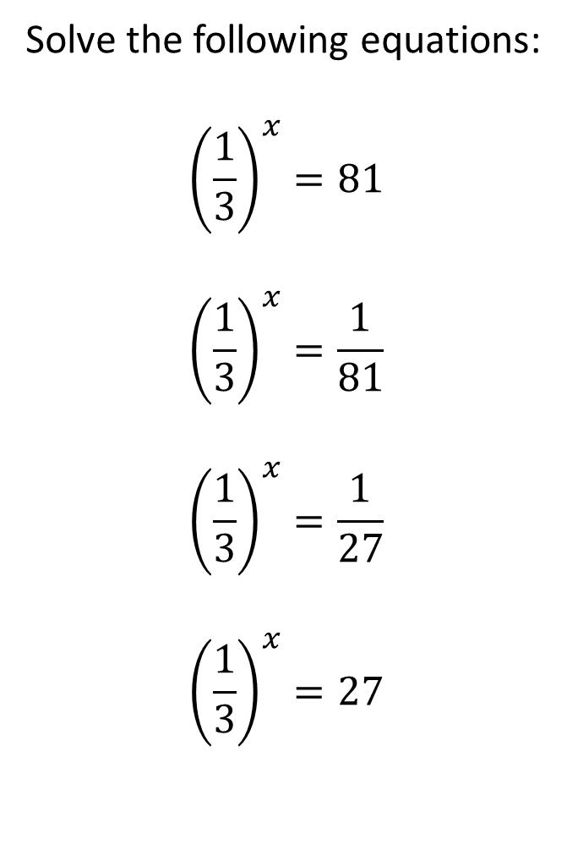
Solve the following equations:
$${\left(\frac{1}{3}\right)}^{x}=81$$
$${\left(\frac{1}{3}\right)}^{x}=\frac{1}{81}$$
$${\left(\frac{1}{3}\right)}^{x}=\frac{1}{27}$$
$${\left(\frac{1}{3}\right)}^{x}=27$$
$${\left(\frac{1}{4}\right)}^{x}=64$$
$${\left(\frac{1}{4}\right)}^{x}=256$$
$${\left(\frac{1}{4}\right)}^{x}=\frac{1}{256}$$
$${\left(\frac{5}{25}\right)}^{x}=625$$

Slide 4
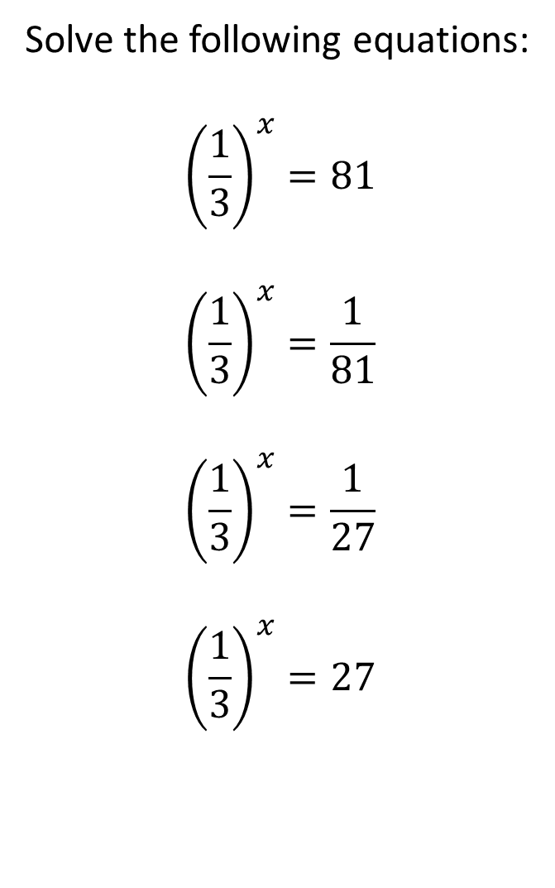
Solve the following equations:
$${\left(\frac{1}{3}\right)}^{x}=81$$
$${\left(\frac{1}{3}\right)}^{x}=\frac{1}{81}$$
$${\left(\frac{1}{3}\right)}^{x}=\frac{1}{27}$$
$${\left(\frac{1}{3}\right)}^{x}=27$$
$${\left(\frac{1}{4}\right)}^{x}=64$$
$${\left(\frac{1}{4}\right)}^{x}=256$$
$${\left(\frac{1}{4}\right)}^{x}=\frac{1}{256}$$
$${\left(\frac{5}{25}\right)}^{x}=625$$
$$x=−4$$
$$x=−3$$
$$x=4$$
$$x=−4$$
$$x=3$$
$$x=4$$
$$x=−3$$
$$x=−4$$

