Slide 1
Sequences: nth term of a Quadratic Sequence
Silent
Teacher
Intelligent Practice
Narration
Your Turn
$$4, 11, 22, 37, 56…$$
$$5, 13, 25, 41, 61…$$
$$4, 12, 24, 40, 60…$$
Example
For more videos visit mrbartonmaths.com/videos

Slide 2


Worked Example
Your Turn
Find the nth term:
$$4, 10, 20, 34, 52…$$
$$8, 17, 32, 53, 80 …$$
Find the nth term:
$$-1, 5, 15, 29, 47…$$
$$7, 15, 29, 49, 75…$$
@fortyninecubed

Slide 3

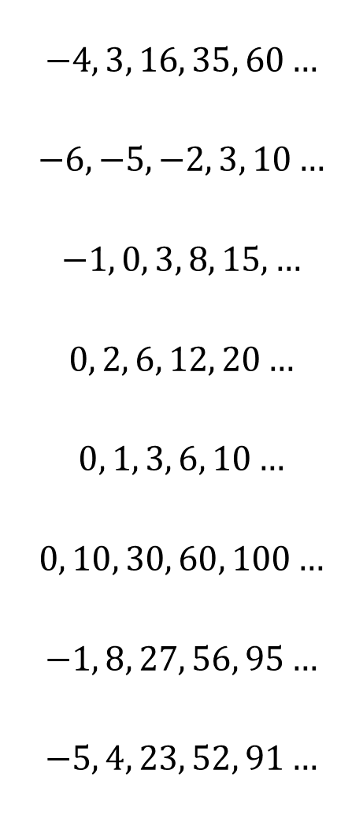
$$2, 8, 18, 32, 50…$$
$$3, 9, 19, 33, 51…$$
$$4, 11, 22, 37, 56…$$
$$5, 13, 25, 41, 61…$$
$$4, 12, 24, 40, 60…$$
$$3, 8, 15, 24, 35…$$
$$5, 16, 33, 56, 85…$$
$$0, 11, 28, 51, 80…$$
$$−4, 3, 16, 35, 60…$$
$$−6, −5, −2, 3, 10…$$
$$−1, 0, 3, 8, 15,…$$
$$0, 2, 6, 12, 20…$$
$$0, 1, 3, 6, 10…$$
$$0, 10, 30, 60, 100…$$
$$−1, 8, 27, 56, 95…$$
$$−5, 4, 23, 52, 91…$$
@fortyninecubed

Slide 4



$$2, 8, 18, 32, 50…$$
$$3, 9, 19, 33, 51…$$
$$4, 11, 22, 37, 56…$$
$$5, 13, 25, 41, 61…$$
$$4, 12, 24, 40, 60…$$
$$3, 8, 15, 24, 35…$$
$$5, 16, 33, 56, 85…$$
$$0, 11, 28, 51, 80…$$
$$−4, 3, 16, 35, 60…$$
$$−6, −5, −2, 3, 10…$$
$$−1, 0, 3, 8, 15,…$$
$$0, 2, 6, 12, 20…$$
$$0, 1, 3, 6, 10…$$
$$0, 10, 30, 60, 100…$$
$$−1, 8, 27, 56, 95…$$
$$−5, 4, 23, 52, 91…$$
$$2n^{2}$$
$$2n^{2}+1$$
$$2n^{2}+n+1$$
$$2n^{2}+2n+1$$
$$2n^{2}+2n$$
$$n^{2}+2n$$
$$3n^{2}+2n$$
$$3n^{2}+2n−5$$
$$3n^{2}−2n−5$$
$$n^{2}−2n−5$$
$$n^{2}−2n$$
$$n^{2}−n$$
$${5n}^{2}−5n$$
$${5n}^{2}−6n$$
$${5n}^{2}−6n−4$$
$$\frac{1}{2}n^{2}−\frac{1}{2}n$$
@fortyninecubed

