Slide 1
Rounding: 1 Significant Figure
Silent
Teacher
Intelligent Practice
Narration
Your Turn
$$36.8$$
$$3.68$$
$$0.368$$
Example
For more videos visit mrbartonmaths.com/videos

Slide 2
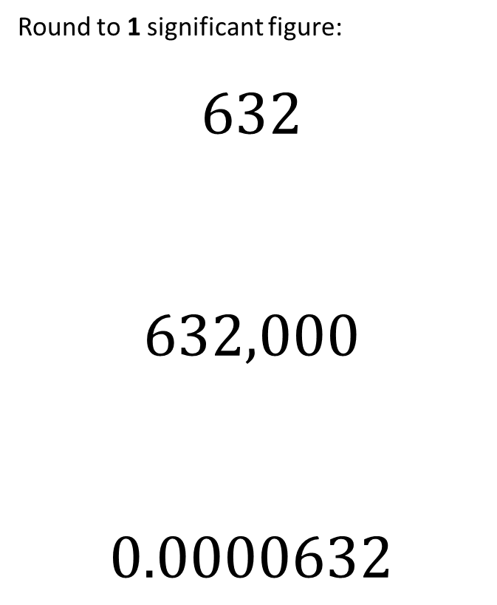
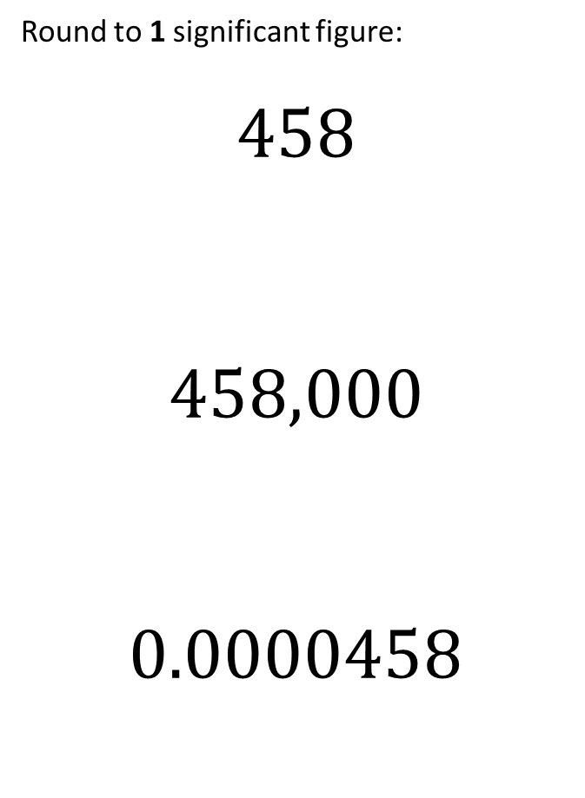
Worked Example
Your Turn
Round to 1 significant figure:
$$458$$
$$458,000$$
$$0.0000458$$
Round to 1 significant figure:
$$632$$
$$632,000$$
$$0.0000632$$
@fortyninecubed

Slide 3
$$32$$
$$320$$
$$328$$
$$368$$
$$36.8$$
$$3.68$$
$$0.368$$
$$0.0368$$
$$0.00000368$$
$$0.00001368$$
$$4.00001368$$
$$4.00009368$$
$$4.90009368$$
$$490009368$$
$$4900093680$$
$$4090009368$$
@fortyninecubed

Slide 4
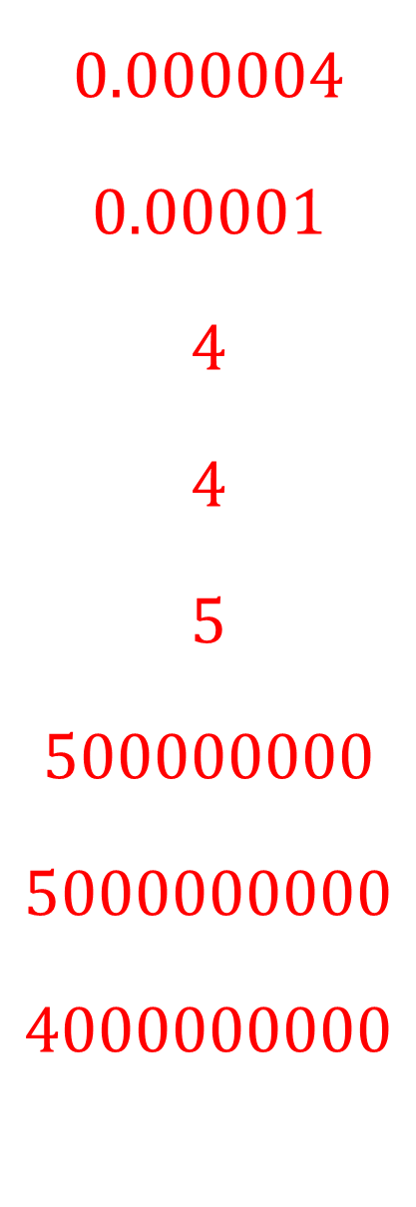
$$32$$
$$320$$
$$328$$
$$368$$
$$36.8$$
$$3.68$$
$$0.368$$
$$0.0368$$
$$30$$
$$300$$
$$300$$
$$400$$
$$40$$
$$4$$
$$0.4$$
$$0.04$$
$$0.00000368$$
$$0.00001368$$
$$4.00001368$$
$$4.00009368$$
$$4.90009368$$
$$490009368$$
$$4900093680$$
$$4090009368$$
$$0.000004$$
$$0.00001$$
$$4$$
$$4$$
$$5$$
$$500000000$$
$$5000000000$$
$$4000000000$$
@fortyninecubed

