Slide 1
Rounding: 1 Decimal Place
Silent
Teacher
Intelligent Practice
Narration
Your Turn
$$6.371$$
$$6.378$$
$$6.478$$
Example
For more videos visit mrbartonmaths.com/videos

Slide 2
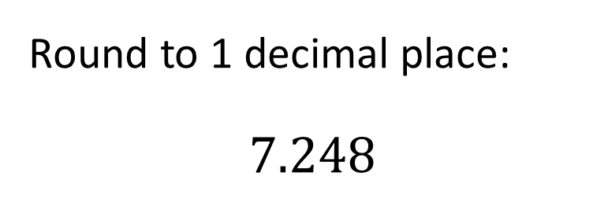
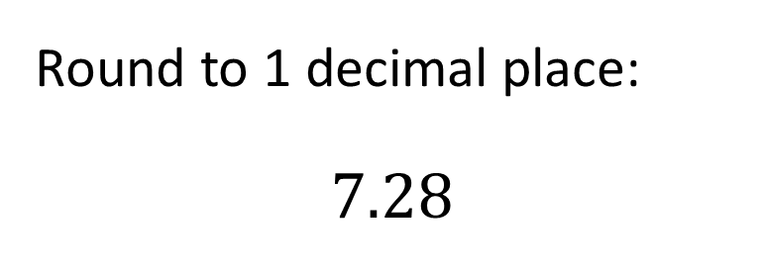
Worked Example
Your Turn
Round to 1 decimal place:
$$7.28$$
Round to 1 decimal place:
$$7.248$$
@fortyninecubed

Slide 3
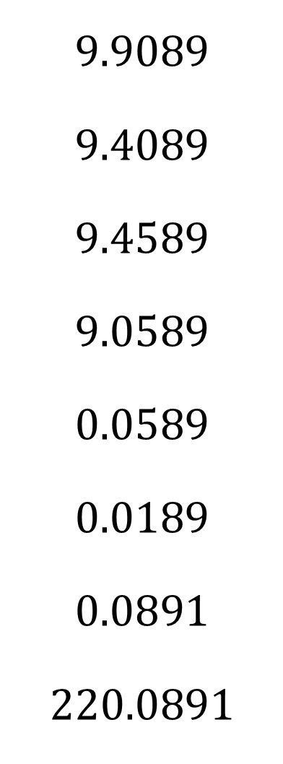

Round to 1 decimal place:
$$6.34$$
$$6.37$$
$$6.371$$
$$6.378$$
$$6.478$$
$$6.978$$
$$9.978$$
$$9.9789$$
$$9.9089$$
$$9.4089$$
$$9.4589$$
$$9.0589$$
$$0.0589$$
$$0.0189$$
$$0.0891$$
$$220.0891$$
@fortyninecubed

Slide 4
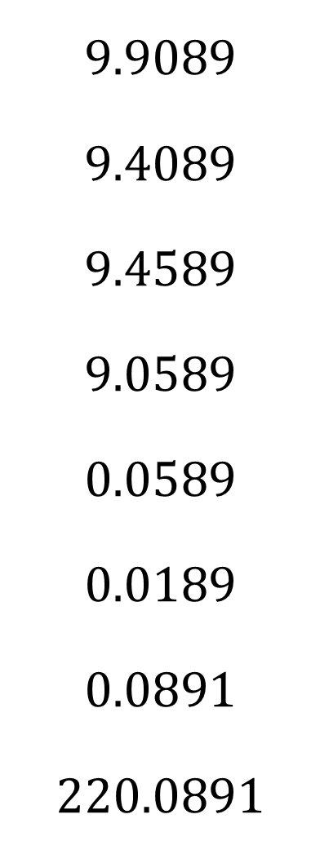

$$6.34$$
$$6.37$$
$$6.371$$
$$6.378$$
$$6.478$$
$$6.978$$
$$9.978$$
$$9.9789$$
$$6.3$$
$$6.4$$
$$6.4$$
$$6.4$$
$$6.5$$
$$7.0$$
$$10.0$$
$$10.0$$
$$9.9089$$
$$9.4089$$
$$9.4589$$
$$9.0589$$
$$0.0589$$
$$0.0189$$
$$0.0891$$
$$220.0891$$
$$9.9$$
$$9.4$$
$$9.5$$
$$9.1$$
$$0.1$$
$$0.0$$
$$0.1$$
$$220.1$$
@fortyninecubed

