Slide 1
Surds: Rationalising the Denominator
Silent
Teacher
Intelligent Practice
Narration
Your Turn
$$\frac{5}{\sqrt{6}}$$
$$\frac{5}{2\sqrt{6}}$$
Example
For more videos visit mrbartonmaths.com/videos

Slide 2
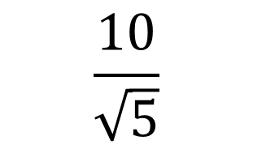
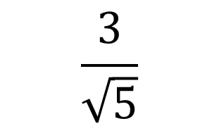
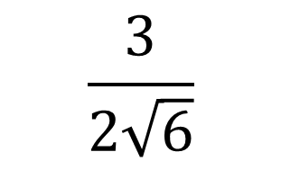
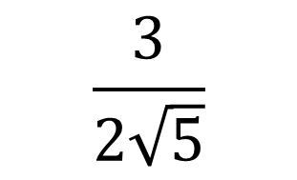
Worked Example
Your Turn
$$\frac{3}{\sqrt{5}}$$
$$\frac{10}{\sqrt{5}}$$
$$\frac{3}{2\sqrt{5}}$$
$$\frac{3}{2\sqrt{6}}$$
@fortyninecubed

Slide 3
$$\frac{5}{\sqrt{2}}$$
$$\frac{6}{\sqrt{2}}$$
$$\frac{6}{\sqrt{3}}$$
$$\frac{4}{\sqrt{3}}$$
$$\frac{4}{\sqrt{6}}$$
$$\frac{5}{\sqrt{6}}$$
$$\frac{5}{2\sqrt{6}}$$
$$\frac{5}{3\sqrt{6}}$$
$$\frac{5}{10\sqrt{6}}$$
$$\frac{5}{10\sqrt{5}}$$
@fortyninecubed

Slide 4
$$\frac{5}{\sqrt{5}}$$
$$\frac{8}{\sqrt{8}}$$
$$\frac{10}{\sqrt{8}}$$
$$\frac{10}{\sqrt{12}}$$
$$\frac{10}{2\sqrt{3}}$$
@fortyninecubed

Slide 5

$$\frac{5}{\sqrt{2}}$$
$$\frac{6}{\sqrt{2}}$$
$$\frac{6}{\sqrt{3}}$$
$$\frac{4}{\sqrt{3}}$$
$$\frac{4}{\sqrt{6}}$$
$$\frac{5\sqrt{2}}{2}$$
$$\frac{5}{\sqrt{6}}$$
$$\frac{5}{2\sqrt{6}}$$
$$\frac{5}{3\sqrt{6}}$$
$$\frac{5}{10\sqrt{6}}$$
$$\frac{5}{10\sqrt{5}}$$
$$\frac{5\sqrt{6}}{6}$$
$$\frac{5\sqrt{6}}{12}$$
$$\frac{5\sqrt{6}}{18}$$
$$\frac{\sqrt{6}}{12}$$
$$\frac{\sqrt{5}}{10}$$
$$3\sqrt{2}$$
$$2\sqrt{3}$$
$$\frac{4\sqrt{3}}{3}$$
$$\frac{2\sqrt{6}}{3}$$
@fortyninecubed

Slide 6
$$\frac{5}{\sqrt{5}}$$
$$\frac{8}{\sqrt{8}}$$
$$\frac{10}{\sqrt{8}}$$
$$\frac{10}{\sqrt{12}}$$
$$\frac{10}{2\sqrt{3}}$$
$$\sqrt{5}$$
$$2\sqrt{2}$$
$$\frac{5\sqrt{2}}{2}$$
$$\frac{5\sqrt{3}}{3}$$
$$\frac{5\sqrt{3}}{3}$$
@fortyninecubed

