Slide 1
Differentiation: Basic differentiation
True/false
Reflect
Your Turn
$y=x^{2}−3x$ $\frac{dy}{dx}=$
$y=x^{2}−5x$ $\frac{dy}{dx}=$
$y=x^{2}−5$ $\frac{dy}{dx}=$
Rule

Slide 2


$y=x^{2}$ $\frac{dy}{dx}=$
$y=x^{2}+3x$ $\frac{dy}{dx}=$
$y=x^{2}−3x$ $\frac{dy}{dx}=$
$y=x^{2}−5x$ $\frac{dy}{dx}=$
$y=x^{2}−5$ $\frac{dy}{dx}=$
$y=x^{2}+5$ $\frac{dy}{dx}=$
$y=x^{2}+6$ $\frac{dy}{dx}=$
$y=x^{2}+3x+6$ $\frac{dy}{dx}=$
$y=x^{2}+3x+5$ $\frac{dy}{dx}=$
$y=x^{2}+2x+5$ $\frac{dy}{dx}=$
$y=x^{2}+x+5$ $\frac{dy}{dx}=$
$y=x^{2}+x−5$ $\frac{dy}{dx}=$
$y=x^{2}−x−5$ $\frac{dy}{dx}=$
$y=x^{2}−2x−5$ $\frac{dy}{dx}=$
$y=2x^{2}−2x−5$ $\frac{dy}{dx}=$
$y={3x}^{2}−2x−5$ $\frac{dy}{dx}=$
$y={3x}^{3}−2x^{2}−5x$ $\frac{dy}{dx}=$
$y={2x}^{3}−2x^{2}−5x$ $\frac{dy}{dx}=$
$y={2x}^{3}+2x^{2}−5x$ $\frac{dy}{dx}=$
$y={2x}^{3}+2−5x$ $\frac{dy}{dx}=$
$y={2x}^{3}−5x+2$ $\frac{dy}{dx}=$
$y=2−5x−{2x}^{3}$ $\frac{dy}{dx}=$
@mrbartonmaths

Slide 3
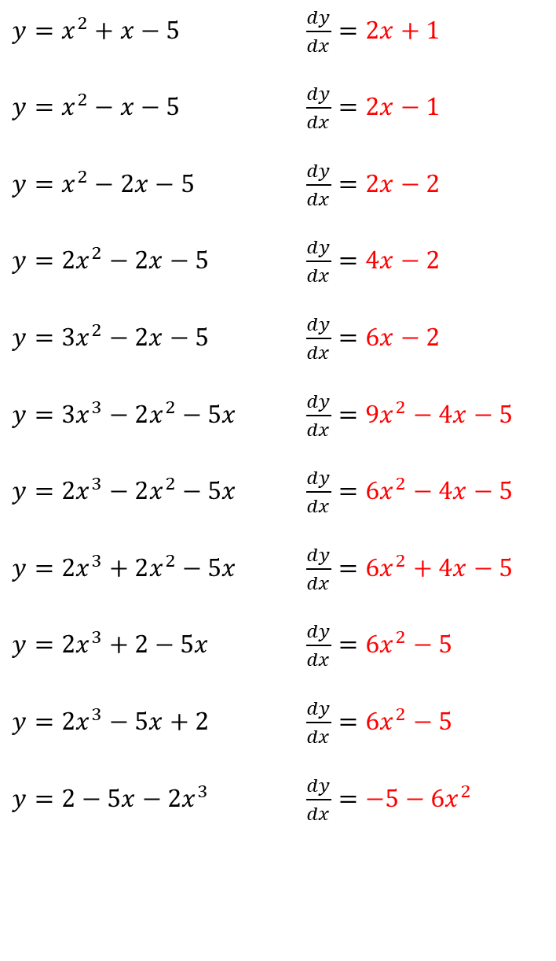

$y=x^{2}$ $\frac{dy}{dx}=2x$
$y=x^{2}+3x$ $\frac{dy}{dx}=2x+3$
$y=x^{2}−3x$ $\frac{dy}{dx}=2x−3$
$y=x^{2}−5x$ $\frac{dy}{dx}=2x−5$
$y=x^{2}−5$ $\frac{dy}{dx}=2x$
$y=x^{2}+5$ $\frac{dy}{dx}=2x$
$y=x^{2}+6$ $\frac{dy}{dx}=2x$
$y=x^{2}+3x+6$ $\frac{dy}{dx}=2x+3$
$y=x^{2}+3x+5$ $\frac{dy}{dx}=2x+3$
$y=x^{2}+2x+5$ $\frac{dy}{dx}=2x+2$
$y=x^{2}+x+5$ $\frac{dy}{dx}=2x+1$
$y=x^{2}+x−5$ $\frac{dy}{dx}=2x+1$
$y=x^{2}−x−5$ $\frac{dy}{dx}=2x−1$
$y=x^{2}−2x−5$ $\frac{dy}{dx}=2x−2$
$y=2x^{2}−2x−5$ $\frac{dy}{dx}=4x−2$
$y={3x}^{2}−2x−5$ $\frac{dy}{dx}=6x−2$
$y={3x}^{3}−2x^{2}−5x$ $\frac{dy}{dx}={9x}^{2}−4x−5$
$y={2x}^{3}−2x^{2}−5x$ $\frac{dy}{dx}={6x}^{2}−4x−5$
$y={2x}^{3}+2x^{2}−5x$ $\frac{dy}{dx}={6x}^{2}+4x−5$
$y={2x}^{3}+2−5x$ $\frac{dy}{dx}={6x}^{2}−5$
$y={2x}^{3}−5x+2$ $\frac{dy}{dx}={6x}^{2}−5$
$y=2−5x−{2x}^{3}$ $\frac{dy}{dx}={−5−6x}^{2}$
@mrbartonmaths

Slide 4

Your Turn
$y=x^{3}$ $\frac{dy}{dx}=$
$y=x^{3}−5x^{2}$ $\frac{dy}{dx}=$
$y=x^{3}−5x$ $\frac{dy}{dx}=$
$y=x^{3}−5$ $\frac{dy}{dx}=$
$y={5−x}^{3}$ $\frac{dy}{dx}=$
@mrbartonmaths

Slide 5

Your Turn - answers
$y=x^{3}$ $\frac{dy}{dx}={3x}^{2}$
$y=x^{3}−5x^{2}$ $\frac{dy}{dx}={3x}^{2}−10x$
$y=x^{3}−5x$ $\frac{dy}{dx}={3x}^{2}−5$
$y=x^{3}−5$ $\frac{dy}{dx}={3x}^{2}$
$y={5−x}^{3}$ $\frac{dy}{dx}={−3x}^{2}$
@mrbartonmaths

