Slide 1
Binomial expansion 2
Silent
Teacher
Intelligent Practice
Narration
Your Turn
$$Use the binomial theorem to find the first 4 terms in the expansion of$$
$$the following:$$
${\left(1+x\right)}^{10}$
${\left(1+3x\right)}^{6}$
${\left(2−x\right)}^{8}$
Example
For more videos visit mrbartonmaths.com/videos

Slide 2
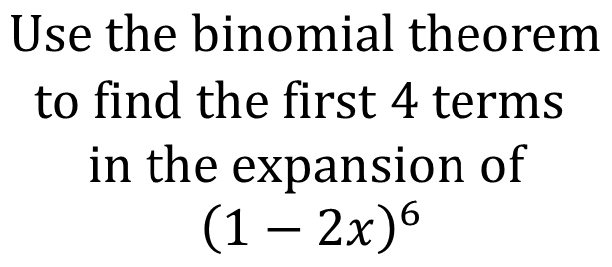
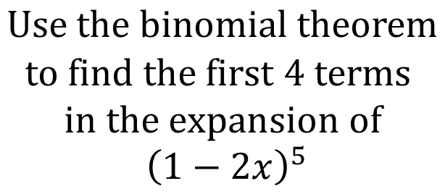
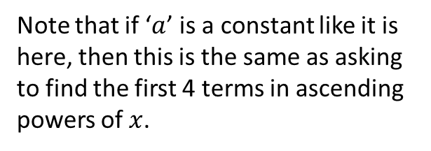
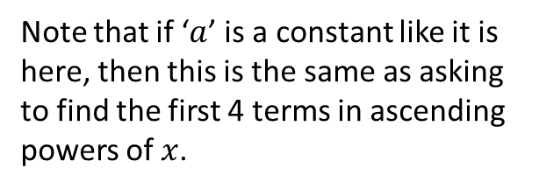
Worked Example
Your Turn
$$Use the binomial theorem$$
$$to find the first 4 terms$$
$$in the expansion of$$
$${\left(1−2x\right)}^{5}$$
$$Use the binomial theorem$$
$$to find the first 4 terms$$
$$in the expansion of$$
$${\left(1−2x\right)}^{6}$$
Note that if ‘$a$’ is a constant like it is here, then this is the same as asking to find the first 4 terms in ascending powers of $x$.
Note that if ‘$a$’ is a constant like it is here, then this is the same as asking to find the first 4 terms in ascending powers of $x$.
@mrbartonmaths

Slide 3
$$Use the binomial theorem to find the first 4 terms in the expansion of$$
$$the following:$$
${\left(1+x\right)}^{10}$
${\left(1+3x\right)}^{6}$
${\left(2−x\right)}^{8}$
${\left(3−x\right)}^{7}$
${\left(2−\frac{1}{2}x\right)}^{10}$
@mrbartonmaths

Slide 4
$$Use the binomial theorem to find the first 4 terms in the expansion of$$
$$the following:$$
${\left(1+x\right)}^{10}$
${\left(1+3x\right)}^{6}$
${\left(2−x\right)}^{8}$
${\left(3−x\right)}^{7}$
${\left(2−\frac{1}{2}x\right)}^{10}$
$$1+10x+45x^{2}+120x^{3}$$
$$1+18x+135x^{2}+540x^{3}$$
$$256−1024x+1792x^{2}−1792x^{3}$$
$$2187−5103x+5103x^{2}−2835x^{3}$$
$$1024−2560x+2880x^{2}−1920x^{3}$$
@mrbartonmaths

