Slide 1
Binomial expansion 4
Silent
Teacher
Intelligent Practice
Narration
Your Turn
$$Find the coefficient of x^{3} in the expansion of {\left(2−3x\right)}^{8}$$
$$Find the coefficient of x^{8} in the expansion of {\left(2−x\right)}^{10}$$
$$Find the coefficient of x^{5} in the expansion of {\left(5+2x\right)}^{7}$$
Example
For more videos visit mrbartonmaths.com/videos

Slide 2
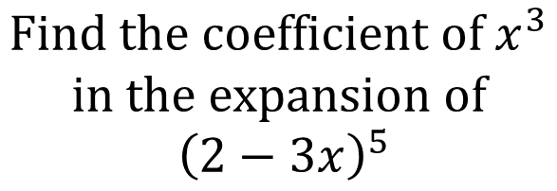
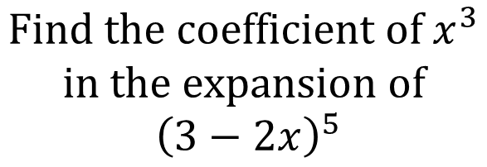
Worked Example
Your Turn
$$Find the coefficient of x^{3}$$
$$in the expansion of$$
$${\left(3−2x\right)}^{5}$$
$$Find the coefficient of x^{3}$$
$$in the expansion of$$
$${\left(2−3x\right)}^{5}$$
@mrbartonmaths

Slide 3
$$Find the coefficient of x^{3} in the expansion of {\left(2−3x\right)}^{8}$$
$$Find the coefficient of x^{8} in the expansion of {\left(2−x\right)}^{10}$$
$$Find the coefficient of x^{5} in the expansion of {\left(5+2x\right)}^{7}$$
$$Find the coefficient of x^{3} in the expansion of {\left(3+\frac{x}{4}\right)}^{7}$$
$$Find the coefficient of x^{4} in the expansion of {\left(x+3\right)}^{7}$$
@mrbartonmaths

Slide 4
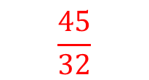
$$Find the coefficient of x^{3} in the expansion of {\left(2−3x\right)}^{8}$$
$$−48,384$$
$$Find the coefficient of x^{8} in the expansion of {\left(2−x\right)}^{10}$$
$$180$$
$$Find the coefficient of x^{5} in the expansion of {\left(5+2x\right)}^{7}$$
$$16,800$$
$$Find the coefficient of x^{3} in the expansion of {\left(3+\frac{x}{4}\right)}^{7}$$
$$\frac{45}{32}$$
$$Find the coefficient of x^{4} in the expansion of {\left(x+3\right)}^{7}$$
$$135$$
@mrbartonmaths

