Slide 1
Binomial expansion 6
Silent
Teacher
Intelligent Practice
Narration
Your Turn
$Use the binomial theorem to find the first 4 terms of the$
$expansion {\left(1+2x\right)}^{8}. Use the expansion to estimate {\left(1.02\right)}^{8}.$
$Use the binomial theorem to find the first 4 terms of the$
$expansion {\left(2−x\right)}^{12}. Use the expansion to estimate {\left(1.99\right)}^{12}.$
Example
For more videos visit mrbartonmaths.com/videos

Slide 2
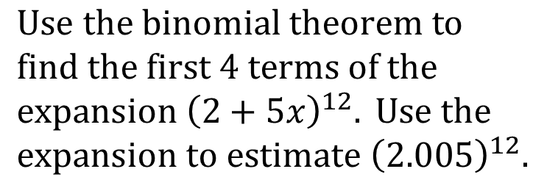
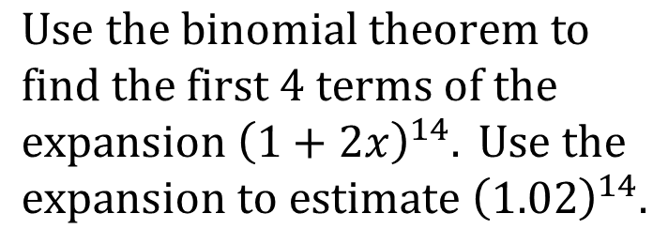
Worked Example
Your Turn
$Use the binomial theorem to$
$find the first 4 terms of the$
$expansion {\left(1+2x\right)}^{14}. Use the$
$expansion to estimate {\left(1.02\right)}^{14}.$
$Use the binomial theorem to$
$find the first 4 terms of the$
$expansion {\left(2+5x\right)}^{12}. Use the$
$expansion to estimate {\left(2.005\right)}^{12}.$
@mrbartonmaths

Slide 3
$Use the binomial theorem to find the first 4 terms of the$
$expansion {\left(1+2x\right)}^{8}. Use the expansion to estimate {\left(1.02\right)}^{8}.$
$Use the binomial theorem to find the first 4 terms of the$
$expansion {\left(2−x\right)}^{12}. Use the expansion to estimate {\left(1.99\right)}^{12}.$
$Use the binomial theorem to find the first 4 terms of the$
$expansion {\left(2−3x\right)}^{5}. Use the expansion to estimate {\left(1.85\right)}^{5}.$
$Use the binomial theorem to find the first 4 terms of the$
$expansion {\left(1−5x\right)}^{30}. Use the expansion to estimate {\left(0.995\right)}^{30}.$
@mrbartonmaths

Slide 4
$Use the binomial theorem to find the first 4 terms of the$
$expansion {\left(1+2x\right)}^{8}. Use the expansion to estimate {\left(1.02\right)}^{8}.$
$$1.171648$$
$Use the binomial theorem to find the first 4 terms of the$
$expansion {\left(2−x\right)}^{12}. Use the expansion to estimate {\left(1.99\right)}^{12}.$
$$3856.89$$
$Use the binomial theorem to find the first 4 terms of the$
$expansion {\left(2−3x\right)}^{5}. Use the expansion to estimate {\left(1.85\right)}^{5}.$
$$21.665$$
$Use the binomial theorem to find the first 4 terms of the$
$expansion {\left(1−5x\right)}^{30}. Use the expansion to estimate {\left(0.995\right)}^{30}.$
$$0.860368$$
@mrbartonmaths

