Slide 1
Simplifying expressions: Collecting like terms - basics
Silent
Teacher
Intelligent Practice
Narration
Your Turn
$$b+b+b+b$$
$$2b+b+b+b$$
$$b+2b+b+b$$
Example
For more videos visit mrbartonmaths.com/videos

Slide 2
Worked Example
Your Turn
Simplify: $a+a+a+b$
Simplify: $a+a+b+b$

Slide 3
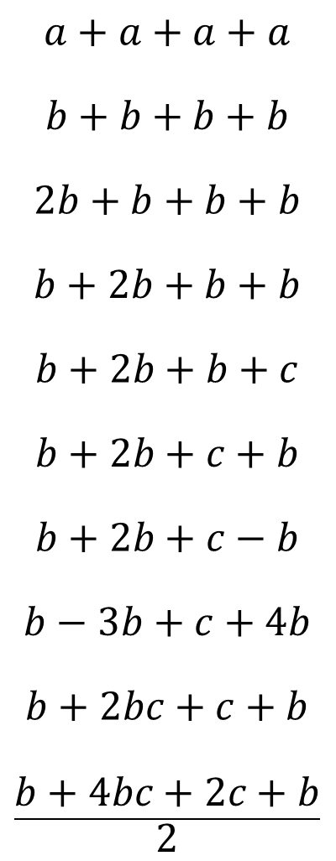
$$a+a+a+a$$
$$b+b+b+b$$
$$2b+b+b+b$$
$$b+2b+b+b$$
$$b+2b+b+c$$
$$b+2b+c+b$$
$$b+2b+c−b$$
$$b−3b+c+4b$$
$$b+2bc+c+b$$
$$\frac{b+4bc+2c+b}{2}$$

Slide 4
$$a+a+a+a$$
$$b+b+b+b$$
$$2b+b+b+b$$
$$b+2b+b+b$$
$$b+2b+b+c$$
$$b+2b+c+b$$
$$b+2b+c−b$$
$$b−3b+c+4b$$
$$b+2bc+c+b$$
$$\frac{b+4bc+2c+b}{2}$$
$$4a$$
$$4b$$
$$5b$$
$$5b$$
$$4b+c$$
$$4b+c$$
$$2b+c$$
$$2b+c$$
$$2b+2bc+c$$
$$b+2bc+c$$

