Slide 1
Angles: Angles on a straight line
Watch
Predict
Your Turn
Demonstration

Slide 2
Link to demonstration:
https://www.geogebra.org/m/sSN8Kant

Slide 3
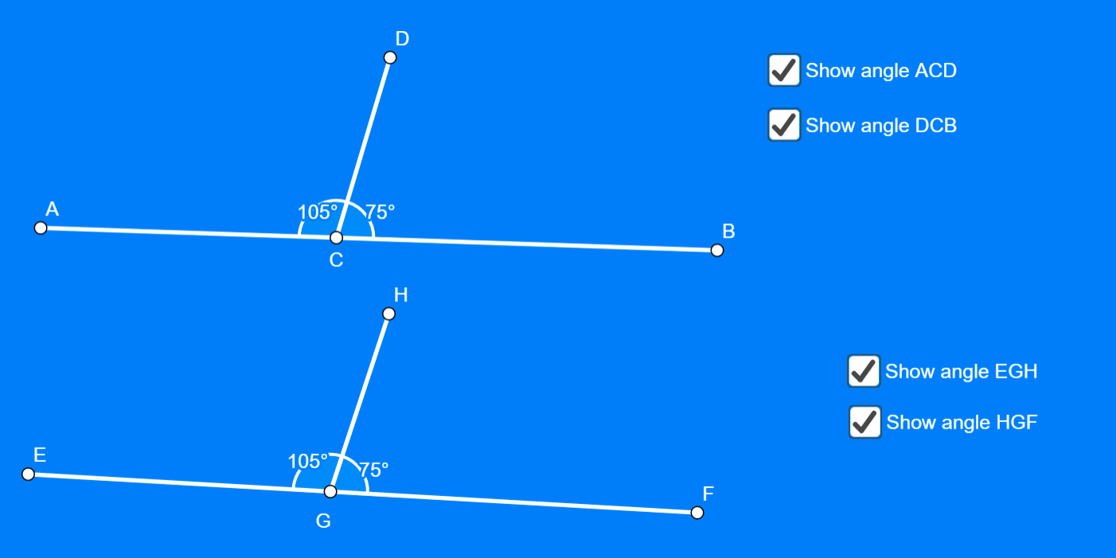

Slide 4
Possible Variations…
Vary the size of the one angle
Vary the length of the line segment
Vary the orientation of the “base” line
Vary the angle that is hidden

