Slide 1
$e^{x}$: Derivative of the function?
True/false
Reflect
Your Turn
$\frac{d(e^{x})}{dx}=xe^{x}$?
$\frac{d(e^{2x})}{dx}=2e^{2x}$?
Rule
For more videos visit mrbartonmaths.com/videos

Slide 2
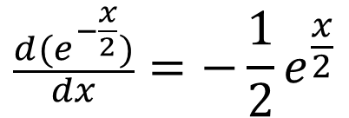
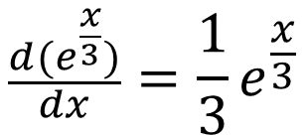
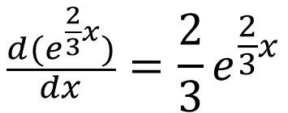
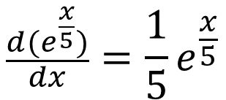
$$\frac{d(e^{\frac{x}{3}})}{dx}=\frac{1}{3}e^{\frac{x}{3}}$$
$$\frac{d(e^{x})}{dx}=xe^{x}$$
Yes / No
Yes / No
$$\frac{d(e^{2x})}{dx}=2e^{2x}$$
$$\frac{d(e^{−x})}{dx}=−e^{−x}$$
Yes / No
Yes / No
$$\frac{d(e^{2x})}{dx}=2e^{x}$$
Yes / No
$$\frac{d(e^{x})}{dx}=xe^{x}$$
Yes / No
$$\frac{d(e^{\frac{x}{5}})}{dx}=\frac{1}{5}e^{\frac{x}{5}}$$
$$\frac{d(e^{5x})}{dx}=5e^{5x}$$
Yes / No
Yes / No
$$\frac{d(e^{6x})}{dx}=6e^{x}$$
Yes / No
$$\frac{d(e^{−3x})}{dx}=3e^{−3x}$$
Yes / No
$$\frac{d(e^{−\frac{x}{2}})}{dx}=−\frac{1}{2}e^{\frac{x}{2}}$$
$$\frac{d(e^{\frac{2}{3}x})}{dx}=\frac{2}{3}e^{\frac{2}{3}x}$$
Yes / No
Yes / No

Slide 3
$$\frac{d(e^{\frac{x}{3}})}{dx}=\frac{1}{3}e^{\frac{x}{3}}$$
$$\frac{d(e^{x})}{dx}=xe^{x}$$
Yes / No
Yes / No
$$\frac{d(e^{2x})}{dx}=2e^{2x}$$
$$\frac{d(e^{−x})}{dx}=−e^{−x}$$
Yes / No
Yes / No
$$\frac{d(e^{2x})}{dx}=2e^{x}$$
Yes / No
$$\frac{d(e^{x})}{dx}=−e^{x}$$
Yes / No
$$\frac{d(e^{\frac{x}{5}})}{dx}=\frac{1}{5}e^{\frac{x}{5}}$$
$$\frac{d(e^{5x})}{dx}=5e^{5x}$$
Yes / No
Yes / No
$$\frac{d(e^{6x})}{dx}=6e^{x}$$
Yes / No
$$\frac{d(e^{−3x})}{dx}=3e^{−3x}$$
Yes / No
$$\frac{d(e^{−\frac{x}{2}})}{dx}=−\frac{1}{2}e^{\frac{x}{2}}$$
$$\frac{d(e^{\frac{2}{3}x})}{dx}=\frac{2}{3}e^{\frac{2}{3}x}$$
Yes / No
Yes / No

Slide 4
Your Turn
$$\frac{d(e^{x})}{dx}=e^{x}$$
Yes / No
$$\frac{d(e^{−2x})}{dx}=−2e^{2x}$$
Yes / No
$$\frac{d(e^{−5x})}{dx}=−5e^{−5x}$$
Yes / No
$$\frac{d(e^{5x})}{dx}=7e^{7x}$$
Yes / No
$$\frac{d(e^{−\frac{3x}{7}})}{dx}=−\frac{3}{7}e^{−\frac{3x}{7}}$$
Yes / No

Slide 5
Your Turn
$$\frac{d(e^{x})}{dx}=e^{x}$$
Yes / No
$$\frac{d(e^{−2x})}{dx}=−2e^{2x}$$
Yes / No
$$\frac{d(e^{−5x})}{dx}=−5e^{−5x}$$
Yes / No
$$\frac{d(e^{5x})}{dx}=7e^{7x}$$
Yes / No
$$\frac{d(e^{−\frac{3x}{7}})}{dx}=−\frac{3}{7}e^{−\frac{3x}{7}}$$
Yes / No

