Slide 1
Polynomials 2: Dividing polynomials
Silent
Teacher
Intelligent Practice
Narration
Your Turn
$$Divide 2x^{3}+x^{2}+2x−12 by (2x−3)$$
$$Divide {4x}^{4}−3x^{3}+11x^{2}−x−1 by (4x+1)$$
$$Divide {4x}^{4}−6x^{3}+10x^{2}−11x−6 by (2x−3)$$
Example
For more videos visit mrbartonmaths.com/videos

Slide 2
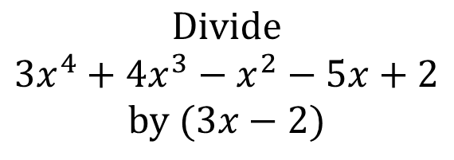
Worked Example
Your Turn
$$Divide$$
$${3x}^{4}+8x^{3}−11x^{2}+2x+8$$
$$by (3x+2)$$
$$Divide$$
$${3x}^{4}+4x^{3}−x^{2}−5x+2$$
$$by (3x−2)$$
@mrbartonmaths

Slide 3
$$Divide 2x^{3}+7x^{2}−x−2 by (2x+1)$$
$$Divide 2x^{3}+x^{2}+2x−12 by (2x−3)$$
$$Divide {4x}^{4}−3x^{3}+11x^{2}−x−1 by (4x+1)$$
$$Divide {4x}^{4}−6x^{3}+10x^{2}−11x−6 by (2x−3)$$
$$Divide {4x}^{4}+5x^{3}−6x^{2}−16x+12 by (4x−3)$$
@mrbartonmaths

Slide 4
$$Divide 2x^{3}+7x^{2}−x−2 by (2x+1)$$
$$x^{2}+3x−2$$
$$Divide 2x^{3}+x^{2}+2x−12 by (2x−3)$$
$$x^{2}+2x+4$$
$$Divide {4x}^{4}−3x^{3}+11x^{2}−x−1 by (4x+1)$$
$${x^{3}−x}^{2}+3x−1$$
$$Divide {4x}^{4}−6x^{3}+10x^{2}−11x−6 by (2x−3)$$
$${2x}^{3}+5x+2$$
$$Divide {4x}^{4}+5x^{3}−6x^{2}−16x+12 by (4x−3)$$
$${x^{3}+2x}^{2}−4$$
@mrbartonmaths

