Slide 1
Inequalities: Solving Quadratic Inequalities
Silent
Teacher
Intelligent Practice
Narration
Your Turn
$x^{2}+5x+6>0$
$x^{2}+5x+6≥0$
$x^{2}+5x+6≤0$
Example
For more videos visit mrbartonmaths.com/videos

Slide 2
Worked Example
Your Turn
Solve $x^{2}+6x+8>0$
Solve $x^{2}+6x+8≤\text{0}$
@PixiMaths

Slide 3
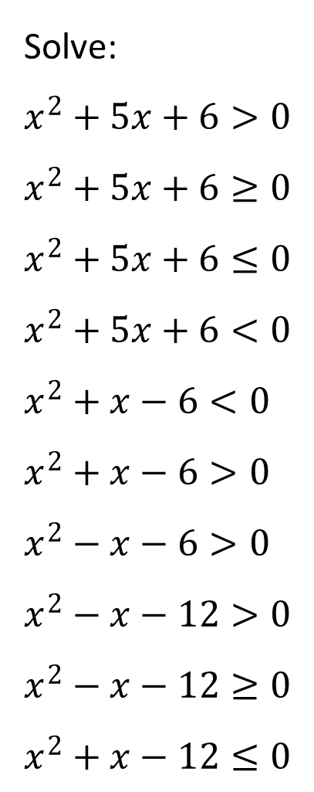
Solve:
$x^{2}+5x+6>0$
$x^{2}+5x+6≥0$
$x^{2}+5x+6≤0$
$x^{2}+5x+6<0$
$x^{2}+x−6<0$
$x^{2}+x−6>0$
$x^{2}−x−6>0$
$x^{2}−x−12>0$
$x^{2}−x−12≥0$
$x^{2}+x−12≤0$
@PixiMaths

Slide 4
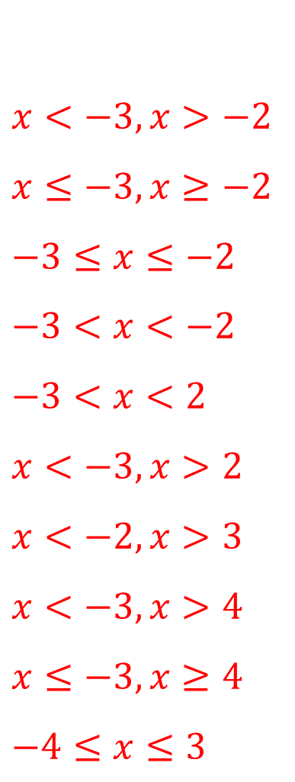
Solve:
$x^{2}+5x+6>0$
$x^{2}+5x+6≥0$
$x^{2}+5x+6≤0$
$x^{2}+5x+6<0$
$x^{2}+x−6<0$
$x^{2}+x−6>0$
$x^{2}−x−6>0$
$x^{2}−x−12>0$
$x^{2}−x−12≥0$
$x^{2}+x−12≤0$
$x<−3,x>−2$
$x≤−3,x≥−2$
$−3≤x≤−2$
$−3<x<−2$
$−3<x<2$
$x<−3,x>2$
$x<−2,x>3$
$x<−3,x>4$
$x≤−3,x≥4$
$−4≤x≤3$
@PixiMaths

