Slide 1
Revision: Factorising quadratics
Silent
Teacher
Intelligent Practice
Narration
Your Turn
$$x^{2}+9x=$$
$$x^{2}+9=$$
$$x^{2}−9=$$
Practice

Slide 2


Worked Example
Your Turn
$$x^{2}−2x−15=$$
$$x^{2}−2x=$$
@mrbartonmaths

Slide 3
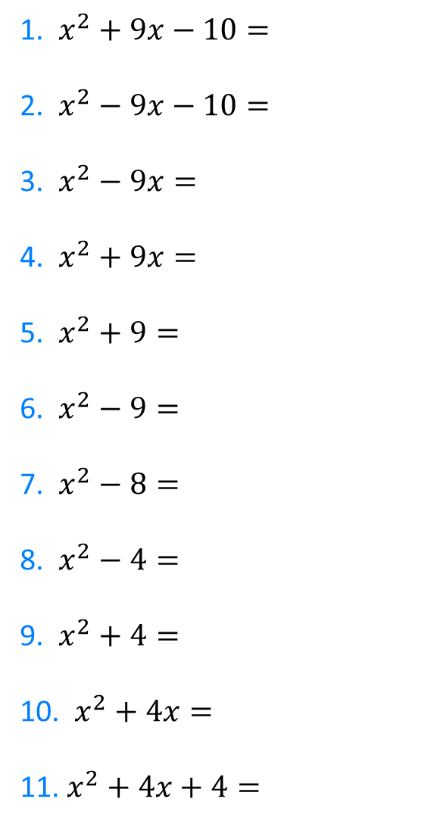
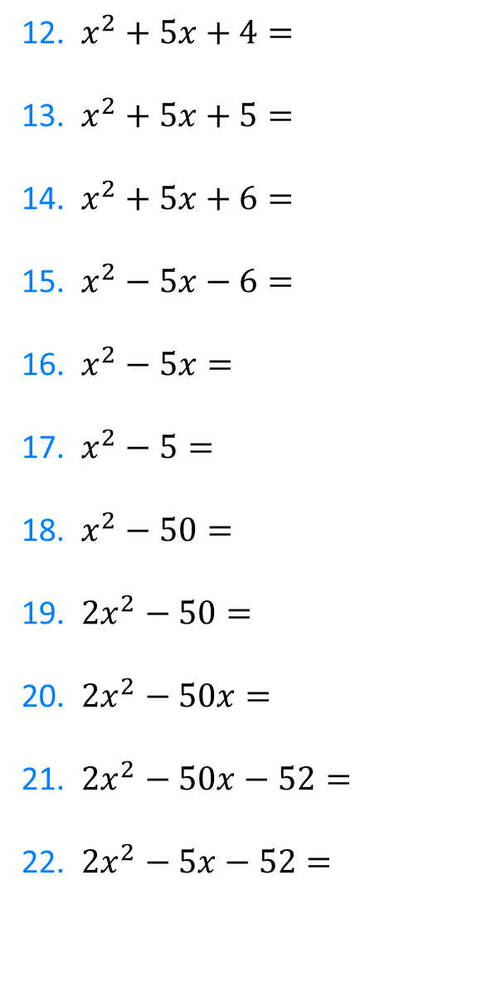
1. $x^{2}+9x−10=$
2. $x^{2}−9x−10=$
3. $x^{2}−9x=$
4. $x^{2}+9x=$
5. $x^{2}+9=$
6. $x^{2}−9=$
7. $x^{2}−8=$
8. $x^{2}−4=$
9. $x^{2}+4=$
10. $x^{2}+4x=$
11. $x^{2}+4x+4=$
12. $x^{2}+5x+4=$
13. $x^{2}+5x+5=$
14. $x^{2}+5x+6=$
15. $x^{2}−5x−6=$
16. $x^{2}−5x=$
17. $x^{2}−5=$
18. $x^{2}−50=$
19. ${2x}^{2}−50=$
20. ${2x}^{2}−50x=$
21. ${2x}^{2}−50x−52=$
22. ${2x}^{2}−5x−52=$
@mrbartonmaths

Slide 4
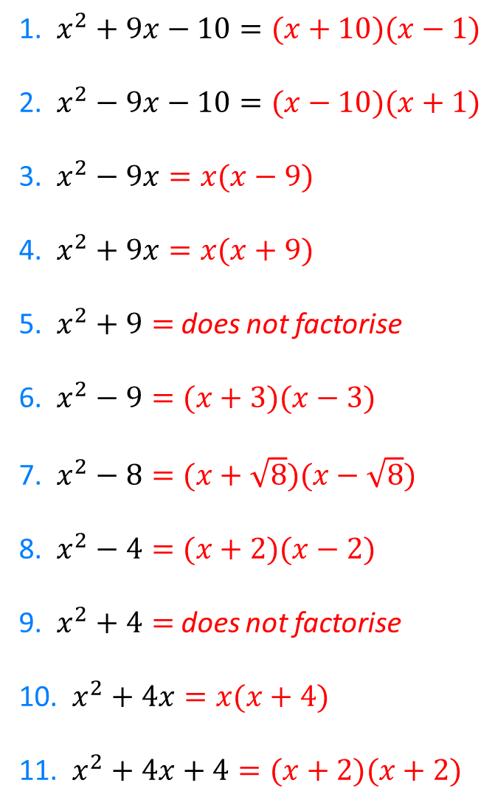
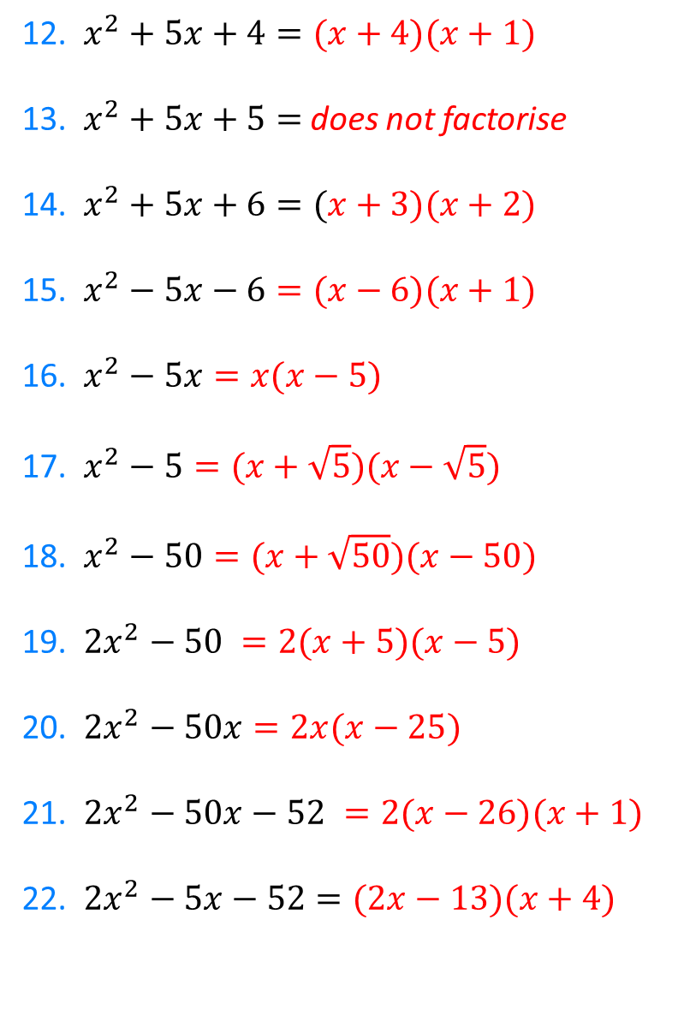
1. $x^{2}+9x−10=(x+10)(x−1)$
2. $x^{2}−9x−10=(x−10)(x+1)$
3. $x^{2}−9x=x(x−9)$
4. $x^{2}+9x=x(x+9)$
5. $x^{2}+9=$ does not factorise
6. $x^{2}−9=(x+3)(x−3)$
7. $x^{2}−8=(x+\sqrt{8})(x−\sqrt{8})$
8. $x^{2}−4=(x+2)(x−2)$
9. $x^{2}+4=$does not factorise
10. $x^{2}+4x=x(x+4)$
11. $x^{2}+4x+4=(x+2)(x+2)$
12. $x^{2}+5x+4=(x+4)(x+1)$
13. $x^{2}+5x+5=$ does not factorise
14. $x^{2}+5x+6=(x+3)(x+2)$
15. $x^{2}−5x−6=(x−6)(x+1)$
16. $x^{2}−5x=x(x−5)$
17. $x^{2}−5=(x+\sqrt{5})(x−\sqrt{5})$
18. $x^{2}−50=(x+\sqrt{50})(x−50)$
19. ${2x}^{2}−50 =2(x+5)(x−5)$
20. ${2x}^{2}−50x=2x(x−25)$
21. ${2x}^{2}−50x−52 =2(x−26)(x+1)$
22. ${2x}^{2}−5x−52=(2x−13)(x+4)$
@mrbartonmaths

