Slide 1
Fractions: Ready to be added?
True/false
Reflect
Your Turn
$$\frac{2}{3}+\frac{2}{5} ?$$
$$\frac{2}{x}+\frac{2}{x} ?$$
Rule

Slide 2
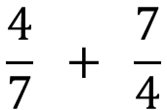
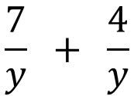
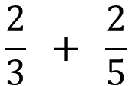
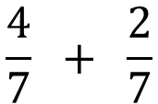
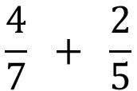
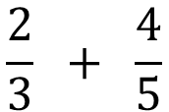
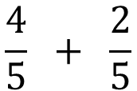
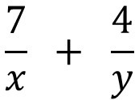
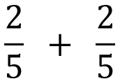
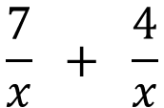
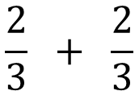
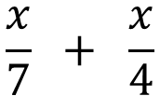
$$\frac{2}{3} + \frac{4}{5}$$
Yes / No
$$\frac{4}{7} + \frac{2}{7}$$
Yes / No
$$\frac{2}{3} + \frac{2}{5}$$
$$\frac{4}{7} + \frac{7}{4}$$
Yes / No
Yes / No
$$\frac{2}{3} + \frac{2}{3}$$
$$\frac{x}{7} + \frac{x}{4}$$
Yes / No
Yes / No
$$\frac{2}{5} + \frac{2}{5}$$
Yes / No
$$\frac{7}{x} + \frac{4}{x}$$
Yes / No
$$\frac{4}{5} + \frac{2}{5}$$
$$\frac{7}{x} + \frac{4}{y}$$
Yes / No
Yes / No
$$\frac{4}{7} + \frac{2}{5}$$
$$\frac{7}{y} + \frac{4}{y}$$
Yes / No
Yes / No
@mrbartonmaths

Slide 3
$$\frac{2}{3} + \frac{4}{5}$$
Yes / No
$$\frac{4}{7} + \frac{2}{7}$$
Yes / No
$$\frac{2}{3} + \frac{2}{5}$$
$$\frac{4}{7} + \frac{7}{4}$$
Yes / No
Yes / No
$$\frac{2}{3} + \frac{2}{3}$$
$$\frac{x}{7} + \frac{x}{4}$$
Yes / No
Yes / No
$$\frac{2}{5} + \frac{2}{5}$$
Yes / No
$$\frac{7}{x} + \frac{4}{x}$$
Yes / No
$$\frac{4}{5} + \frac{2}{5}$$
$$\frac{7}{x} + \frac{4}{y}$$
Yes / No
Yes / No
$$\frac{4}{7} + \frac{2}{5}$$
$$\frac{7}{y} + \frac{4}{y}$$
Yes / No
Yes / No
@mrbartonmaths

Slide 4
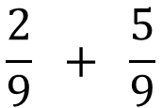
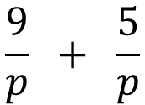
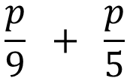
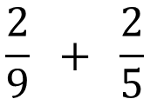
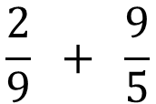
Your Turn
$$\frac{2}{9} + \frac{5}{9}$$
Yes / No
$$\frac{2}{9} + \frac{9}{5}$$
Yes / No
$$\frac{2}{9} + \frac{2}{5}$$
Yes / No
$$\frac{p}{9} + \frac{p}{5}$$
Yes / No
$$\frac{9}{p} + \frac{5}{p}$$
Yes / No
@mrbartonmaths

Slide 5
Your Turn - answers
$$\frac{2}{9} + \frac{5}{9}$$
Yes / No
$$\frac{2}{9} + \frac{9}{5}$$
Yes / No
$$\frac{2}{9} + \frac{2}{5}$$
Yes / No
$$\frac{p}{9} + \frac{p}{5}$$
Yes / No
$$\frac{9}{p} + \frac{5}{p}$$
Yes / No
@mrbartonmaths

