Slide 1
Set Notation Writing the sub sets
Silent
Teacher
Intelligent Practice
Narration
Your Turn
$$∈=\left\{1, 2, 3, 4, 5, 6, 7, 8, 9, 10, 11, 12, 13, 14, 15\right\}$$
A = Even numbers B= Multiples of 3
Write down numbers in Set
A=
A’ =
Example
For more videos visit mrbartonmaths.com/videos

Slide 2
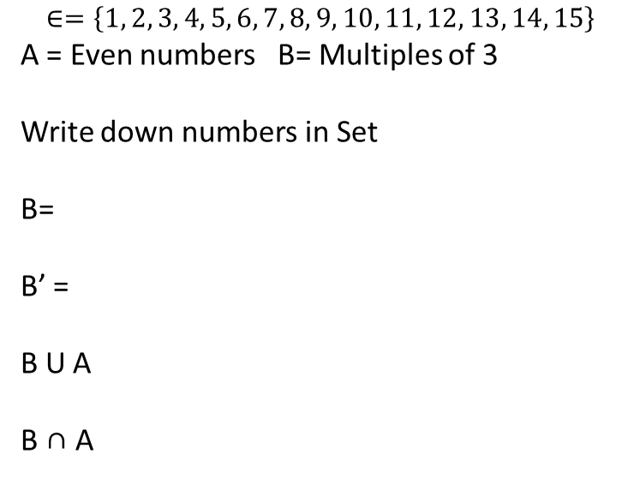
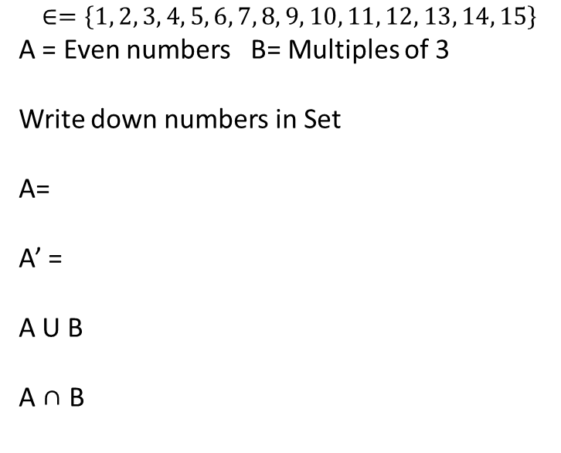
Worked Example
Your Turn
$$∈=\left\{1, 2, 3, 4, 5, 6, 7, 8, 9, 10, 11, 12, 13, 14, 15\right\}$$
A = Even numbers B= Multiples of 3
Write down numbers in Set
B=
B’ =
B U A
B ∩ A
$$∈=\left\{1, 2, 3, 4, 5, 6, 7, 8, 9, 10, 11, 12, 13, 14, 15\right\}$$
A = Even numbers B= Multiples of 3
Write down numbers in Set
A=
A’ =
A U B
A ∩ B

Slide 3
$$∈=\left\{1, 2, 3, 4, 5, 6, 7, 8, 9, 10, 11, 12, 13, 14, 15\right\}$$
A = Even numbers B= Prime numbers
Write down numbers in Set
A
A’ U B
A’
B’ U A
B
A’ U B’
B’
(A U B)’
A ∩ B
(A’ U B’)’
B ∩ A
A’ ∩ B
B’ ∩ A
A’ ∩ B’
(A ∩ B)’
A U B

Slide 4
$$∈=\left\{1, 2, 3, 4, 5, 6, 7, 8, 9, 10, 11, 12, 13, 14, 15\right\}$$
A = Even numbers B= Prime numbers
Write down numbers in Set
= {2, 4, 6, 8, 10, 12, 14 }
A U B =
{2, 3, 4, 5, 6, 7, 8, 10, 11, 12, 13, 14}
A
A’
={1, 3, 5, 7, 9, 11,13,15}
A’ U B=
{1, 2, 3, 5, 7, 9, 11, 13, 15}
B
= {2, 3, 5, 7, 11, 13 }
B’
={1, 4, 6, 8, 9, 10, 12, 14, 15}
B’ U A =
{1, 2, 4, 6, 8, 9, 10, 12, 14, 15}
= { 2 }
A ∩ B
= { 2 }
A’ U B’=
{1, 3, 4, 5, 6, 7, 8, 9, 10, 11, 12, 13, 14 15}
B ∩ A
A’ ∩ B
= {3, 5, 7, 11, 13 }
B’ ∩ A
= {4, 6, 8, 10, 12, 14}
(A U B)’=
{1, 9, 15}
A’ ∩ B’
= {1, 9, 15}
{1, 9, 15}
(A’ U B’)’=
(A ∩ B)’ =
{1, 3, 4, 5, 6, 7, 8, 9, 10, 11, 12, 13, 14, 15}

