Slide 1
Solving linear equations: Solving two step equations
Silent
Teacher
Intelligent Practice
Narration
Your Turn
$$3 + 2x=21$$
$$2x−3=21$$
$$3 −2x=21$$
Example
For more videos visit mrbartonmaths.com/videos

Slide 2
Worked Example
Your Turn
Solve:
$4x+3=15$
Solve:
$4x−3=15$

Slide 3
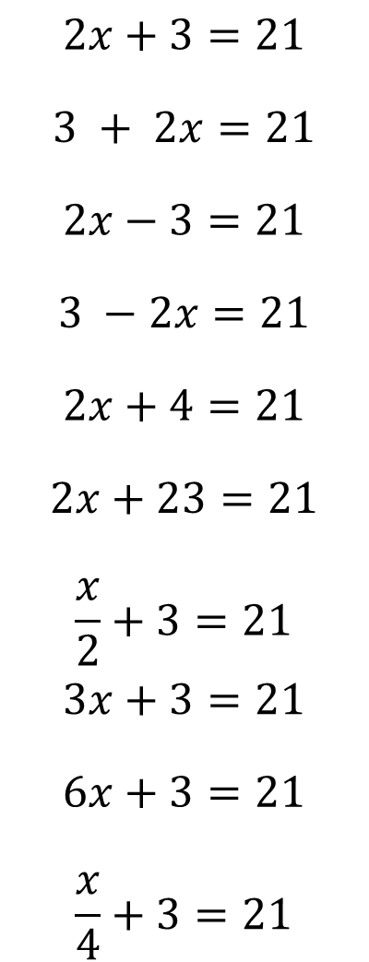
$$2x+3=21$$
$$3 + 2x=21$$
$$2x−3=21$$
$$3 −2x=21$$
$$2x+4=21$$
$$2x+23=21$$
$$\frac{x}{2}+3=21$$
$$3x+3=21$$
$$6x+3=21$$
$$\frac{x}{4}+3=21$$

Slide 4
$$2x+3=21$$
$$3 + 2x=21$$
$$2x−3=21$$
$$3 −2x=21$$
$$2x+4=21$$
$$2x+23=21$$
$$\frac{x}{2}+3=21$$
$$3x+3=21$$
$$6x+3=21$$
$$\frac{x}{4}+3=21$$
$$x=9$$
$$x=9$$
$$x=12$$
$$x=−9$$
$$x=8.5$$
$$x=−1$$
$$x=36$$
$$x=6$$
$$x=3$$
$$x=72$$

