Slide 1
Logarithms: Using the laws of logarithms
Silent
Teacher
Intelligent Practice
Narration
Your Turn
$\log_{a}{{(x}^{2}yz^{3})}$=?
Write in terms of $\log_{a}{x},\log_{a}{y,}$ and $\log_{a}{z}.$
$\log_{a}\left(\frac{x^{−3}}{y^{2}}\right)$=?
$$\log_{a}\left(\sqrt{axy}\right)=?$$
Example
For more videos visit mrbartonmaths.com/videos

Slide 2
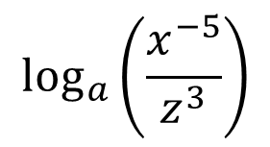
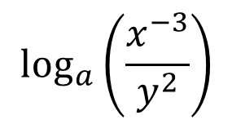
Worked Example
Your Turn
Write in terms of $\log_{a}{x},\log_{a}{y,}$ and $\log_{a}{z}.$
Write in terms of $\log_{a}{x},\log_{a}{y,}$ and $\log_{a}{z}.$
$$\log_{a}{{(x}^{2}yz^{3})}$$
$$\log_{a}{{(x}^{2}yz^{3})}$$
$$\log_{a}\left(\frac{x^{−3}}{y^{2}}\right)$$
$$\log_{a}\left(\frac{x^{−5}}{z^{3}}\right)$$
$$\log_{a}\left(\sqrt{axy}\right)$$
$$\log_{a}\left(\sqrt{axyz}\right)$$
@mrbartonmaths

Slide 3
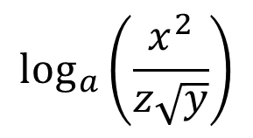
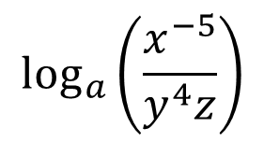
Write in terms of $\log_{a}{x},\log_{a}{y,}$ and $\log_{a}{z}.$
$$\log_{a}{{(x}^{2}yz^{−2})}$$
$$\log_{a}{{(a}^{2}z^{3})}$$
$$\log_{a}\left(\frac{x^{−5}}{y^{4}z}\right)$$
$$\log_{a}\left(\frac{x^{2}}{z\sqrt{y}}\right)$$
$$\log_{a}\left(\sqrt{a}x\right)$$
$$\log_{a}\left(\sqrt{a}xy^{2}\right)$$
@mrbartonmaths

Slide 4
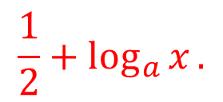
Write in terms of $\log_{a}{x},\log_{a}{y,}$ and $\log_{a}{z}.$
$$\log_{a}{{(x}^{2}yz^{−2})}$$
$$2\log_{a}{x}+\log_{a}{y}−2\log_{a}{z}.$$
$$\log_{a}{{(a}^{2}z^{3})}$$
$$2+3\log_{a}{z}.$$
$$\log_{a}\left(\frac{x^{−5}}{y^{4}z}\right)$$
$$−5\log_{a}{x}−4\log_{a}{y}−\log_{a}{z}.$$
$$\log_{a}\left(\frac{x^{2}}{z\sqrt{y}}\right)$$
$$2\log_{a}{x}−\frac{1}{2}\log_{a}{y}−\log_{a}{z}.$$
$$\frac{1}{2}+\log_{a}{x}.$$
$$\log_{a}\left(\sqrt{a}x\right)$$
$$\frac{1}{2}+\log_{a}{x}+2\log_{a}{y}.$$
$$\log_{a}\left(\sqrt{a}xy^{2}\right)$$
@mrbartonmaths

