Slide 1
Factors, multiples, primes: Algebraic lowest common multiple
Silent
Teacher
Intelligent Practice
Narration
Your Turn
Find the LCM:
$3x^{2}$ and $x$
$3x^{2}$ and $2x$
$3x^{2}$ and $2y$
Example
For more videos visit mrbartonmaths.com/videos

Slide 2
Worked Example
Your Turn
Find the LCM:
$y^{2}$ and $3y$
${6y}^{2}$ and $3xy$
Find the LCM:
$y^{2}$ and $3xy$
${6x^{3}y}^{2}$ and $15xy$
@fortyninecubed

Slide 3
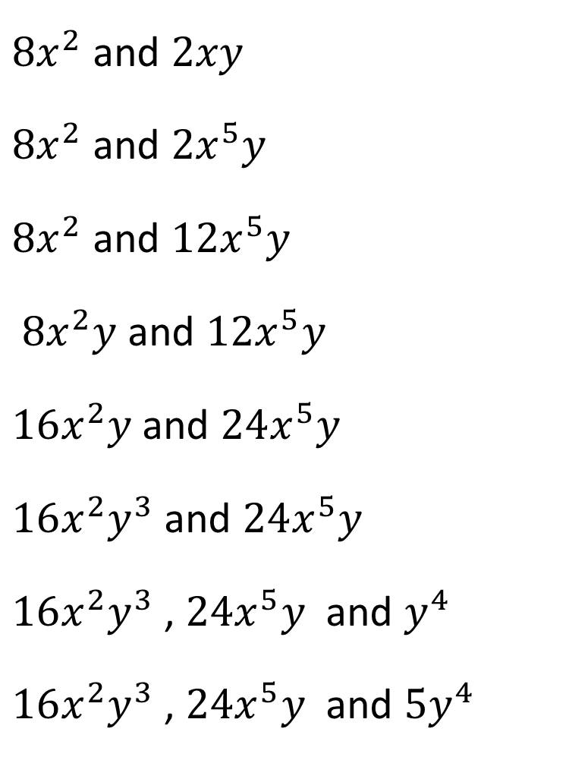
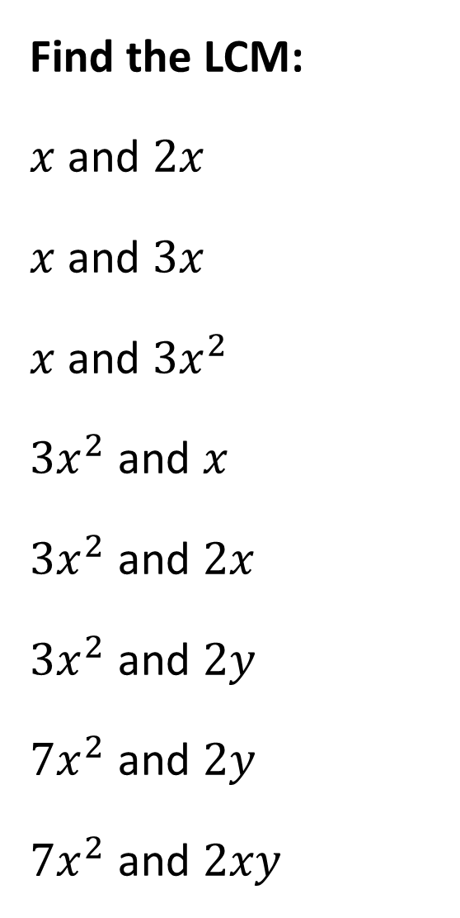
Find the LCM:
$x$ and $2x$
$x$and $3x$
$x$ and $3x^{2}$
$3x^{2}$ and $x$
$3x^{2}$ and $2x$
$3x^{2}$ and $2y$
$7x^{2}$ and $2y$
$7x^{2}$ and $2xy$
$8x^{2}$ and $2xy$
$8x^{2}$ and $2x^{5}y$
$8x^{2}$ and $12x^{5}y$
$8x^{2}y$ and $12x^{5}y$
$16x^{2}y$ and $24x^{5}y$
$16x^{2}y^{3}$ and $24x^{5}y$
$16x^{2}y^{3}$ , $24x^{5}y$and $y^{4}$
$16x^{2}y^{3}$ , $24x^{5}y$and ${5y}^{4}$
@fortyninecubed

Slide 4
Find the LCM:
$x$ and $2x$
$x$and $3x$
$x$ and $3x^{2}$
$3x^{2}$ and $x$
$3x^{2}$ and $2x$
$3x^{2}$ and $2y$
$7x^{2}$ and $2y$
$7x^{2}$ and $2xy$
$8x^{2}$ and $2xy$
$8x^{2}$ and $2x^{5}y$
$8x^{2}$ and $12x^{5}y$
$8x^{2}y$ and $12x^{5}y$
$16x^{2}y$ and $24x^{5}y$
$16x^{2}y^{3}$ and $24x^{5}y$
$16x^{2}y^{3}$ , $24x^{5}y$and $y^{4}$
$16x^{2}y^{3}$ , $24x^{5}y$and ${5y}^{4}$
$$8x^{2}y$$
$$8x^{5}y$$
$$24x^{5}y$$
$$24x^{5}y$$
$$48x^{5}y$$
$$48x^{5}y^{3}$$
$$48x^{5}y^{4}$$
$$80x^{5}y^{4}$$
$$2x$$
$$3x$$
$$3x^{2}$$
$$3x^{2}$$
$$6x^{2}$$
$$6x^{2}y$$
$$14x^{2}y$$
$$14x^{2}y$$

