Slide 1
Averages and range: Estimated Mean from a Grouped Frequency Table
Silent
Teacher
Intelligent Practice
Narration
Your Turn
Mass, $x$ (kg) | Frequency
$$0<x≤10$$ | $$2$$
$$10<x≤20$$ | $$4$$
$$20<x≤30$$ | $$8$$
$$30<x≤40$$ | $$6$$
Example
For more videos visit mrbartonmaths.com/videos

Slide 2
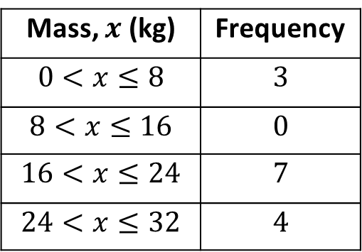
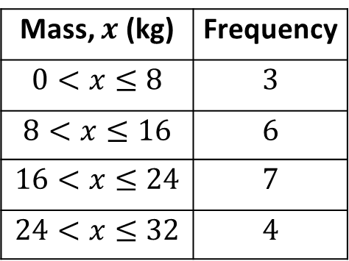
Worked Example
Your Turn
Calculate an estimate for the mean:
Calculate an estimate for the mean:
Mass, $x$ (kg) | Frequency
$$0<x≤8$$ | $$3$$
$$8<x≤16$$ | $$6$$
$$16<x≤24$$ | $$7$$
$$24<x≤32$$ | $$4$$
Mass, $x$ (kg) | Frequency
$$0<x≤8$$ | $$3$$
$$8<x≤16$$ | $$0$$
$$16<x≤24$$ | $$7$$
$$24<x≤32$$ | $$4$$
@fortyninecubed

Slide 3
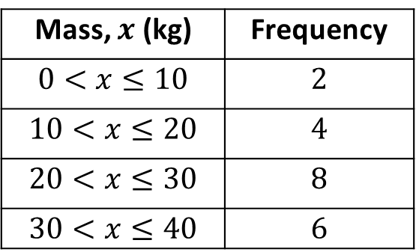
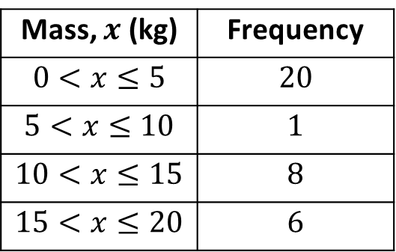
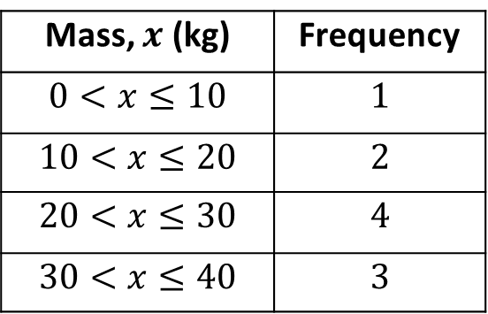
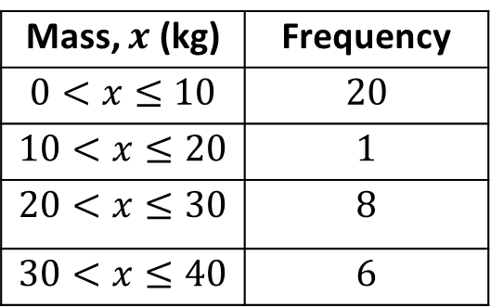
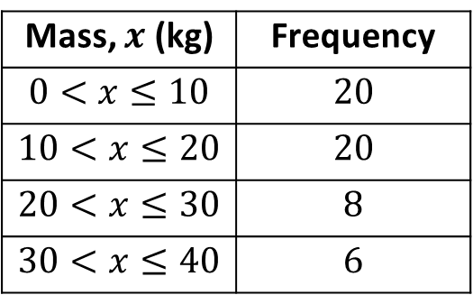
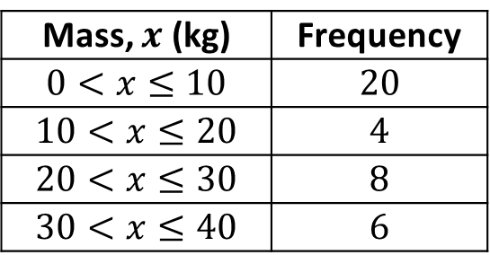
Calculate an estimate for the mean:
Mass, $x$ (kg) | Frequency
$$0<x≤10$$ | $$20$$
$$10<x≤20$$ | $$20$$
$$20<x≤30$$ | $$8$$
$$30<x≤40$$ | $$6$$
Mass, $x$ (kg) | Frequency
$$0<x≤10$$ | $$1$$
$$10<x≤20$$ | $$2$$
$$20<x≤30$$ | $$4$$
$$30<x≤40$$ | $$3$$
Mass, $x$ (kg) | Frequency
$$0<x≤10$$ | $$20$$
$$10<x≤20$$ | $$1$$
$$20<x≤30$$ | $$8$$
$$30<x≤40$$ | $$6$$
Mass, $x$ (kg) | Frequency
$$0<x≤10$$ | $$2$$
$$10<x≤20$$ | $$4$$
$$20<x≤30$$ | $$8$$
$$30<x≤40$$ | $$6$$
Mass, $x$ (kg) | Frequency
$$0<x≤5$$ | $$20$$
$$5<x≤10$$ | $$1$$
$$10<x≤15$$ | $$8$$
$$15<x≤20$$ | $$6$$
Mass, $x$ (kg) | Frequency
$$0<x≤10$$ | $$20$$
$$10<x≤20$$ | $$4$$
$$20<x≤30$$ | $$8$$
$$30<x≤40$$ | $$6$$

Slide 4
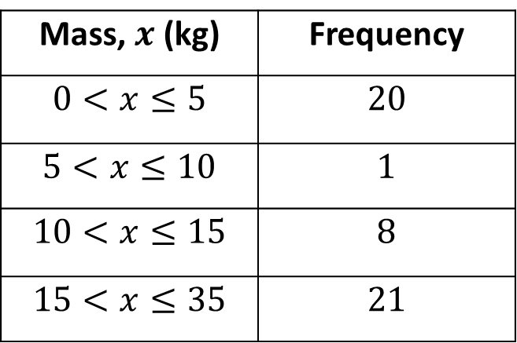
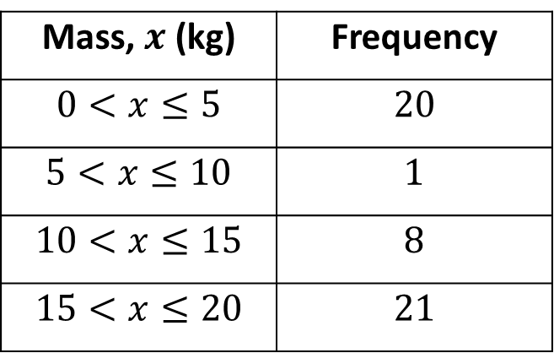
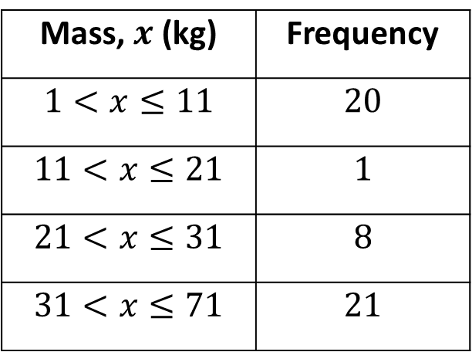
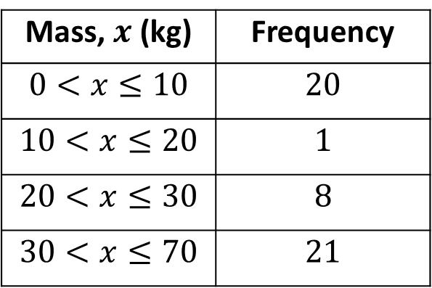
Calculate an estimate for the mean:
Mass, $x$ (kg) | Frequency
$$0<x≤5$$ | $$20$$
$$5<x≤10$$ | $$1$$
$$10<x≤15$$ | $$8$$
$$15<x≤20$$ | $$21$$
Mass, $x$ (kg) | Frequency
$$0<x≤10$$ | $$20$$
$$10<x≤20$$ | $$1$$
$$20<x≤30$$ | $$8$$
$$30<x≤70$$ | $$21$$
Mass, $x$ (kg) | Frequency
$$0<x≤5$$ | $$20$$
$$5<x≤10$$ | $$1$$
$$10<x≤15$$ | $$8$$
$$15<x≤35$$ | $$21$$
Mass, $x$ (kg) | Frequency
$$1<x≤11$$ | $$20$$
$$11<x≤21$$ | $$1$$
$$21<x≤31$$ | $$8$$
$$31<x≤71$$ | $$21$$
@fortyninecubed

Slide 5
Mass, $x$ (kg) | Frequency
$$0<x≤10$$ | $$20$$
$$10<x≤20$$ | $$20$$
$$20<x≤30$$ | $$8$$
$$30<x≤40$$ | $$6$$
Mass, $x$ (kg) | Frequency
$$0<x≤10$$ | $$1$$
$$10<x≤20$$ | $$2$$
$$20<x≤30$$ | $$4$$
$$30<x≤40$$ | $$3$$
15kg
24kg
Mass, $x$ (kg) | Frequency
$$0<x≤10$$ | $$20$$
$$10<x≤20$$ | $$1$$
$$20<x≤30$$ | $$8$$
$$30<x≤40$$ | $$6$$
Mass, $x$ (kg) | Frequency
$$0<x≤10$$ | $$2$$
$$10<x≤20$$ | $$4$$
$$20<x≤30$$ | $$8$$
$$30<x≤40$$ | $$6$$
15kg
24kg
Mass, $x$ (kg) | Frequency
$$0<x≤5$$ | $$20$$
$$5<x≤10$$ | $$1$$
$$10<x≤15$$ | $$8$$
$$15<x≤20$$ | $$6$$
Mass, $x$ (kg) | Frequency
$$0<x≤10$$ | $$20$$
$$10<x≤20$$ | $$4$$
$$20<x≤30$$ | $$8$$
$$30<x≤40$$ | $$6$$
7.5kg
15kg

Slide 6
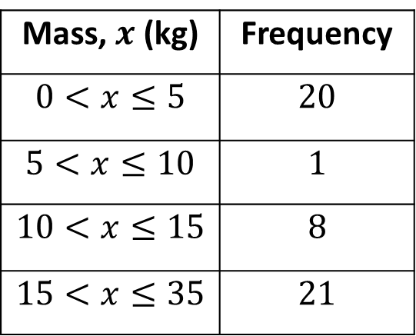
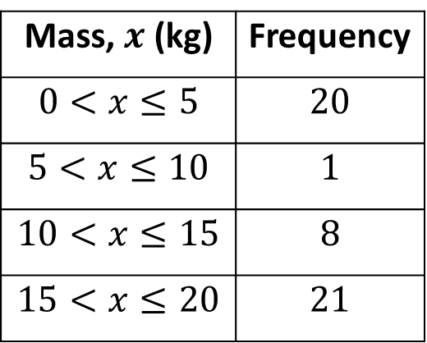
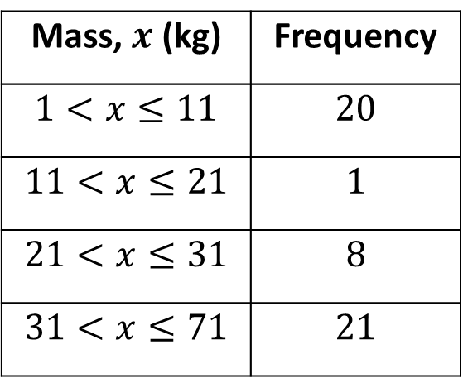
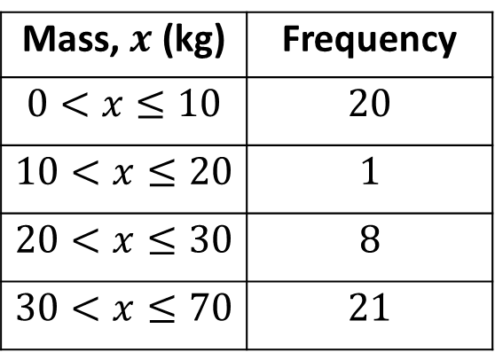
Mass, $x$ (kg) | Frequency
$$0<x≤5$$ | $$20$$
$$5<x≤10$$ | $$1$$
$$10<x≤15$$ | $$8$$
$$15<x≤20$$ | $$21$$
Mass, $x$ (kg) | Frequency
$$0<x≤10$$ | $$20$$
$$10<x≤20$$ | $$1$$
$$20<x≤30$$ | $$8$$
$$30<x≤70$$ | $$21$$
10.5 kg
27.3 kg
Mass, $x$ (kg) | Frequency
$$0<x≤5$$ | $$20$$
$$5<x≤10$$ | $$1$$
$$10<x≤15$$ | $$8$$
$$15<x≤35$$ | $$21$$
Mass, $x$ (kg) | Frequency
$$1<x≤11$$ | $$20$$
$$11<x≤21$$ | $$1$$
$$21<x≤31$$ | $$8$$
$$31<x≤71$$ | $$21$$
28.3 kg
13.65 kg
@fortyninecubed

