Slide 1
Percentages: Reverse percentage of amounts
Silent
Teacher
Intelligent Practice
Narration
Your Turn
$20\%$ of $x$ is $6$. What is $x$?
$20\%$ of $x$ is $12$. What is $x$?
$25\%$ of $x$ is $12$. What is $x$?
Example
For more videos visit mrbartonmaths.com/videos

Slide 2
Worked Example
Your Turn
$10\%$ of $x$ is $12$. What is $x$?
$15\%$ of $x$ is $12$. What is $x$?
@fortyninecubed

Slide 3
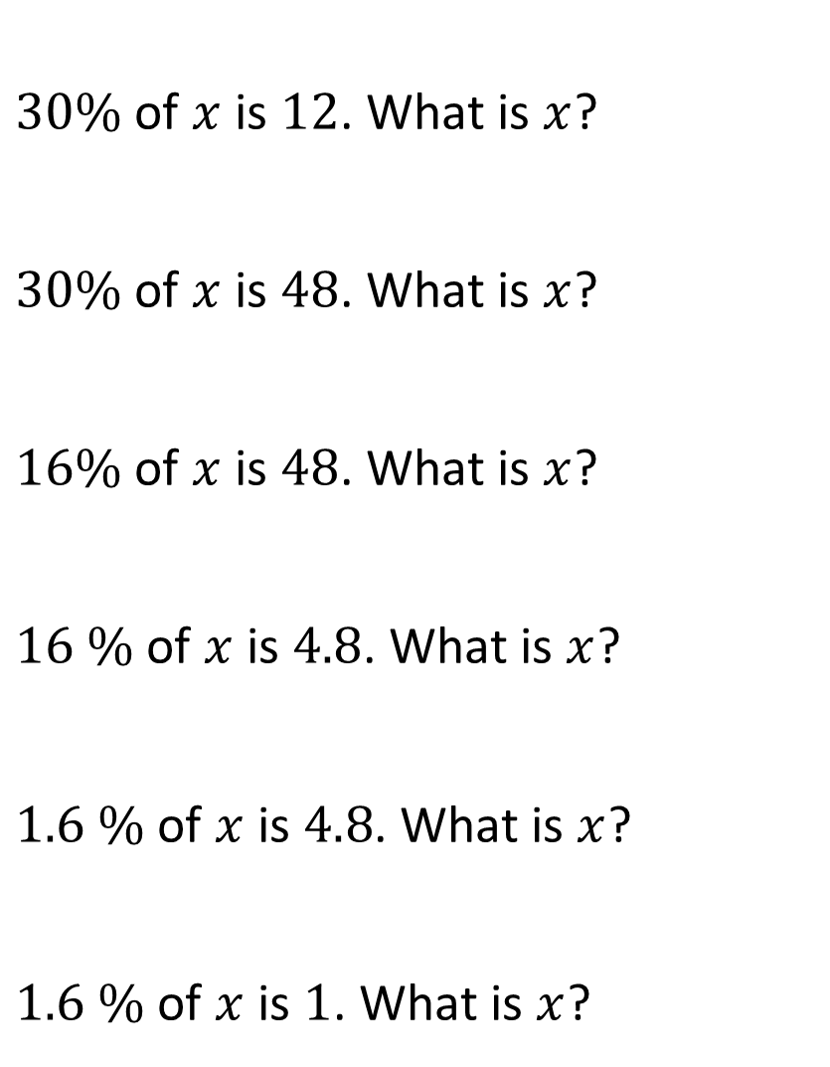
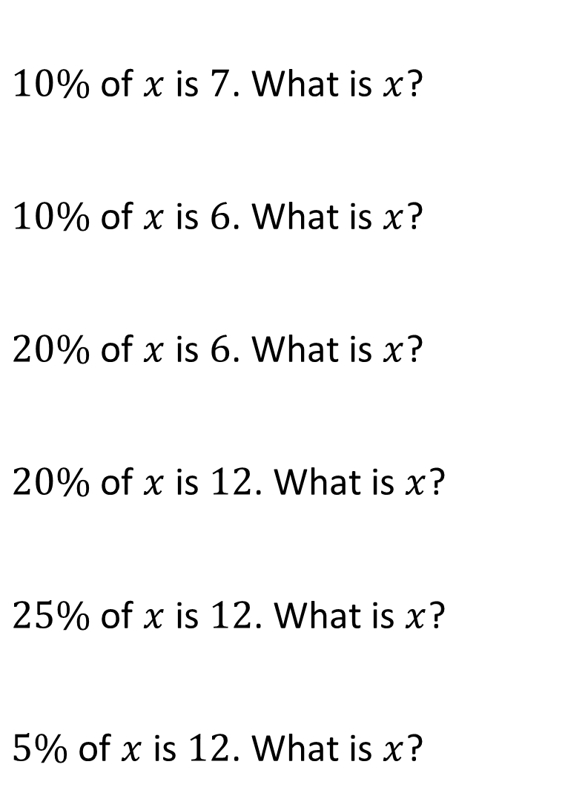
$10\%$ of $x$ is $7$. What is $x$?
$10\%$ of $x$ is $6$. What is $x$?
$20\%$ of $x$ is $6$. What is $x$?
$20\%$ of $x$ is $12$. What is $x$?
$25\%$ of $x$ is $12$. What is $x$?
$5\%$ of $x$ is $12$. What is $x$?
$30\%$ of $x$ is $12$. What is $x$?
$30\%$ of $x$ is $48$. What is $x$?
$16\%$ of $x$ is $48$. What is $x$?
$16 \%$ of $x$ is $4.8$. What is $x$?
$1.6 \%$ of $x$ is $4.8$. What is $x$?
$1.6 \%$ of $x$ is $1$. What is $x$?
@fortyninecubed

Slide 4

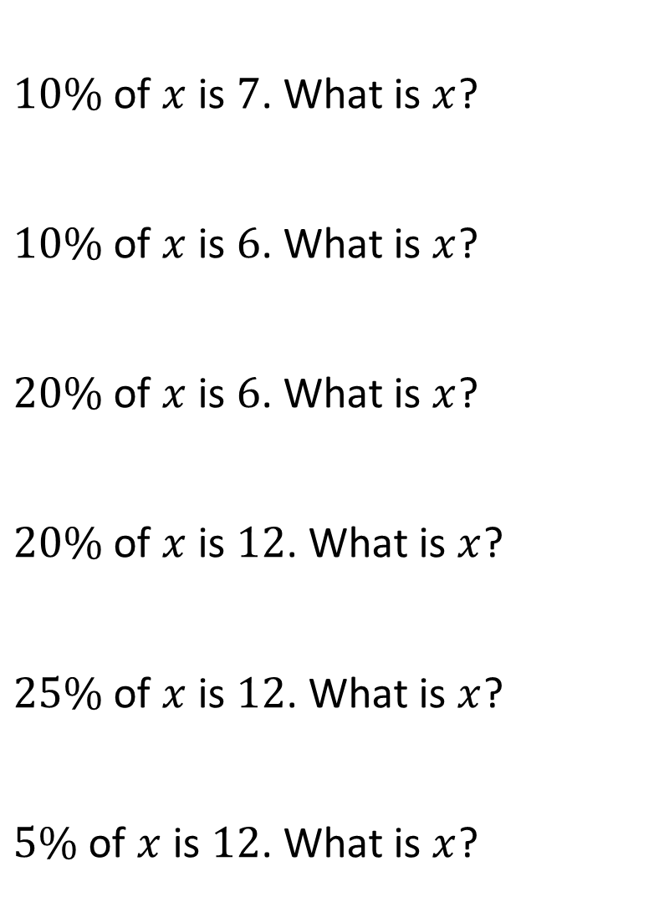

$10\%$ of $x$ is $7$. What is $x$?
$10\%$ of $x$ is $6$. What is $x$?
$20\%$ of $x$ is $6$. What is $x$?
$20\%$ of $x$ is $12$. What is $x$?
$25\%$ of $x$ is $12$. What is $x$?
$5\%$ of $x$ is $12$. What is $x$?
$30\%$ of $x$ is $12$. What is $x$?
$30\%$ of $x$ is $48$. What is $x$?
$16\%$ of $x$ is $48$. What is $x$?
$16 \%$ of $x$ is $4.8$. What is $x$?
$1.6 \%$ of $x$ is $4.8$. What is $x$?
$1.6 \%$ of $x$ is $1$. What is $x$?
$$70$$
$$60$$
$$30$$
$$60$$
$$48$$
$$240$$
$$40$$
$$160$$
$$300$$
$$30$$
$$300$$
$$62.5$$
@fortyninecubed

