Slide 1
Perimeter and area: Area of a traingle
Silent
Teacher
Intelligent Practice
Narration
Your Turn
Practice

Slide 2
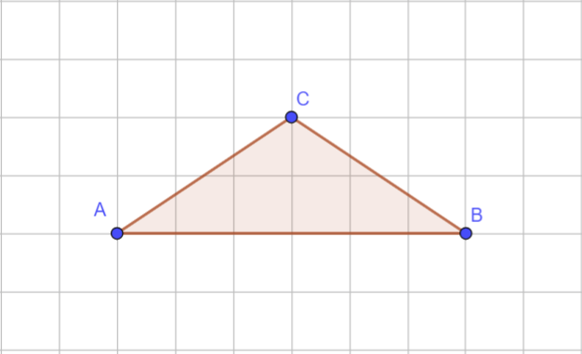
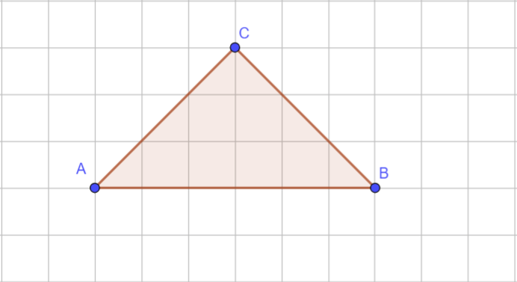
Worked Example
Your Turn
@mrbartonmaths

Slide 3
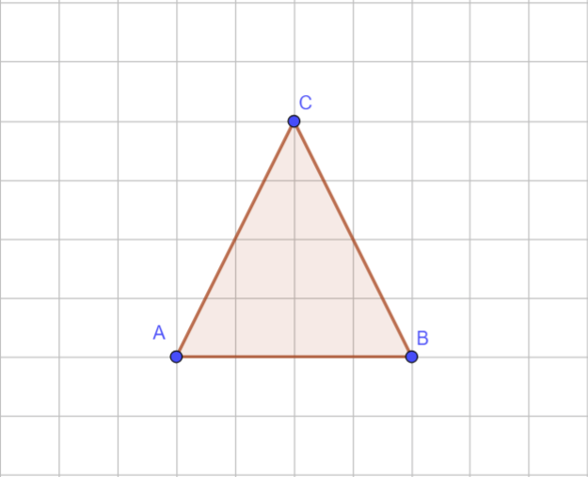
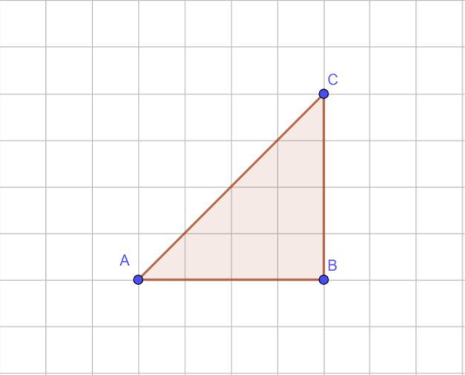
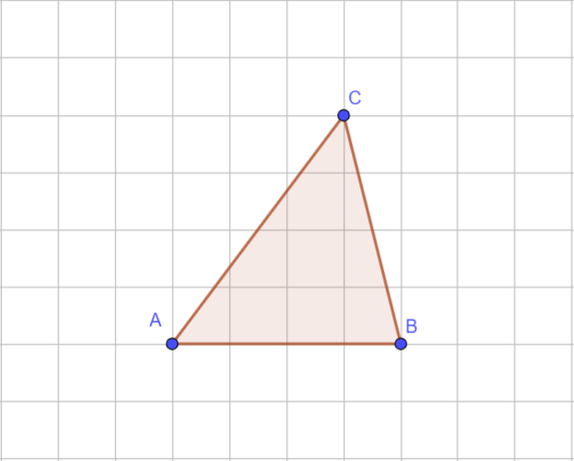
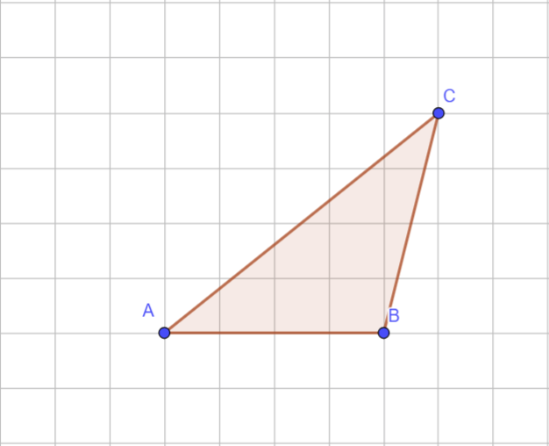
Area =
Area =
Area =
Area =

Slide 4
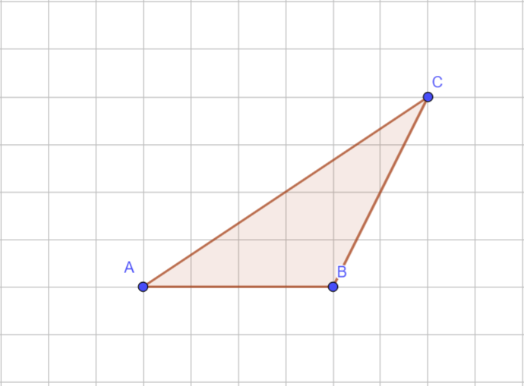
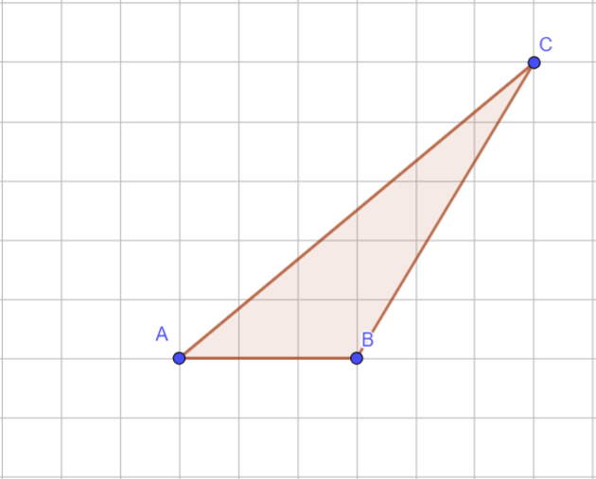
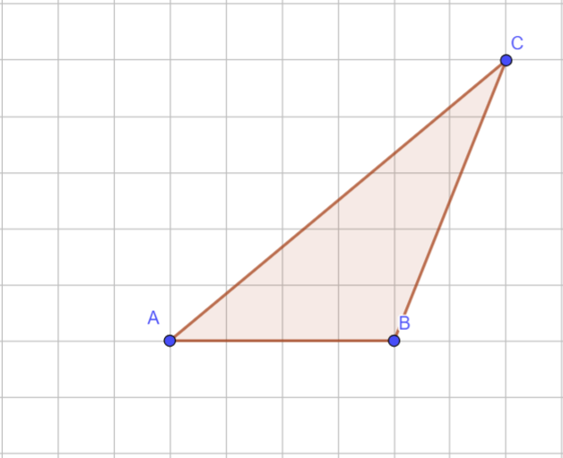
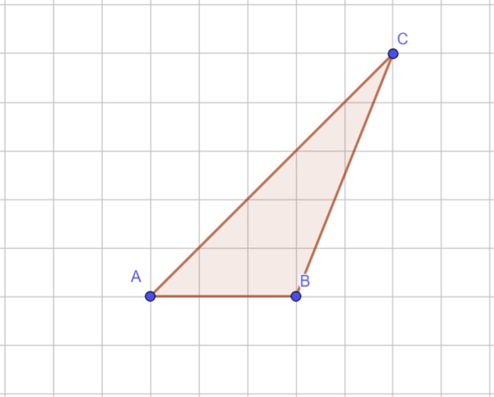
Area =
Area =
Area =
Area =

Slide 5
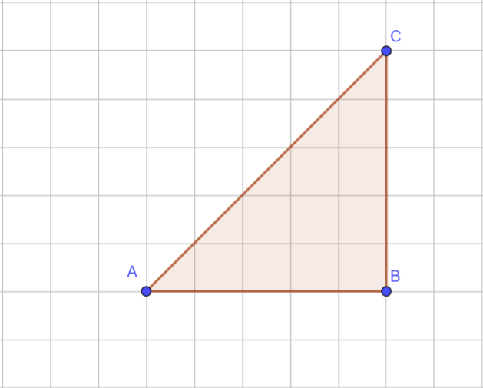
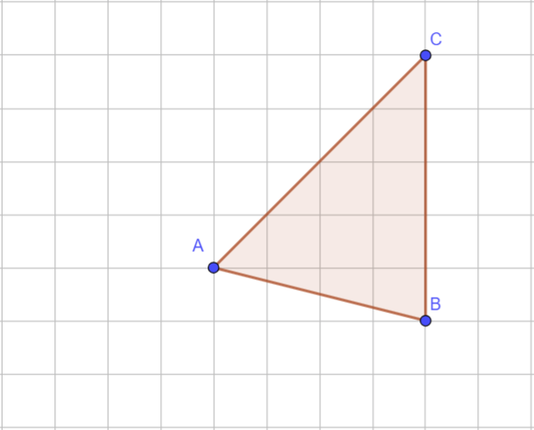
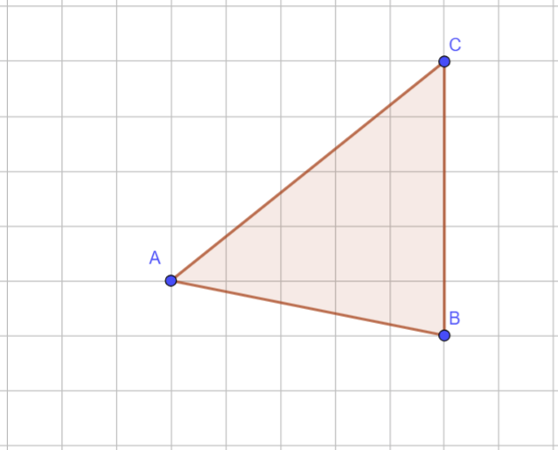
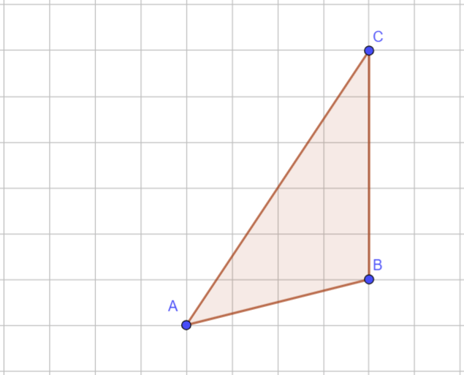
Area =
Area =
Area =
Area =

Slide 6
Area = 8 units²
Area = 8 units²
Area = 8 units²
Area = 8 units²

Slide 7
Area = 8 units²
Area = 8 units²
Area = 10 units²
Area = 7.5 units²

Slide 8
Area = 12.5 units²
Area = 10 units²
Area = 12.5 units²
Area = 10 units²

