Slide 1
Averages and range from a list of data: Increase, decrease, same?
Silent
Teacher
Intelligent Practice
Narration
Your Turn
$$2, 2, 4, 5, 12=$$
$$3, 3, 5, 6, 13=$$
$$6, 6, 10, 12, 26=$$
Practice

Slide 2
Worked Example
Your Turn
$$1, 5, 5, 7, 12$$
$$0, 4, 4, 6, 11$$
Mean =
Median =
Mode =
Range =
Mean =
Median =
Mode =
Range =
@mrbartonmaths

Slide 3
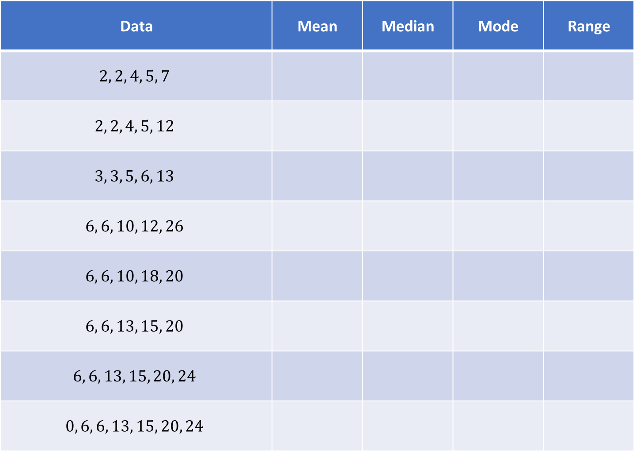
Data | Mean | Median | Mode | Range
$$2, 2, 4, 5, 7$$
$$2, 2, 4, 5, 12$$
$$3, 3, 5, 6, 13$$
$$6, 6, 10, 12, 26$$
$$6, 6, 10, 18, 20$$
$$6, 6, 13, 15, 20$$
$$6, 6, 13, 15, 20, 24$$
$$0, 6, 6, 13, 15, 20, 24$$

Slide 4
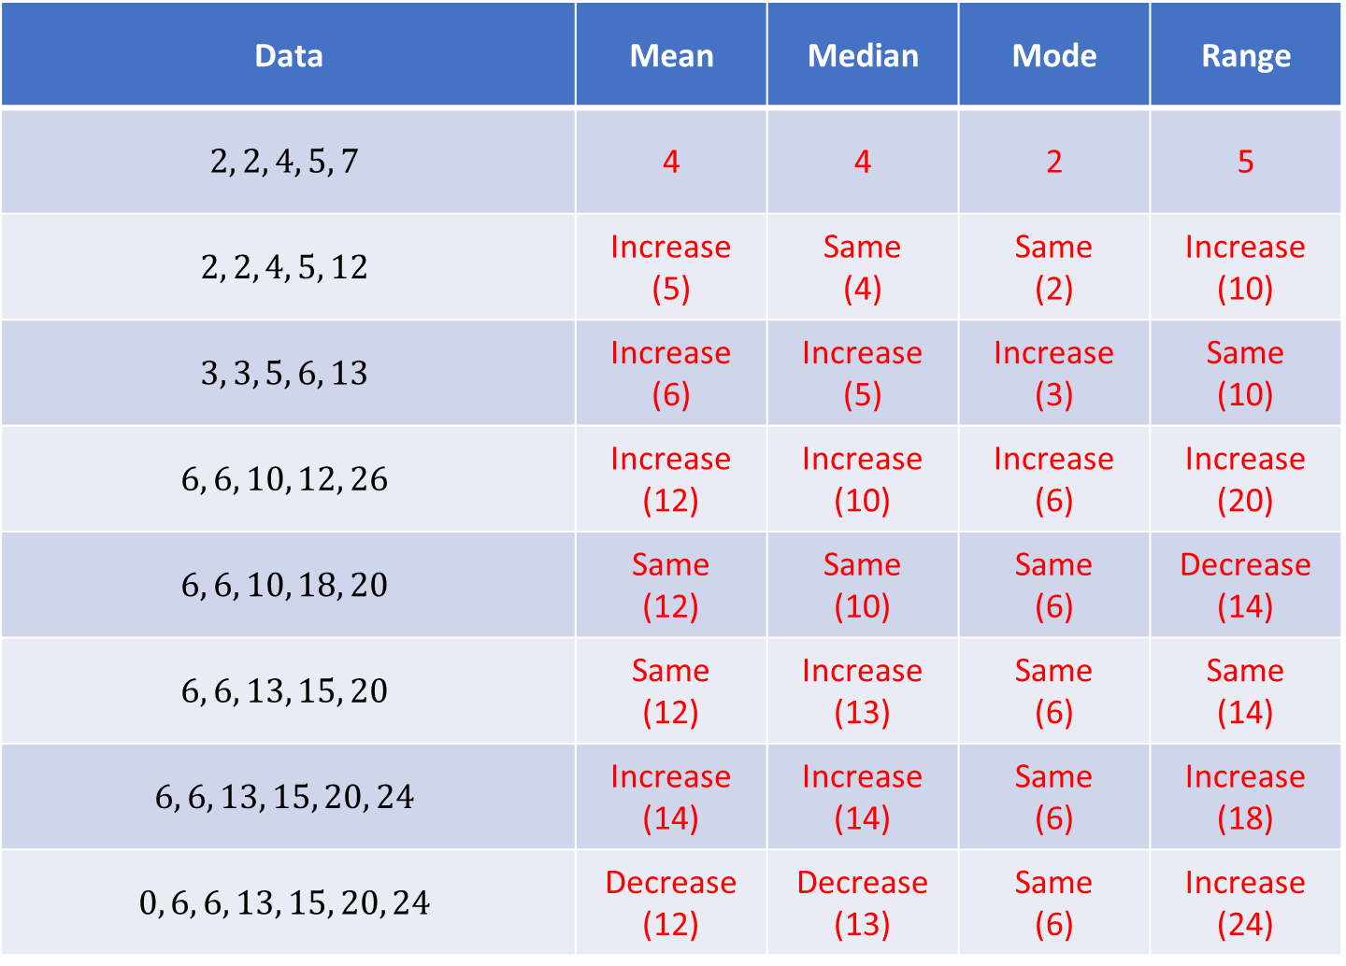
Data | Mean | Median | Mode | Range
$$2, 2, 4, 5, 7$$ | 4 | 4 | 2 | 5
$$2, 2, 4, 5, 12$$ | Increase (5) | Same (4) | Same (2) | Increase (10)
$$3, 3, 5, 6, 13$$ | Increase (6) | Increase (5) | Increase (3) | Same (10)
$$6, 6, 10, 12, 26$$ | Increase (12) | Increase (10) | Increase (6) | Increase (20)
$$6, 6, 10, 18, 20$$ | Same (12) | Same (10) | Same (6) | Decrease (14)
$$6, 6, 13, 15, 20$$ | Same (12) | Increase (13) | Same (6) | Same (14)
$$6, 6, 13, 15, 20, 24$$ | Increase (14) | Increase (14) | Same (6) | Increase (18)
$$0, 6, 6, 13, 15, 20, 24$$ | Decrease (12) | Decrease (13) | Same (6) | Increase (24)

