Slide 1
Box plots: Increase, decrease, same?
Silent
Teacher
Intelligent Practice
Narration
Your Turn
Practice

Slide 2
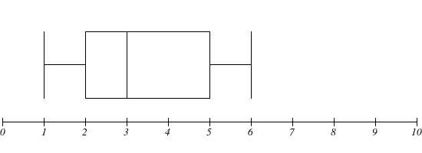
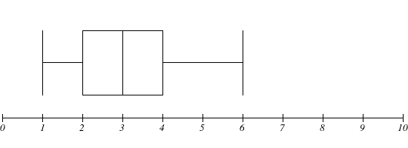
Worked Example
Your Turn
Median =
Range =
Interquartile range =
Median =
Range =
Interquartile range =
@mrbartonmaths

Slide 3
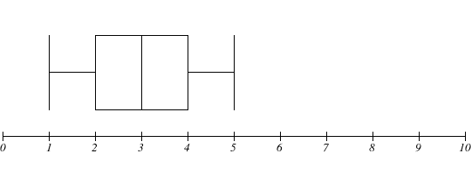
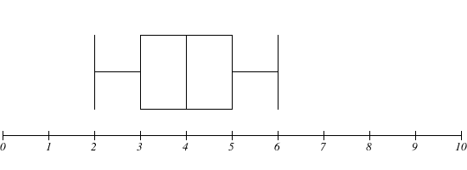
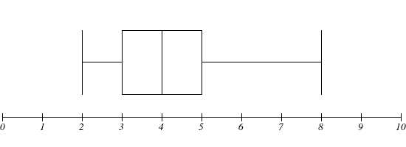
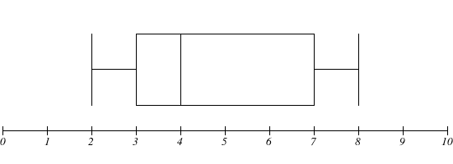
Median | Range | Interquartile range

Slide 4
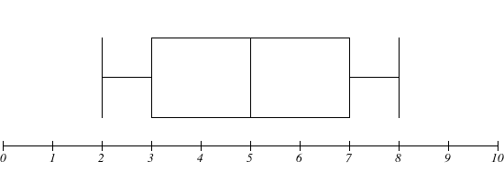
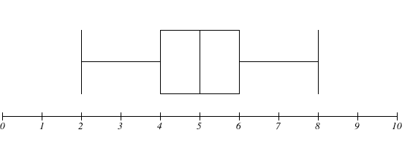
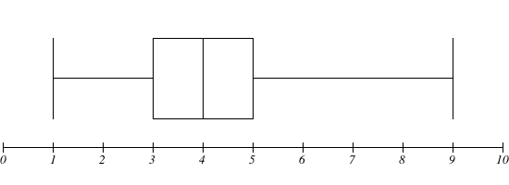
Median | Range | Interquartile range

Slide 5
Median | Range | Interquartile range
3 | 4 | 2
Increase (4) | Same (4) | Same (2)
Same (4) | Increase (6) | Same (2)
Same (4) | Same (6) | Increase (4)

Slide 6
Median | Range | Interquartile range
Increase (5) | Same (6) | Same (4)
Same (5) | Same (6) | Decrease (2)
Decrease (4) | Same (6) | Same (2)
Same (4) | Increase (8) | Same (2)

