Slide 1
Probability: Probability from Venn Diagrams
Silent
Teacher
Intelligent Practice
Narration
Your Turn
Practice

Slide 2
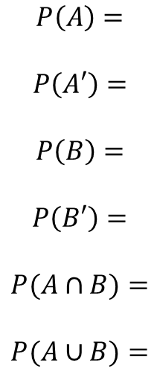
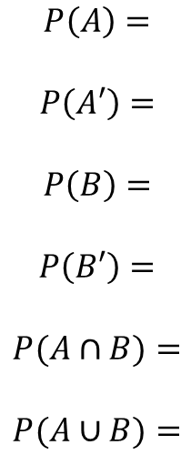
Worked Example
Your Turn
$$A$$
$$B$$
$$A$$
$$B$$
1
4
1
5
2
2
3
3
$$P\left(A\right)=$$
$$P\left(A′\right)=$$
$$P\left(B\right)=$$
$$P\left(B′\right)=$$
$$P(A∩B)=$$
$$P(A∪B)=$$
$$P\left(A\right)=$$
$$P\left(A′\right)=$$
$$P\left(B\right)=$$
$$P\left(B′\right)=$$
$$P(A∩B)=$$
$$P(A∪B)=$$
@mrbartonmaths

Slide 3
$$P\left(A\right)$$ | $$P\left(A′\right)$$ | $$P\left(B\right)$$ | $$P\left(B′\right)$$ | $$P(A∩B)$$ | $$P(A∪B)$$
$$A$$
$$B$$
4
2
3
1
$$A$$
$$B$$
5
2
3
1
$$A$$
$$B$$
5
1
3
1

Slide 4
$$P\left(A\right)$$ | $$P\left(A′\right)$$ | $$P\left(B\right)$$ | $$P\left(B′\right)$$ | $$P(A∩B)$$ | $$P(A∪B)$$
$$A$$
$$B$$
5
1
2
1
$$A$$
$$B$$
5
1
2
0
$$A$$
$$B$$
5
1
2
3

Slide 5
$$P\left(A\right)$$ | $$P\left(A′\right)$$ | $$P\left(B\right)$$ | $$P\left(B′\right)$$ | $$P(A∩B)$$ | $$P(A∪B)$$
$$A$$
$$B$$
5
1
3
3
$$A$$
$$B$$
3
1
5
3
$$A$$
$$B$$
6
2
10
6

Slide 6
$$P\left(A\right)$$ | $$P\left(A′\right)$$ | $$P\left(B\right)$$ | $$P\left(B′\right)$$ | $$P(A∩B)$$ | $$P(A∪B)$$
$$A$$
$$B$$
0
2
10
6
$$A$$
$$B$$
10
2
0
6
$$A$$
$$B$$
10
0
0
6

Slide 7
$$P\left(A\right)$$ | $$P\left(A′\right)$$ | $$P\left(B\right)$$ | $$P\left(B′\right)$$ | $$P(A∩B)$$ | $$P(A∪B)$$
$$A$$
$$B$$
10
0
0
0
$$A$$
$$B$$
0
0
10
0
$$A$$
$$B$$
0
0
0
10

Slide 8
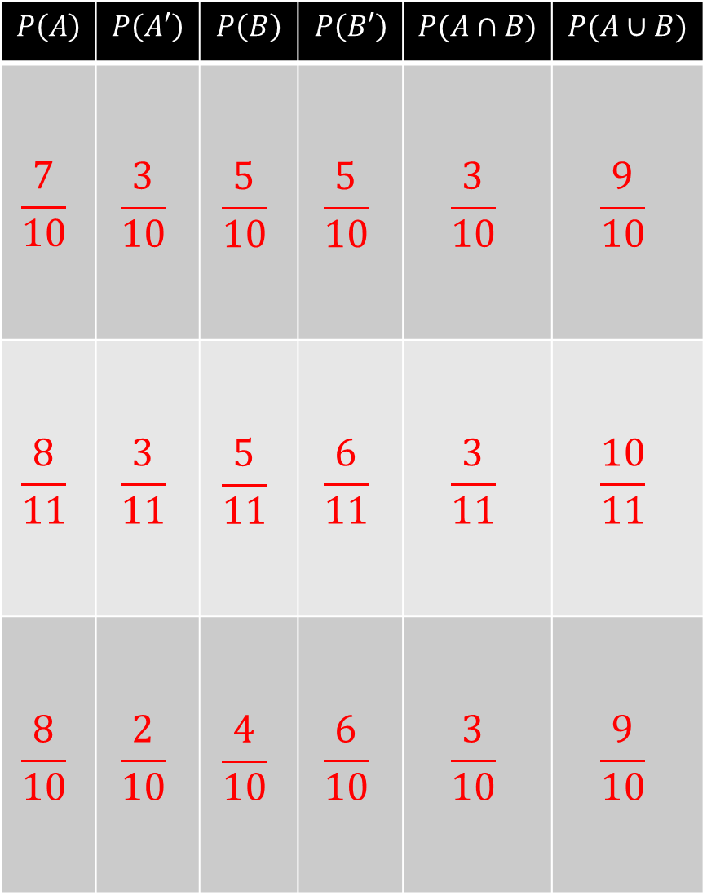
$$P\left(A\right)$$ | $$P\left(A′\right)$$ | $$P\left(B\right)$$ | $$P\left(B′\right)$$ | $$P(A∩B)$$ | $$P(A∪B)$$
$$\frac{7}{10}$$ | $$\frac{3}{10}$$ | $$\frac{5}{10}$$ | $$\frac{5}{10}$$ | $$\frac{3}{10}$$ | $$\frac{9}{10}$$
$$\frac{8}{11}$$ | $$\frac{3}{11}$$ | $$\frac{5}{11}$$ | $$\frac{6}{11}$$ | $$\frac{3}{11}$$ | $$\frac{10}{11}$$
$$\frac{8}{10}$$ | $$\frac{2}{10}$$ | $$\frac{4}{10}$$ | $$\frac{6}{10}$$ | $$\frac{3}{10}$$ | $$\frac{9}{10}$$
$$A$$
$$B$$
4
2
3
1
$$A$$
$$B$$
5
2
3
1
$$A$$
$$B$$
5
1
3
1

Slide 9
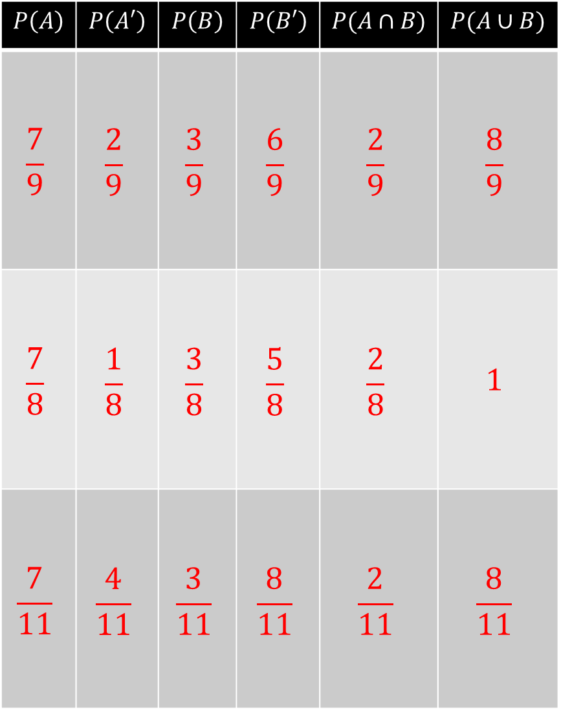
$$P\left(A\right)$$ | $$P\left(A′\right)$$ | $$P\left(B\right)$$ | $$P\left(B′\right)$$ | $$P(A∩B)$$ | $$P(A∪B)$$
$$\frac{7}{9}$$ | $$\frac{2}{9}$$ | $$\frac{3}{9}$$ | $$\frac{6}{9}$$ | $$\frac{2}{9}$$ | $$\frac{8}{9}$$
$$\frac{7}{8}$$ | $$\frac{1}{8}$$ | $$\frac{3}{8}$$ | $$\frac{5}{8}$$ | $$\frac{2}{8}$$ | $$1$$
$$\frac{7}{11}$$ | $$\frac{4}{11}$$ | $$\frac{3}{11}$$ | $$\frac{8}{11}$$ | $$\frac{2}{11}$$ | $$\frac{8}{11}$$
$$A$$
$$B$$
5
1
2
1
$$A$$
$$B$$
5
1
2
0
$$A$$
$$B$$
5
1
2
3

Slide 10
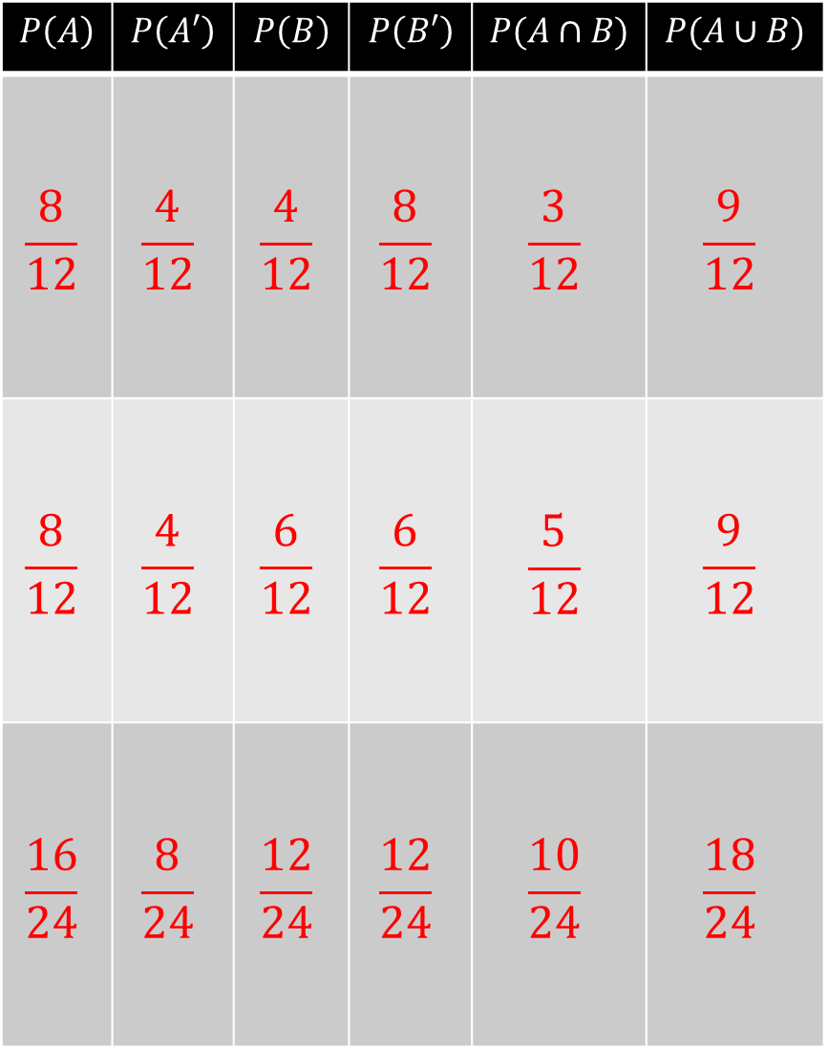
$$P\left(A\right)$$ | $$P\left(A′\right)$$ | $$P\left(B\right)$$ | $$P\left(B′\right)$$ | $$P(A∩B)$$ | $$P(A∪B)$$
$$\frac{8}{12}$$ | $$\frac{4}{12}$$ | $$\frac{4}{12}$$ | $$\frac{8}{12}$$ | $$\frac{3}{12}$$ | $$\frac{9}{12}$$
$$\frac{8}{12}$$ | $$\frac{4}{12}$$ | $$\frac{6}{12}$$ | $$\frac{6}{12}$$ | $$\frac{5}{12}$$ | $$\frac{9}{12}$$
$$\frac{16}{24}$$ | $$\frac{8}{24}$$ | $$\frac{12}{24}$$ | $$\frac{12}{24}$$ | $$\frac{10}{24}$$ | $$\frac{18}{24}$$
$$A$$
$$B$$
5
1
3
3
$$A$$
$$B$$
3
1
5
3
$$A$$
$$B$$
6
2
10
6

Slide 11
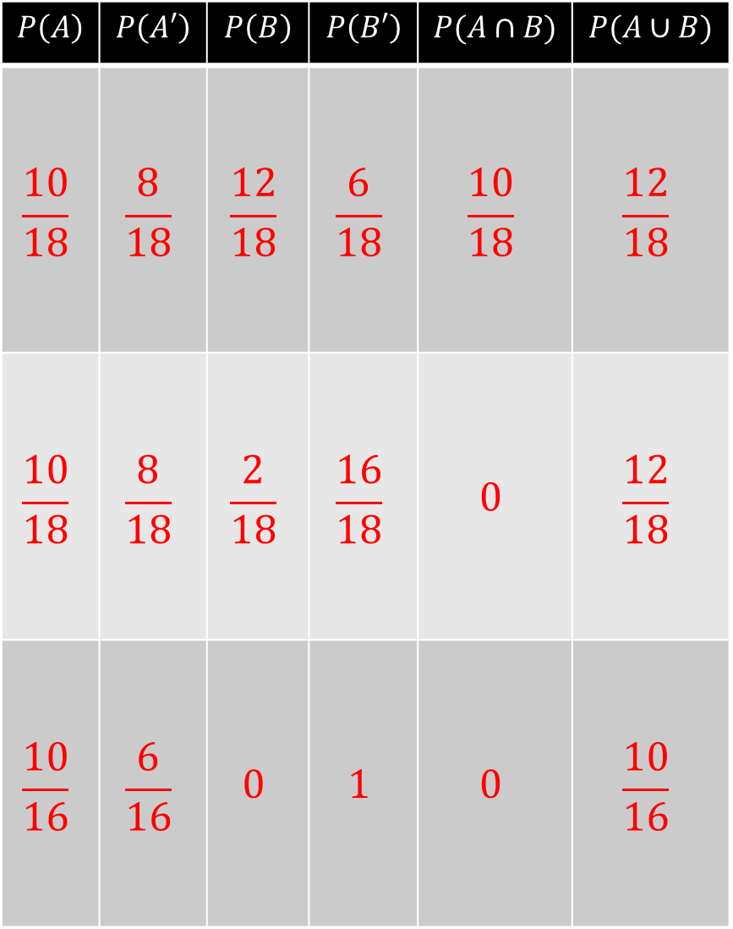
$$P\left(A\right)$$ | $$P\left(A′\right)$$ | $$P\left(B\right)$$ | $$P\left(B′\right)$$ | $$P(A∩B)$$ | $$P(A∪B)$$
$$\frac{10}{18}$$ | $$\frac{8}{18}$$ | $$\frac{12}{18}$$ | $$\frac{6}{18}$$ | $$\frac{10}{18}$$ | $$\frac{12}{18}$$
$$\frac{10}{18}$$ | $$\frac{8}{18}$$ | $$\frac{2}{18}$$ | $$\frac{16}{18}$$ | $$0$$ | $$\frac{12}{18}$$
$$\frac{10}{16}$$ | $$\frac{6}{16}$$ | $$0$$ | $$1$$ | $$0$$ | $$\frac{10}{16}$$
$$A$$
$$B$$
0
2
10
6
$$A$$
$$B$$
10
2
0
6
$$A$$
$$B$$
10
0
0
6

Slide 12
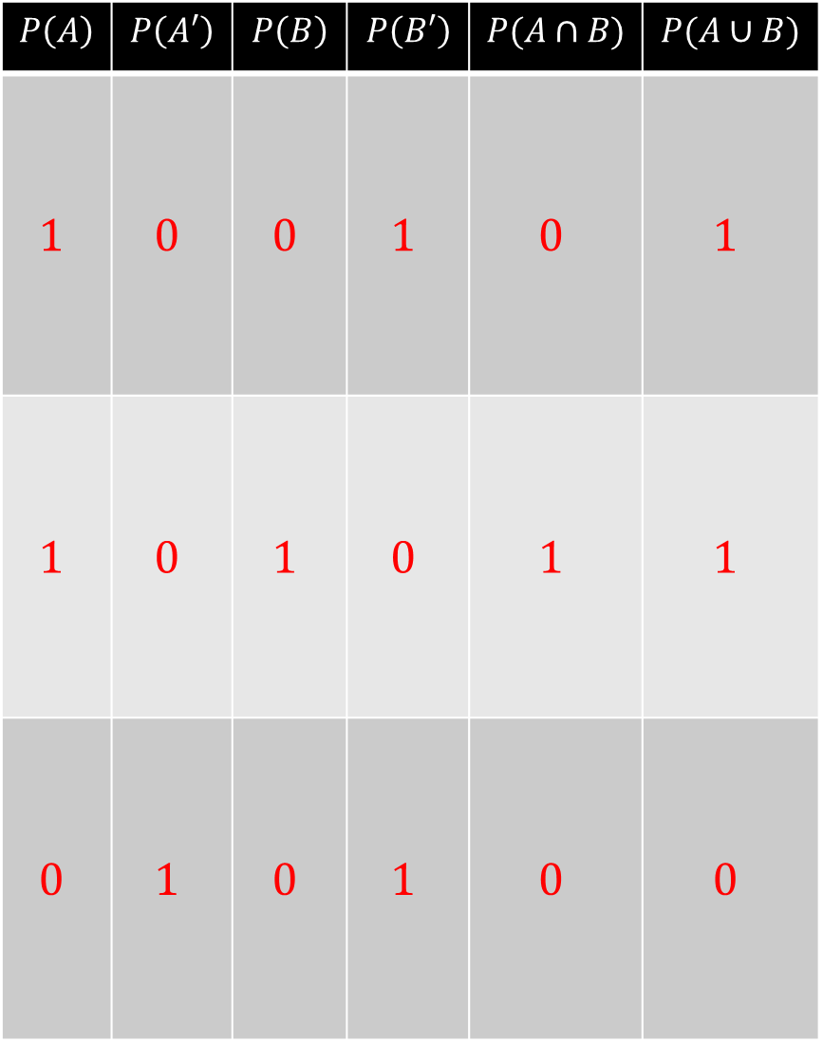
$$P\left(A\right)$$ | $$P\left(A′\right)$$ | $$P\left(B\right)$$ | $$P\left(B′\right)$$ | $$P(A∩B)$$ | $$P(A∪B)$$
$$1$$ | $$0$$ | $$0$$ | $$1$$ | $$0$$ | $$1$$
$$1$$ | $$0$$ | $$1$$ | $$0$$ | $$1$$ | $$1$$
$$0$$ | $$1$$ | $$0$$ | $$1$$ | $$0$$ | $$0$$
$$A$$
$$B$$
10
0
0
0
$$A$$
$$B$$
0
0
10
0
$$A$$
$$B$$
0
0
0
10

