Slide 1
Factors, multiple, primes: Types of numbers from prime factors
True/false
Reflect
Your Turn
$5^{2}×7^{2}$ (Square / Cube / Neither)
$2×5^{2}×7^{2}$ (Square / Cube / Neither)
$2^{2}×5^{2}×7^{2}$ (Square / Cube / Neither)
Rule

Slide 2
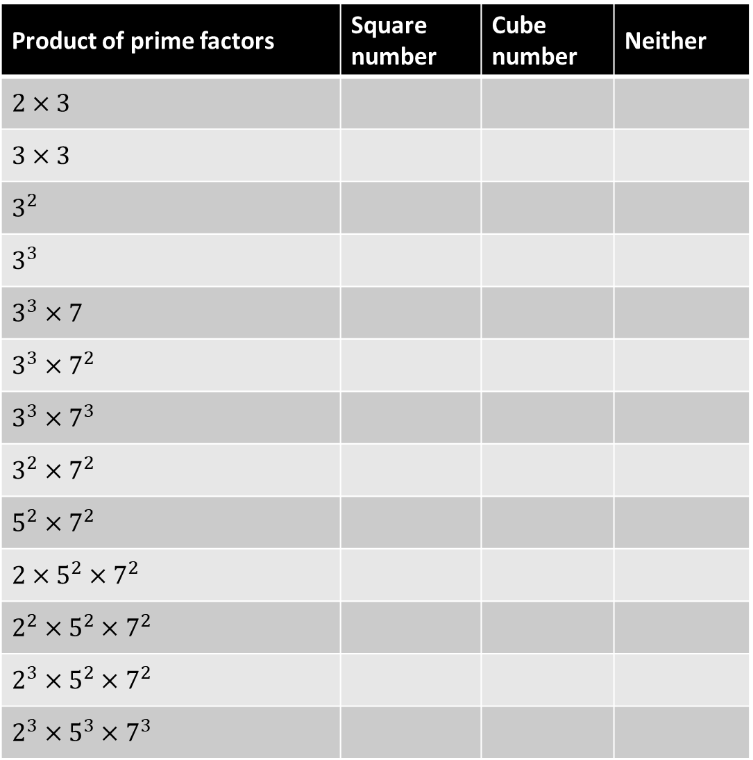
Product of prime factors | Square number | Cube number | Neither
$$2×3$$
$$3×3$$
$$3^{2}$$
$$3^{3}$$
$$3^{3}×7$$
$$3^{3}×7^{2}$$
$$3^{3}×7^{3}$$
$$3^{2}×7^{2}$$
$$5^{2}×7^{2}$$
$$2×5^{2}×7^{2}$$
$$2^{2}×5^{2}×7^{2}$$
$$2^{3}×5^{2}×7^{2}$$
$$2^{3}×5^{3}×7^{3}$$
@mrbartonmaths

Slide 3
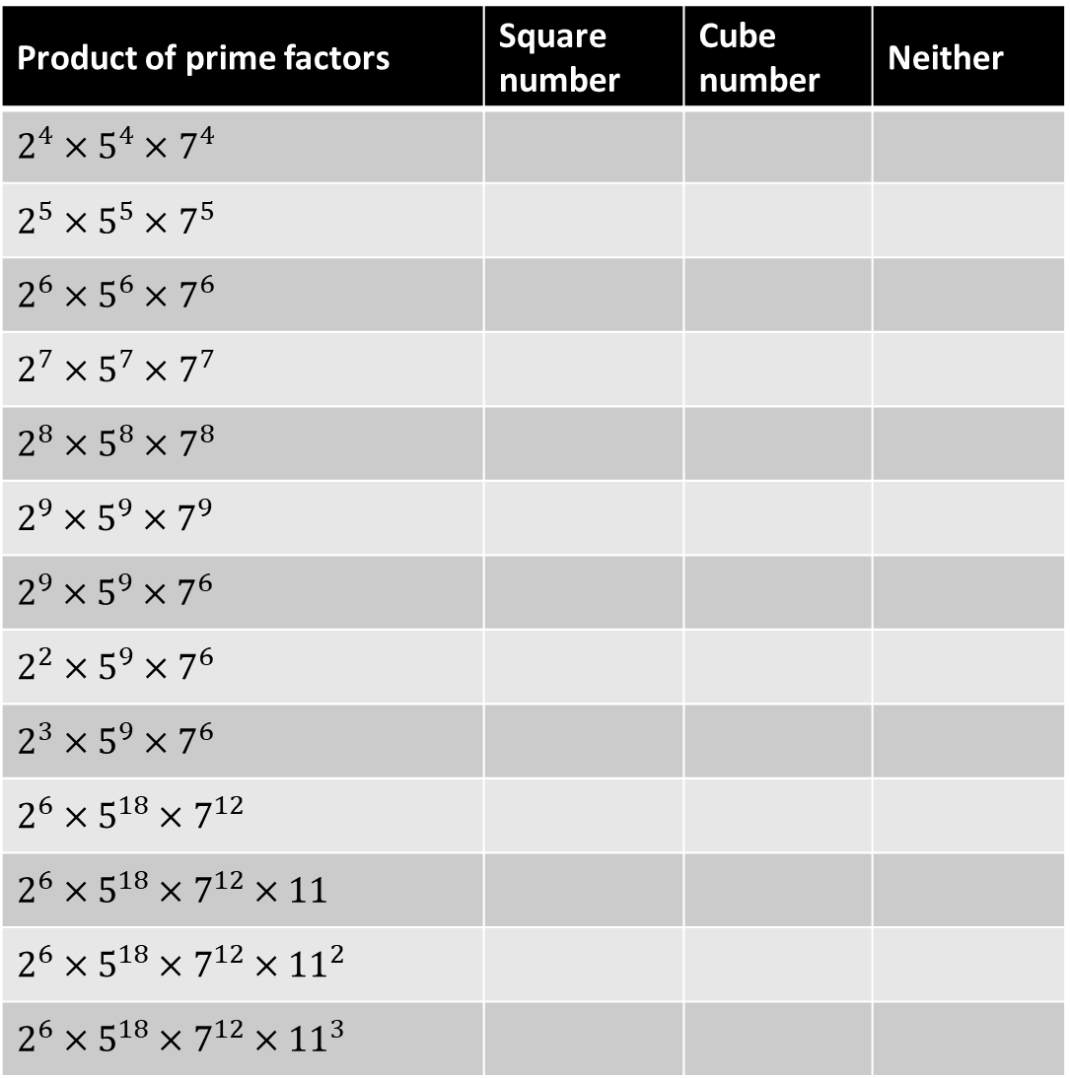
Product of prime factors | Square number | Cube number | Neither
$$2^{4}×5^{4}×7^{4}$$
$$2^{5}×5^{5}×7^{5}$$
$$2^{6}×5^{6}×7^{6}$$
$$2^{7}×5^{7}×7^{7}$$
$$2^{8}×5^{8}×7^{8}$$
$$2^{9}×5^{9}×7^{9}$$
$$2^{9}×5^{9}×7^{6}$$
$$2^{2}×5^{9}×7^{6}$$
$$2^{3}×5^{9}×7^{6}$$
$$2^{6}×5^{18}×7^{12}$$
$$2^{6}×5^{18}×7^{12}×11$$
$$2^{6}×5^{18}×7^{12}×{11}^{2}$$
$$2^{6}×5^{18}×7^{12}×{11}^{3}$$
@mrbartonmaths

Slide 4
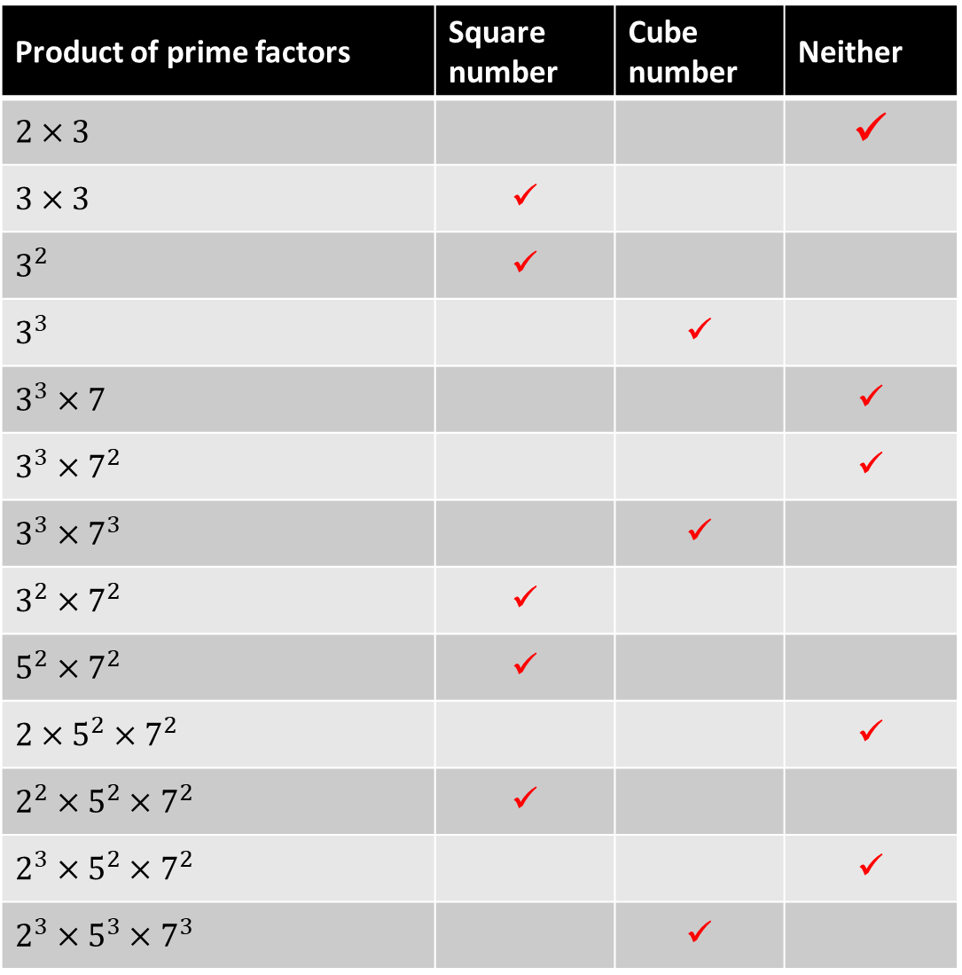
Product of prime factors | Square number | Cube number | Neither
$$2×3$$ |  |  | ✓
$$3×3$$ | ✓
$$3^{2}$$ | ✓
$$3^{3}$$ |  | ✓
$$3^{3}×7$$ |  |  | ✓
$$3^{3}×7^{2}$$ |  |  | ✓
$$3^{3}×7^{3}$$ |  | ✓
$$3^{2}×7^{2}$$ | ✓
$$5^{2}×7^{2}$$ | ✓
$$2×5^{2}×7^{2}$$ |  |  | ✓
$$2^{2}×5^{2}×7^{2}$$ | ✓
$$2^{3}×5^{2}×7^{2}$$ |  |  | ✓
$$2^{3}×5^{3}×7^{3}$$ |  | ✓
@mrbartonmaths

Slide 5
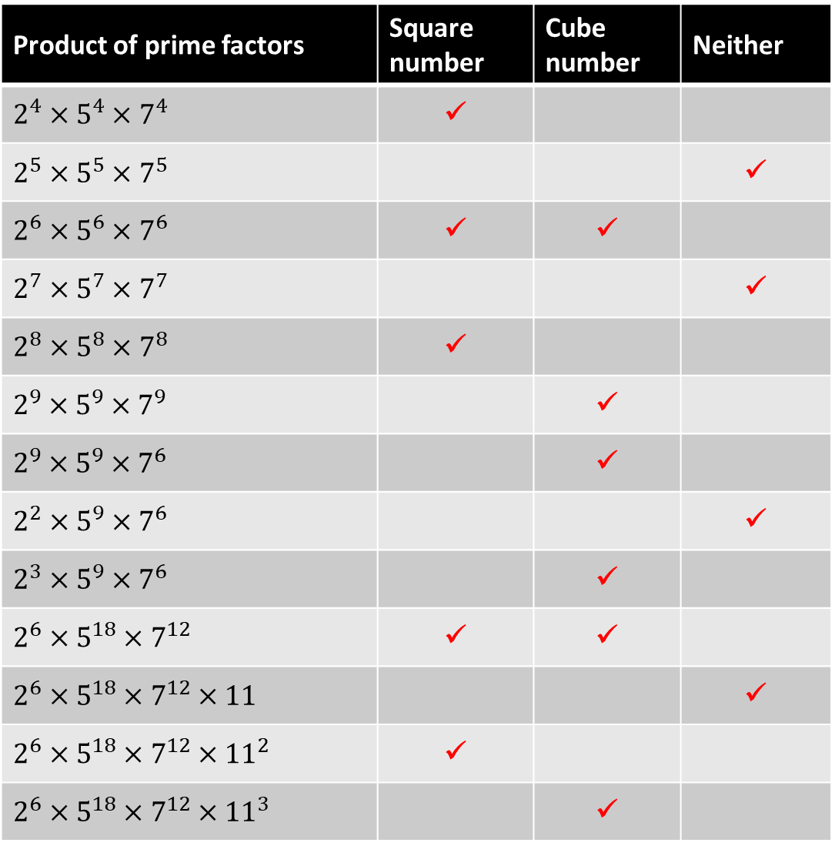
Product of prime factors | Square number | Cube number | Neither
$$2^{4}×5^{4}×7^{4}$$ | ✓
$$2^{5}×5^{5}×7^{5}$$ |  |  | ✓
$$2^{6}×5^{6}×7^{6}$$ | ✓ | ✓
$$2^{7}×5^{7}×7^{7}$$ |  |  | ✓
$$2^{8}×5^{8}×7^{8}$$ | ✓
$$2^{9}×5^{9}×7^{9}$$ |  | ✓
$$2^{9}×5^{9}×7^{6}$$ |  | ✓
$$2^{2}×5^{9}×7^{6}$$ |  |  | ✓
$$2^{3}×5^{9}×7^{6}$$ |  | ✓
$$2^{6}×5^{18}×7^{12}$$ | ✓ | ✓
$$2^{6}×5^{18}×7^{12}×11$$ |  |  | ✓
$$2^{6}×5^{18}×7^{12}×{11}^{2}$$ | ✓
$$2^{6}×5^{18}×7^{12}×{11}^{3}$$ |  | ✓
@mrbartonmaths

Slide 6
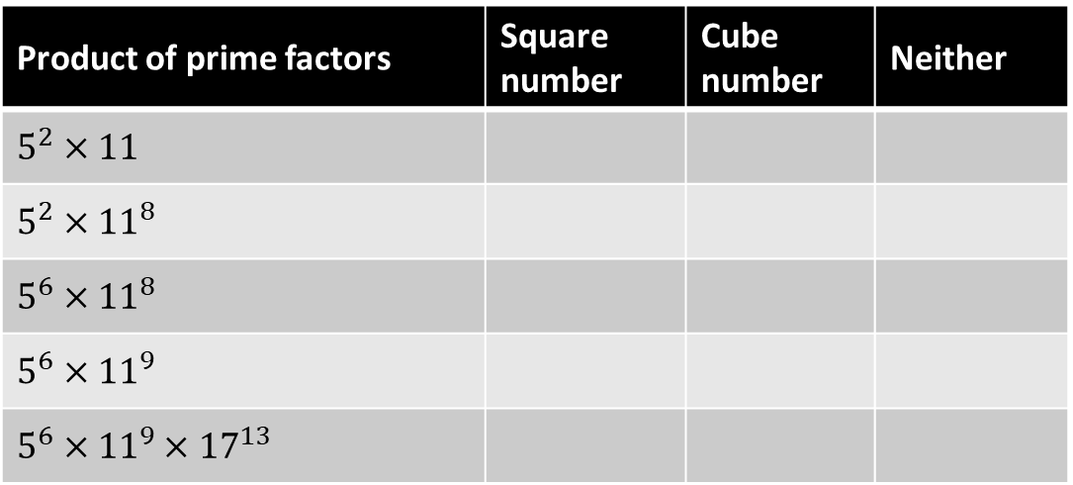
Your Turn
Product of prime factors | Square number | Cube number | Neither
$$5^{2}×11$$
$$5^{2}×{11}^{8}$$
$$5^{6}×{11}^{8}$$
$$5^{6}×{11}^{9}$$
$$5^{6}×{11}^{9}×{17}^{13}$$
@mrbartonmaths

Slide 7
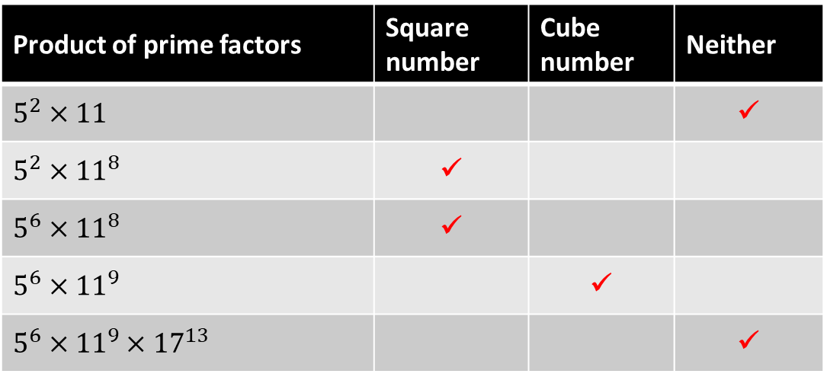
Your Turn - answers
Product of prime factors | Square number | Cube number | Neither
$$5^{2}×11$$ |  |  | ✓
$$5^{2}×{11}^{8}$$ | ✓
$$5^{6}×{11}^{8}$$ | ✓
$$5^{6}×{11}^{9}$$ |  | ✓
$$5^{6}×{11}^{9}×{17}^{13}$$ |  |  | ✓
@mrbartonmaths

