Slide 1
Shape properties: What is a polygon?
True/false
Reflect
Your Turn
Rule

Slide 2
Shape | Polygon?
Shape | Polygon?
No
No
No
Yes
Yes
Yes
Yes
Yes
Yes
No

Slide 3
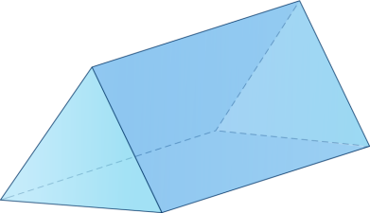
Shape | Polygon?
Shape | Polygon?
No
No
Yes
Yes
Yes
Yes
No
Yes
No
Yes

Slide 4
Shape | Polygon?
Shape | Polygon?
Yes
No
Yes
Yes
No
Yes
No
No
No
Yes

Slide 5
Your turn
Shape | Polygon?
@mrbartonmaths

Slide 6
Your turn - answers
Shape | Polygon?
 | Yes
 | Yes
 | No
 | No
 | Yes
@mrbartonmaths

