Slide 1
Shape properties: What is a prism?
True/false
Reflect
Your Turn
Rule

Slide 2
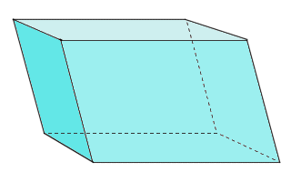
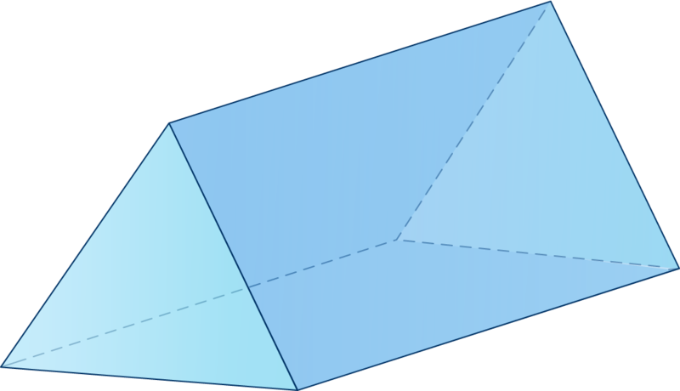
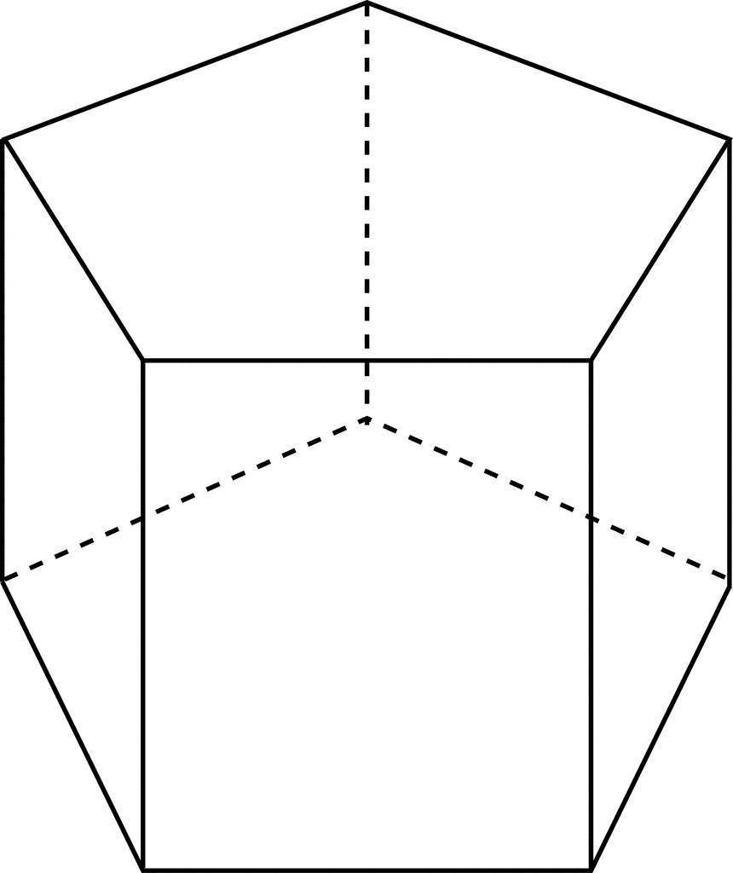
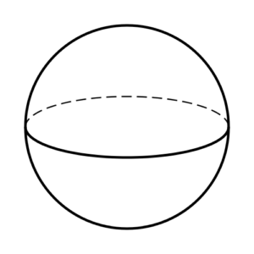
Shape | Prism?
Shape | Prism?

Slide 3
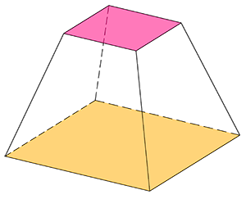
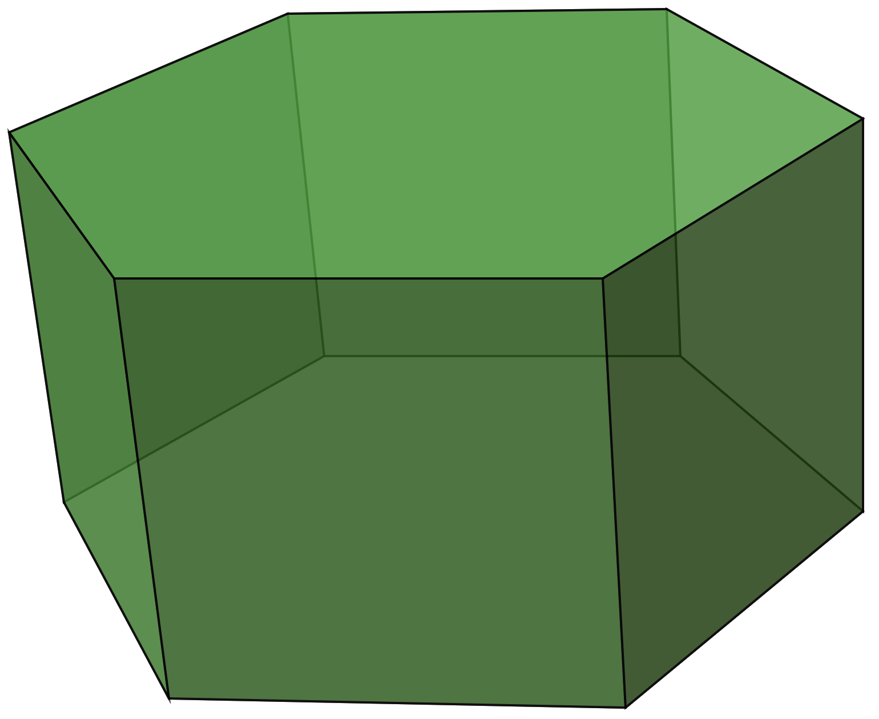
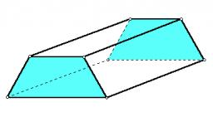
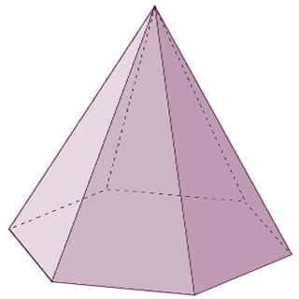
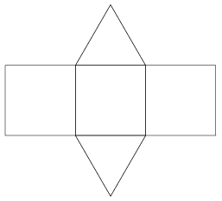
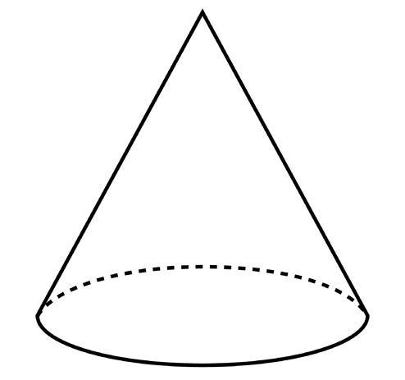
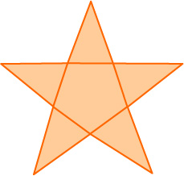
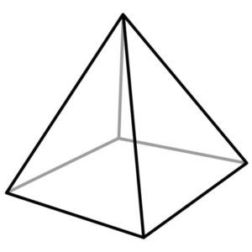
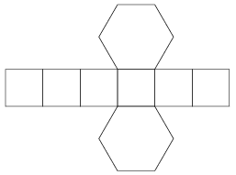
Shape | Prism?
Shape | Prism?
Net
Net
Net

Slide 4
Shape | Prism?
 | No
 | No
 | No
 | Yes
 | Yes
Shape | Prism?
 | Yes
 | Yes
 | Yes
 | Yes
 | No

Slide 5
Shape | Prism?
 | No
 | Yes
 | No
 | No
 | No
Shape | Prism?
 | No
 | Yes
 | Yes
 | No
 | Yes
Net
Net
Net

Slide 6
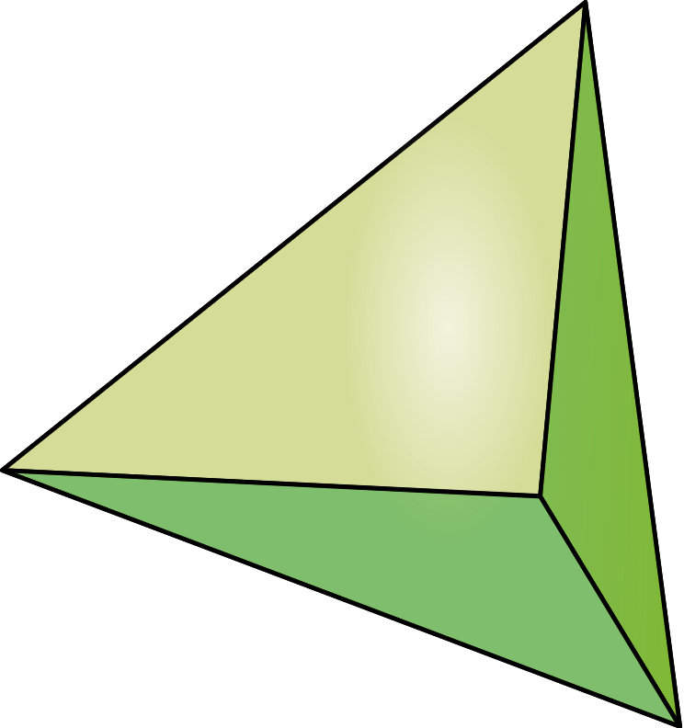
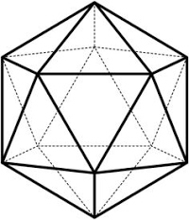
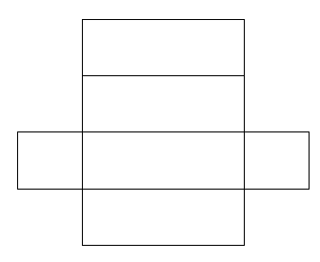
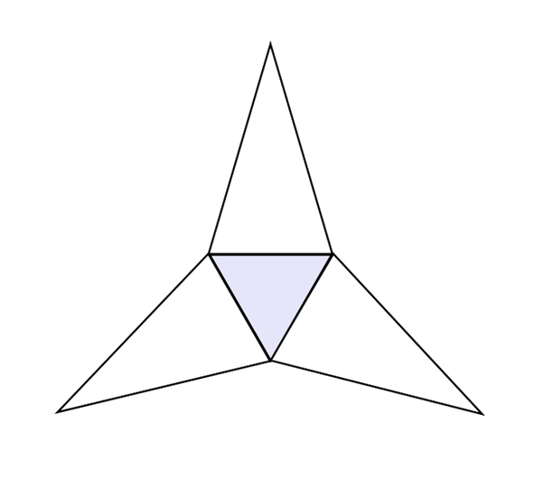
Your turn
Shape | Prism?
Net
Net
@mrbartonmaths

Slide 7
Your turn
Shape | Prism?
 | No
 | Yes
 | No
 | Yes
 | No
Net
Net
@mrbartonmaths

