Slide 1
Straight Line Graphs: Equation of a Tangent to a Circle at a point
Silent
Teacher
Intelligent Practice
Narration
Your Turn
Find the equation of the tangent to ________ at the point $\left( , \right).$
$x^{2}+y^{2}=25$ at $(3,4)$.
$x^{2}+y^{2}=25$ at $(4,3)$.
$x^{2}+y^{2}=25$ at $(−4,−3)$.
Practice

Slide 2
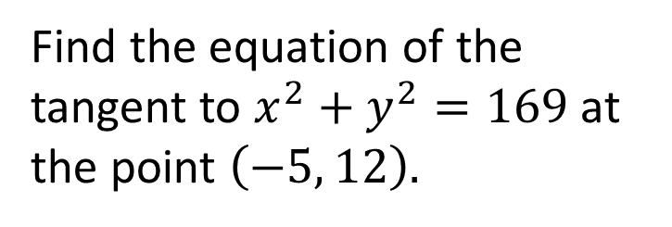
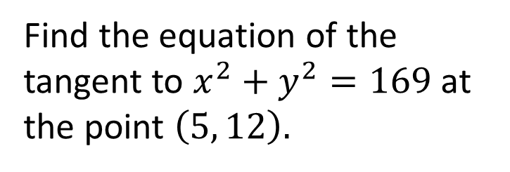
Worked Example
Your Turn
Find the equation of the tangent to $x^{2}+y^{2}=169$ at the point $\left(5, 12\right).$
Find the equation of the tangent to $x^{2}+y^{2}=169$ at the point $\left(−5, 12\right).$
@fortyninecubed

Slide 3
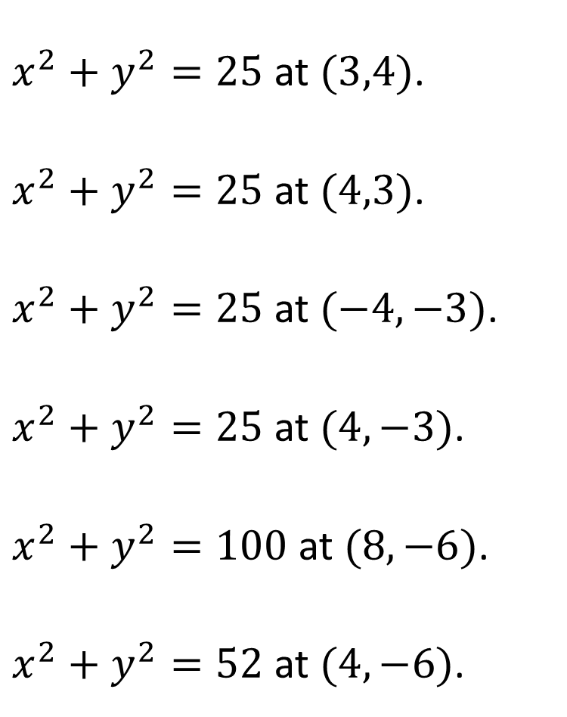
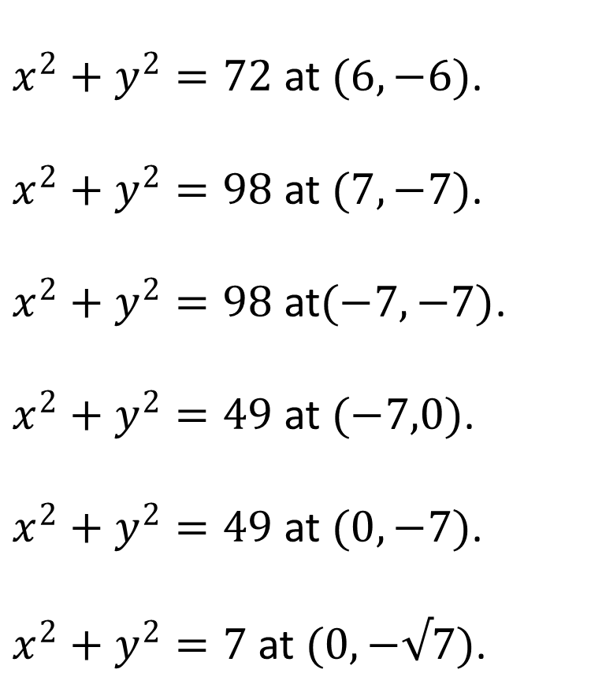
Find the equation of the tangent to ________ at the point $\left( , \right).$
$x^{2}+y^{2}=25$ at $(3,4)$.
$x^{2}+y^{2}=25$ at $(4,3)$.
$x^{2}+y^{2}=25$ at $(−4,−3)$.
$x^{2}+y^{2}=25$ at $(4,−3)$.
$x^{2}+y^{2}=100$ at $(8,−6)$.
$x^{2}+y^{2}=52$ at $(4,−6)$.
$x^{2}+y^{2}=72$ at $(6,−6)$.
$x^{2}+y^{2}=98$ at $(7,−7)$.
$x^{2}+y^{2}=98$ at$(−7,−7)$.
$x^{2}+y^{2}=49$ at $(−7,0)$.
$x^{2}+y^{2}=49$ at $(0,−7)$.
$x^{2}+y^{2}=7$ at $(0,−√7)$.
@fortyninecubed

Slide 4


Find the equation of the tangent to ________ at the point $\left( , \right).$
$x^{2}+y^{2}=25$ at $(3,4)$.
$x^{2}+y^{2}=25$ at $(4,3)$.
$x^{2}+y^{2}=25$ at $(−4,−3)$.
$x^{2}+y^{2}=25$ at $(4,−3)$.
$x^{2}+y^{2}=100$ at $(8,−6)$.
$x^{2}+y^{2}=52$ at $(4,−6)$.
$x^{2}+y^{2}=72$ at $(6,−6)$.
$x^{2}+y^{2}=98$ at $(7,−7)$.
$x^{2}+y^{2}=98$ at$(−7,−7)$.
$x^{2}+y^{2}=49$ at $(−7,0)$.
$x^{2}+y^{2}=49$ at $(0,−7)$.
$x^{2}+y^{2}=7$ at $(0,−√7)$.
$$y=−\frac{3}{4}x+\frac{25}{4}$$
$$y=−\frac{4}{3}x+\frac{25}{3}$$
$$y=−\frac{4}{3}x−\frac{25}{3}$$
$$y=\frac{4}{3}x−\frac{25}{3}$$
$$y=\frac{4}{3}x−\frac{50}{3}$$
$$y=\frac{2}{3}x−\frac{26}{3}$$
$$y=x−12$$
$$y=x−14$$
$$y=−x−14$$
$$x=−7$$
$$y=−7$$
$$y=−√7$$
@fortyninecubed

