Slide 1
Linear simultaneous Equations: Eliminating the variable $x$ (step 3)
Silent
Teacher
Intelligent Practice
Narration
Your Turn
$$2y+3x=18$$
$$6y+3x=30$$
$$2y+3x=18$$
$$6y−3x=30$$
$$2y+x=18$$
$$6y−x=30$$
Practice

Slide 2
Worked Example
Your Turn
Eliminate a variable from the following sets of equations:
Eliminate a variable from the following sets of equations:
$$5x+4y=23$$
$$5x+2y=19$$
$$5x+8y=31$$
$$5x+2y=19$$
$$−6x+4y=23$$
$$6x+2y=19$$
$$6x+8y=31$$
$$−6x+2y=19$$

Slide 3
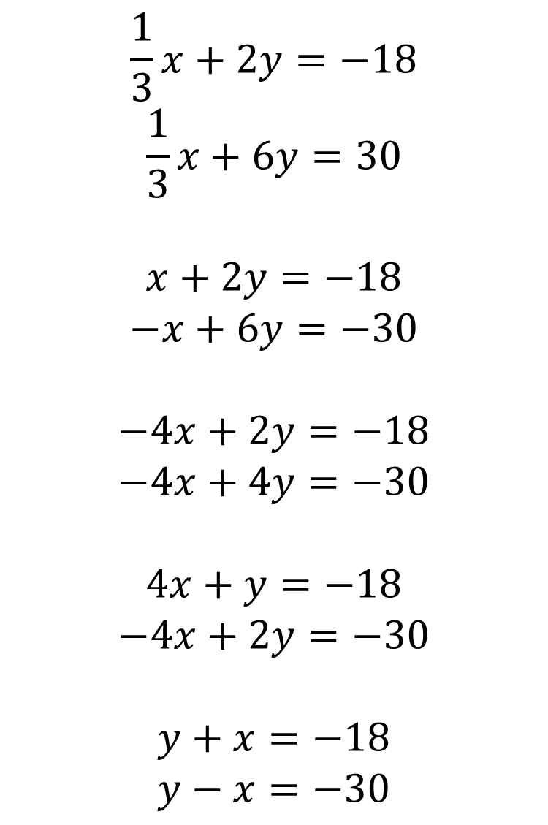
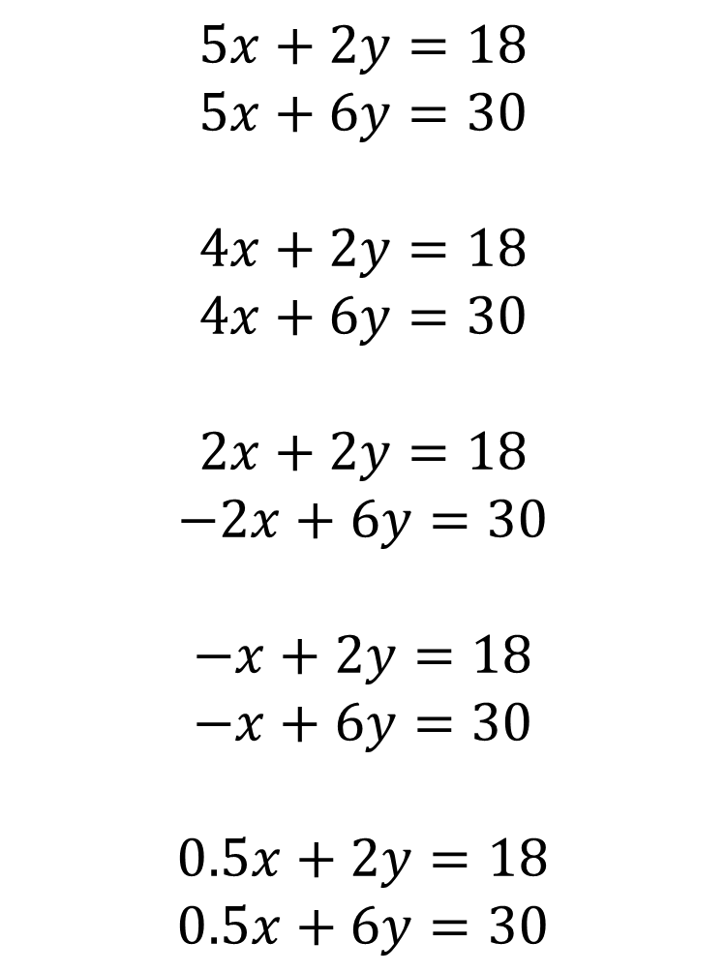
$$\frac{1}{3}x+2y=−18$$
$$\frac{1}{3}x+6y=30$$
$$x+2y=−18$$
$$−x+6y=−30$$
$$−4x+2y=−18$$
$$−4x+4y=−30$$
$$4x+y=−18$$
$$−4x+2y=−30$$
$$y+x=−18$$
$$y−x=−30$$
$$5x+2y=18$$
$$5x+6y=30$$
$$4x+2y=18$$
$$4x+6y=30$$
$$2x+2y=18$$
$$−2x+6y=30$$
$$−x+2y=18$$
$$−x+6y=30$$
$$0.5x+2y=18$$
$$0.5x+6y=30$$

Slide 4



$$4y=12$$
$$8y=48$$
$$8y=48$$
$$\frac{1}{3}x+2y=−18$$
$$\frac{1}{3}x+6y=30$$
$$x+2y=−18$$
$$−x+6y=−30$$
$$−4x+2y=−18$$
$$−4x+4y=−30$$
$$4x+y=−18$$
$$−4x+2y=−30$$
$$y+x=−18$$
$$y−x=−30$$
$$5x+2y=18$$
$$5x+6y=30$$
$$4x+2y=18$$
$$4x+6y=30$$
$$2x+2y=18$$
$$−2x+6y=30$$
$$−x+2y=18$$
$$−x+6y=30$$
$$0.5x+2y=18$$
$$0.5x+6y=30$$
$4y=48$
$8y=−48$
$$2y=−12$$
$$4y=12$$
$$4y=12$$
$$3y=−48$$
$$2y=−48$$

