Slide 1
Linear simultaneous Equations: Eliminating the variable $y$ (step 3)
Silent
Teacher
Intelligent Practice
Narration
Your Turn
$$2x+3y=18$$
$$6x+3y=30$$
$$2x+3y=18$$
$$6x−3y=30$$
$$2x+y=18$$
$$6x−y=30$$
Example
For more videos visit mrbartonmaths.com/videos

Slide 2
Worked Example
Your Turn
Eliminate a variable from the following sets of equations:
Eliminate a variable from the following sets of equations:
$$4x+7y=23$$
$$2x+7y=19$$
$$8x+7y=31$$
$$2x+7y=19$$
$$4x−0.2y=23$$
$$2x+0.2y=19$$
$$8x+0.5y=31$$
$$2x−0.5y=19$$

Slide 3
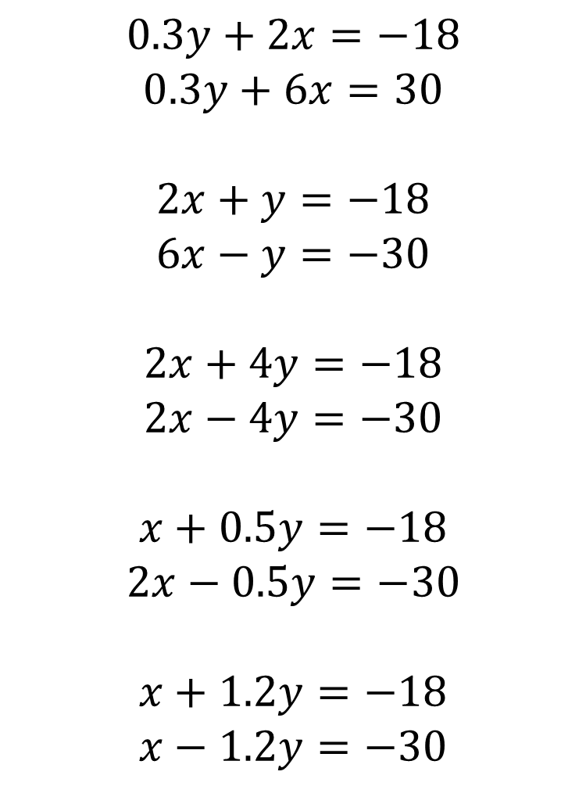
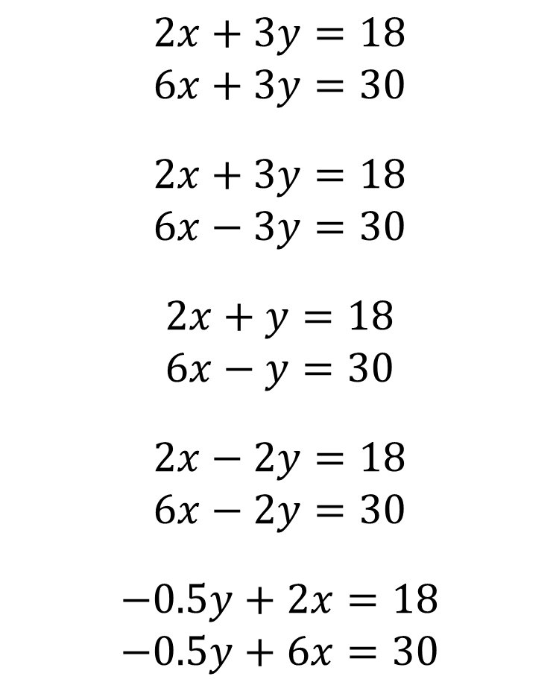
$$0.3y+2x=−18$$
$$0.3y+6x=30$$
$$2x+y=−18$$
$$6x−y=−30$$
$$2x+4y=−18$$
$$2x−4y=−30$$
$$x+0.5y=−18$$
$$2x−0.5y=−30$$
$$x+1.2y=−18$$
$$x−1.2y=−30$$
$$2x+3y=18$$
$$6x+3y=30$$
$$2x+3y=18$$
$$6x−3y=30$$
$$2x+y=18$$
$$6x−y=30$$
$$2x−2y=18$$
$$6x−2y=30$$
$$−0.5y+2x=18$$
$$−0.5y+6x=30$$

Slide 4



$$4x=12$$
$$8x=48$$
$$8x=48$$
$$0.3y+2x=−18$$
$$0.3y+6x=30$$
$$2x+y=−18$$
$$6x−y=−30$$
$$2x+4y=−18$$
$$2x−4y=−30$$
$$x+0.5y=−18$$
$$2x−0.5y=−30$$
$$x+1.2y=−18$$
$$x−1.2y=−30$$
$$2x+3y=18$$
$$6x+3y=30$$
$$2x+3y=18$$
$$6x−3y=30$$
$$2x+y=18$$
$$6x−y=30$$
$$2x−2y=18$$
$$6x−2y=30$$
$$−0.5y+2x=18$$
$$−0.5y+6x=30$$
$4x=48$
$8x=−48$
$$4x=−48$$
$$4x=12$$
$$4x=12$$
$$3x=−48$$
$$2x=−48$$

