Slide 1
Linear simultaneous Equations: Make y the same (step 2*)
Silent
Teacher
Intelligent Practice
Narration
Your Turn
$$4x−3y=−10$$
$$5x−2y=22$$
$$4x−6y=−10$$
$$5x−2y=22$$
Example
For more videos visit mrbartonmaths.com/videos

Slide 2
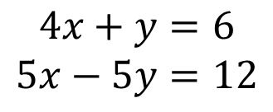
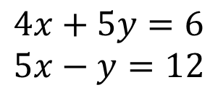
Worked Example
Your Turn
$$4x+5y=6$$
$$5x−y=12$$
$$4x+y=6$$
$$5x−5y=12$$

Slide 3
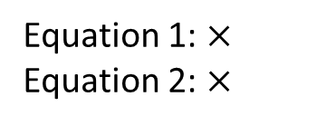
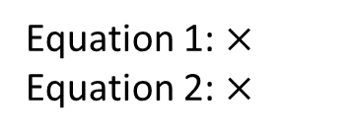
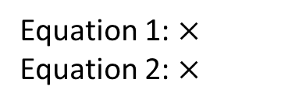
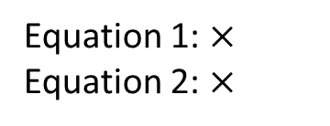
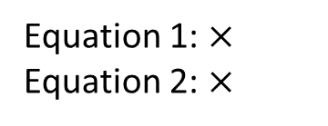
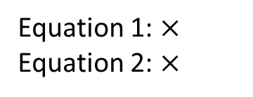
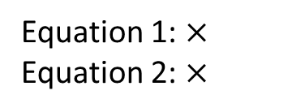
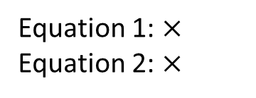
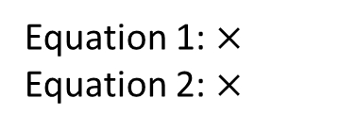
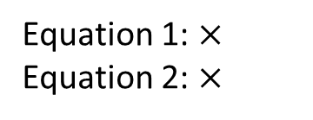
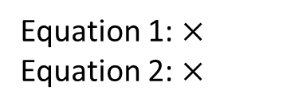
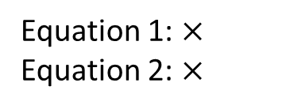
$$3x+y=10$$
$$5x+4y=22$$
$$3x+4y=10$$
$$5x+y=22$$
$$3x+3y=10$$
$$5x+y=22$$
$$4x+3y=10$$
$$5x+y=22$$
$$4x+3y=−10$$
$$5x+y=22$$
$$4x−3y=−10$$
$$5x+y=22$$
Equation 1: $×$
Equation 2: $×$
$$4x−3y=−10$$
$$5x−y=22$$
$$4x−3y=−10$$
$$5x−2y=22$$
$$4x−6y=−10$$
$$5x−2y=22$$
$$4x−6y=−10$$
$$5x−4y=22$$
$$4x+6y=−10$$
$$5x−4y=22$$
$$4x+6y=−10$$
$$5x−5y=22$$
Equation 1: $×$
Equation 2: $×$
Equation 1: $×$
Equation 2: $×$
Equation 1: $×$
Equation 2: $×$
Equation 1: $×$
Equation 2: $×$
Equation 1: $×$
Equation 2: $×$
Equation 1: $×$
Equation 2: $×$
Equation 1: $×$
Equation 2: $×$
Equation 1: $×$
Equation 2: $×$
Equation 1: $×$
Equation 2: $×$
Equation 1: $×$
Equation 2: $×$
Equation 1: $×$
Equation 2: $×$

Slide 4
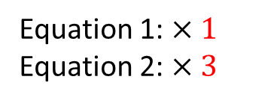
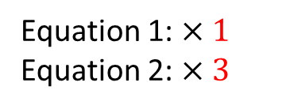
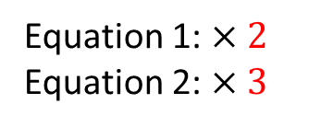
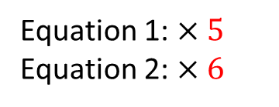
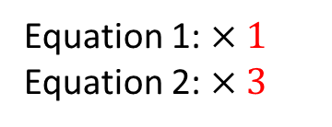
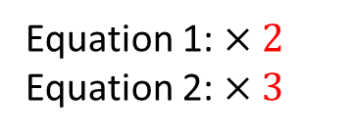
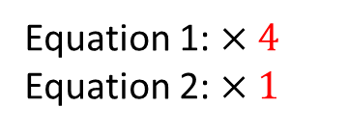
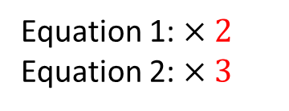
$$3x+y=10$$
$$5x+4y=22$$
$$3x+4y=10$$
$$5x+y=22$$
$$3x+3y=10$$
$$5x+y=22$$
$$4x+3y=10$$
$$5x+y=22$$
$$4x+3y=−10$$
$$5x+y=22$$
$$4x−3y=−10$$
$$5x+y=22$$
Equation 1: $×4$
Equation 2: $×1$
$$4x−3y=−10$$
$$5x−y=22$$
$$4x−3y=−10$$
$$5x−2y=22$$
$$4x−6y=−10$$
$$5x−2y=22$$
$$4x−6y=−10$$
$$5x−4y=22$$
$$4x+6y=−10$$
$$5x−4y=22$$
$$4x+6y=−10$$
$$5x−5y=22$$
Equation 1: $×1$
Equation 2: $×3$
Equation 1: $×1$
Equation 2: $×4$
Equation 1: $×2$
Equation 2: $×3$
Equation 1: $×1$
Equation 2: $×3$
Equation 1: $×1$
Equation 2: $×3$
Equation 1: $×1$
Equation 2: $×3$
Equation 1: $×2$
Equation 2: $×3$
Equation 1: $×1$
Equation 2: $×3$
Equation 1: $×2$
Equation 2: $×3$
Equation 1: $×1$
Equation 2: $×3$
Equation 1: $×5$
Equation 2: $×6$

