Slide 1
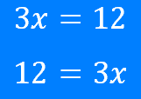
Linear simultaneous equations: Solving a linear equation (step 4)
Silent
Teacher
Intelligent Practice
Narration
Your Turn
Example
For more videos visit mrbartonmaths.com/videos

Slide 2
Worked Example
Your Turn
$$−6x=36$$
$$−8x=104$$
$$−4x=−52$$
$$−7x=−105$$

Slide 3
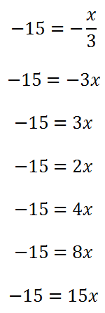
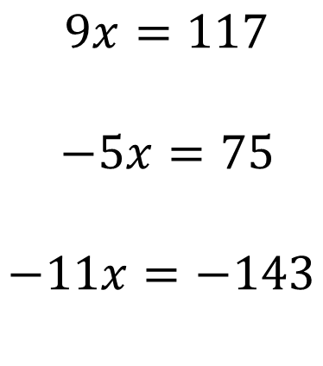
$9x=117$
$−5x=75$
$$−11x=−143$$

Slide 4
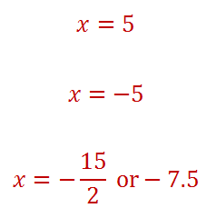
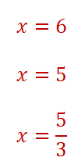
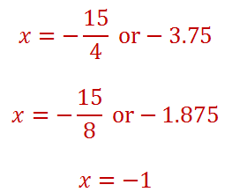
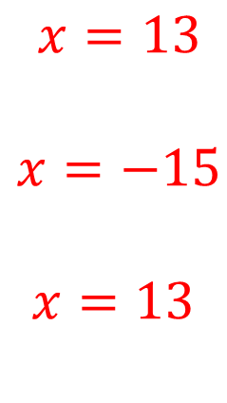
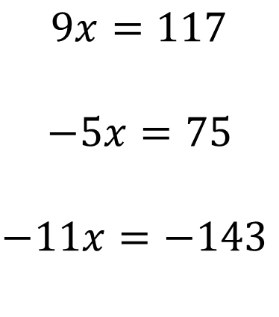
$9x=117$
$−5x=75$
$$−11x=−143$$
$x=13$
$x=−15$
$$x=13$$

