Slide 1
Linear simultaneous equations: Solving equations in the form ax + by = c using substitution (steps 5 and 6)
Silent
Teacher
Intelligent Practice
Narration
Your Turn
Solve $4x+2y=36 when x=10$
Solve $4x+2y=36 when x=−10$
Solve $4x+2y=36 when y=−10$
Solve $4x+2y=36 when y=10$
Example
For more videos visit mrbartonmaths.com/videos

Slide 2
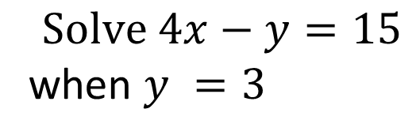
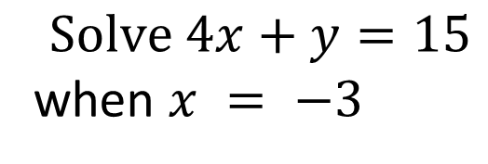
Worked Example
Your Turn
$$Solve 4x+y=15$$
when $x = −3$
$$Solve 4x+y=30$$
when $x=3$
$$Solve 4x−y=15$$
when $y =3$
$$Solve 4x−y=30$$
when $y=−3$

Slide 3
A) Solve $4x+2y=36 when x=10$
B) Solve $4x+2y=36 when x=−10$
C) Solve $4x+2y=36 when y=−10$
D) Solve $4x+2y=36 when y=10$
E) Solve $4x−2y=36 when y=10$
F) Solve $4x−2y=36 when y=−10$
G) Solve $4x−2y=36 when y=−1$
H) Solve $4x−2y=36 when x=−1$
I) Solve $4x−2y=36 when x=1$
J) Solve $−4x+2y=36 when x=1$
K) Solve $−4x+2y=36 when y=1$
L) Solve $−4x+2y=36 when x=−1$
M) Solve $−4x+2y=36 when y=−1$
N) Solve $−4x−2y=36 when y=−1$
O) Solve $4x+2y=−36 when y=−1$
P) Solve $4x−2y=−36 when y=−1$
Q) Solve $−4x−2y=−36 when y=−1$

Slide 4
A) Solve $4x+2y=36 when x=10$
$$y=−2$$
B) Solve $4x+2y=36 when x=−10$
$$y=38$$
C) Solve $4x+2y=36 when y=−10$
$$x=14$$
D) Solve $4x+2y=36 when y=10$
$$x=4$$
E) Solve $4x−2y=36 when y=10$
$$x=14$$
F) Solve $4x−2y=36 when y=−10$
$$x=4$$
G) Solve $4x−2y=36 when y=−1$
$$x=9.5$$
H) Solve $4x−2y=36 when x=−1$
$$y=−20$$
I) Solve $4x−2y=36 when x=1$
$$y=−16$$
J) Solve $−4x+2y=36 when x=1$
$$y=20$$
K) Solve $−4x+2y=36 when y=1$
$$x=−8.5$$
L) Solve $−4x+2y=36 when x=−1$
$$y=16$$
M) Solve $−4x+2y=36 when y=−1$
$$y=−9.5$$
N) Solve $−4x−2y=36 when y=−1$
$$y=−8.5$$
O) Solve $4x+2y=−36 when y=−1$
$$y=−8.5$$
P) Solve $4x−2y=−36 when y=−1$
$$y=−9.5$$
Q) Solve $−4x−2y=−36 when y=−1$
$$y=9.5$$

