Slide 1
Coordinates: Naming 2D coordinates – quadrant 1
True/false
Reflect
Your Turn
$$(4, 2)$$
$$(3, 2)$$
$$(2, 2)$$
Rule

Slide 2
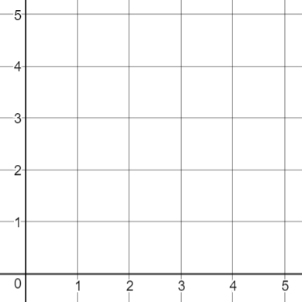
$$4.2$$
$$(4, 2)$$
True / False
True / False
$$2.4$$
$$\left[\begin{aligned}4 \\ 2\end{aligned}\right]$$
True / False
True / False
$$(2, 4)$$
$$[4, 2]$$
True / False
True / False
@mrbartonmaths

Slide 3
@mrbartonmaths

Slide 4
@mrbartonmaths

Slide 5
@mrbartonmaths

Slide 6
$$4.2$$
$$(4, 2)$$
True / False
True / False
$$2.4$$
$$\left[\begin{aligned}4 \\ 2\end{aligned}\right]$$
True / False
True / False
$$(2, 4)$$
$$[4, 2]$$
True / False
True / False
@mrbartonmaths

Slide 7
$$(4, 2)$$
$$(1, 2)$$
$$(3, 2)$$
$$(0, 2)$$
$$(2, 2)$$
$$(0, 3)$$
@mrbartonmaths

Slide 8
$$(0, 5)$$
$$(1, 5)$$
$$(5, 0)$$
$$(1, 4)$$
$$(5, 1)$$
$$(4, 1)$$
@mrbartonmaths

Slide 9
$$(3, 1)$$
$$(0, 0)$$
$$(3, 0)$$
$$(4, 4)$$
$$(0, 3)$$
$$(4, 3.5)$$
@mrbartonmaths

Slide 10
Your Turn
@mrbartonmaths

Slide 11
Your Turn - answers
$$(2, 3)$$
$$(5, 0)$$
$$(5, 3)$$
$$(4.5, 0.5)$$
@mrbartonmaths

