Slide 1
Straight Line Graphs: Gradient between two points
Silent
Teacher
Intelligent Practice
Narration
Your Turn
$\left(4,−2\right)$ and $\left(0,0\right)$
$\left(5,−1\right)$ and $\left(1,1\right)$
$\left(10,−2\right)$ and $\left(2,2\right)$
Practice

Slide 2
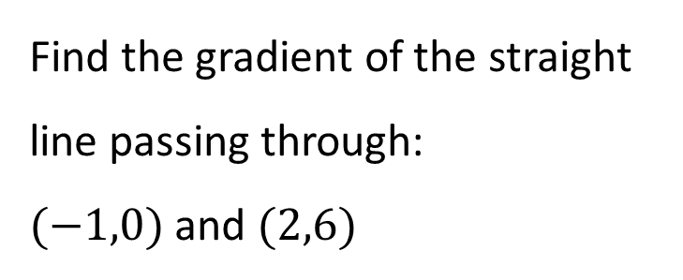
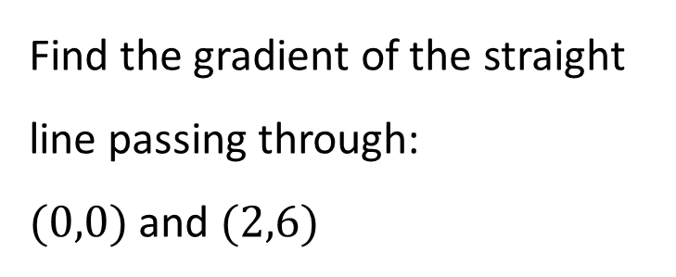
Worked Example
Your Turn
Find the gradient of the straight line passing through:
$(0,0)$ and $(2,6)$
Find the gradient of the straight line passing through:
$(−1,0)$ and $(2,6)$
@fortyninecubed

Slide 3
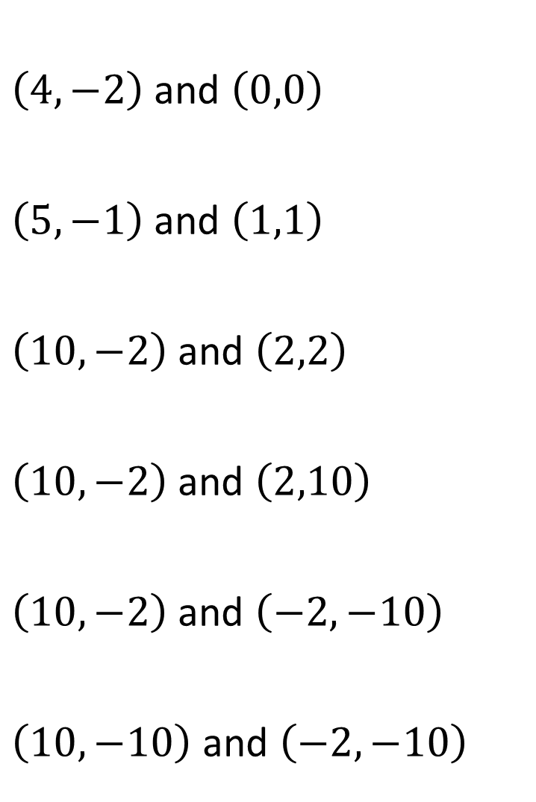
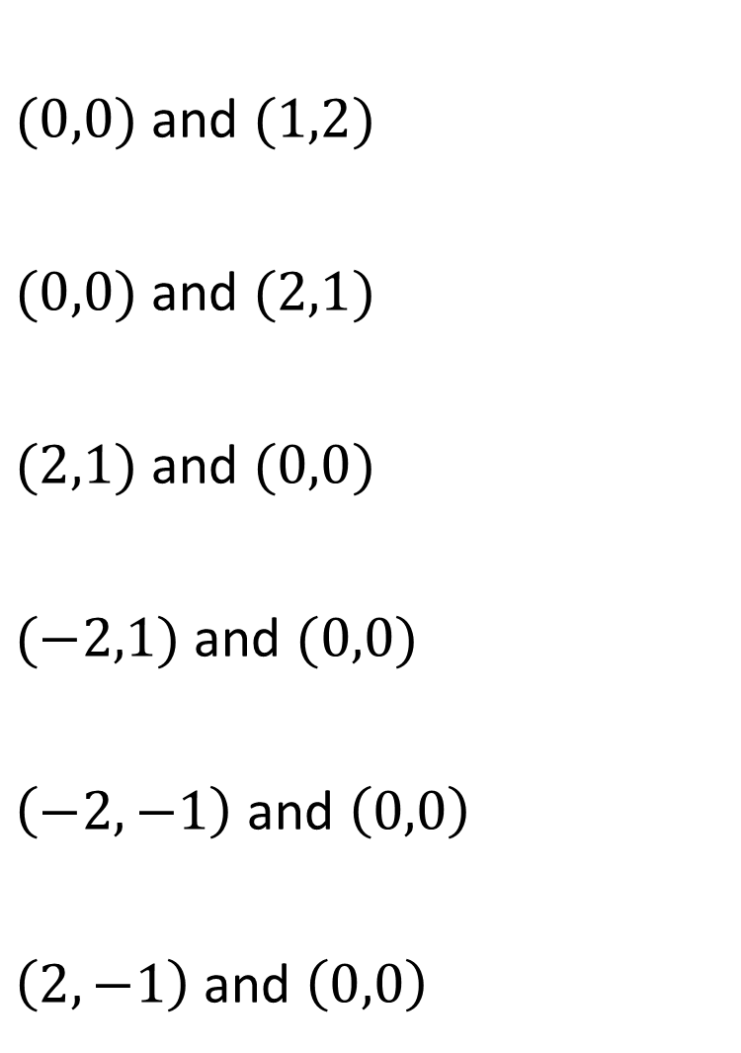
$(0,0)$ and $(1,2)$
$(0,0)$ and $(2,1)$
$(2,1)$ and $(0,0)$
$(−2,1)$ and $(0,0)$
$\left(−2,−1\right)$ and $\left(0,0\right)$
$\left(2,−1\right)$ and $\left(0,0\right)$
$\left(4,−2\right)$ and $\left(0,0\right)$
$\left(5,−1\right)$ and $\left(1,1\right)$
$\left(10,−2\right)$ and $\left(2,2\right)$
$\left(10,−2\right)$ and $\left(2,10\right)$
$\left(10,−2\right)$ and $\left(−2,−10\right)$
$\left(10,−10\right)$ and $\left(−2,−10\right)$
@fortyninecubed

Slide 4



$(0,0)$ and $(1,2)$
$(0,0)$ and $(2,1)$
$(2,1)$ and $(0,0)$
$(−2,1)$ and $(0,0)$
$\left(−2,−1\right)$ and $\left(0,0\right)$
$\left(2,−1\right)$ and $\left(0,0\right)$
$\left(4,−2\right)$ and $\left(0,0\right)$
$\left(5,−1\right)$ and $\left(1,1\right)$
$\left(10,−2\right)$ and $\left(2,2\right)$
$\left(10,−2\right)$ and $\left(2,10\right)$
$\left(10,−2\right)$ and $\left(−2,−10\right)$
$\left(10,−10\right)$ and $\left(−2,−10\right)$
$$−\frac{1}{2}$$
$$−\frac{1}{2}$$
$$−\frac{1}{2}$$
$$−\frac{3}{2}$$
$$\frac{2}{3}$$
$$0$$
$$2$$
$$\frac{1}{2}$$
$$\frac{1}{2}$$
$$−\frac{1}{2}$$
$$\frac{1}{2}$$
$$−\frac{1}{2}$$
@fortyninecubed

