Slide 1
Indices: Multiplication and division rules
True/false
Reflect
Your Turn
$x^{2} × x^{3}$ = $x^{6}$
$x^{4} × x^{5}$ = $x^{20}$
$x^{6}÷ x^{3}$ = $x^{3}$
Rule

Slide 2
$x^{2} × x^{3}$ = $x^{6}$
$x^{8} ÷ x^{2}$ = $x^{4}$
$x^{4} × x^{5}$ = $x^{20}$
$x^{6}÷ x^{3}$ = $x^{3}$
$x^{3} × x^{6}$ = $x^{9}$
$x^{27}÷ x^{3}$ = $x^{24}$
$x^{} × x^{7}$ = $x^{7}$
$x^{5}÷x^{5}$ = $x^{1}$
$x^{5} × x^{}$ = $x^{6}$
$x^{4}÷x^{4}$ = $x^{0}=1$

Slide 3
$x^{2} × x^{3}$ = $x^{6}$
FALSE
$x^{8} ÷ x^{2}$ = $x^{4}$
FALSE
$x^{4} × x^{5}$ = $x^{20}$
FALSE
$x^{6}÷ x^{3}$ = $x^{3}$
TRUE
$x^{3} × x^{6}$ = $x^{9}$
TRUE
$x^{27}÷ x^{3}$ = $x^{24}$
TRUE
$x^{} × x^{7}$ = $x^{7}$
FALSE
$x^{5}÷x^{5}$ = $x^{1}$
FALSE
$x^{5} × x^{}$ = $x^{6}$
TRUE
$x^{4}÷x^{4}$ = $x^{0}=1$
TRUE

Slide 4
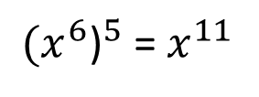
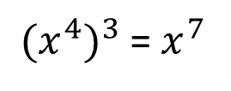
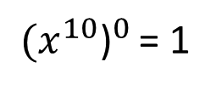
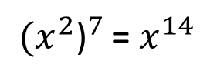
${{(x}^{4})}^{3}$= $x^{7}$
${{(x}^{6}\text{)}}^{5}$ = $x^{11}$
${{(x}^{2}\text{)}}^{7 }$= $x^{14}$
${{(x}^{10}\text{)}}^{0 }$= 1

Slide 5
Can you now write
the rules for indices
in your book, in your
own words.
Write an example of
each.
${{(x}^{4})}^{3}$= $x^{7}$
FALSE
${{(x}^{6}\text{)}}^{5}$ = $x^{11}$
FALSE
${{(x}^{2}\text{)}}^{7 }$= $x^{14}$
TRUE
${{(x}^{10}\text{)}}^{0 }$= 1
TRUE

