Slide 1
Fractions: Adding fractions with different denominators
Silent
Teacher
Intelligent Practice
Narration
Your Turn
$$\frac{2}{5}+ \frac{2}{3}=$$
$$\frac{2}{5}+ \frac{2}{7}=$$
Practice

Slide 2
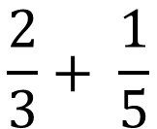
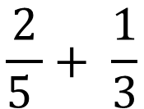
Worked Example
Your Turn
$$\frac{2}{5 }+ \frac{1}{3}$$
$$\frac{2}{3}+ \frac{1}{5}$$

Slide 3


$$\frac{1}{7}+ \frac{2}{5}$$
$$\frac{2}{5}+ \frac{1}{7}$$
$$\frac{2}{5}+ \frac{2}{7}$$
$$\frac{2}{5}+ \frac{2}{3}$$
$$\frac{1}{4}+ \frac{2}{3}$$
$$\frac{3}{4}+ \frac{2}{3}$$
$$\frac{3}{4}+ \frac{2}{5}$$
$$\frac{3}{40 }+ \frac{2}{5}$$
$$\frac{3}{4}+ \frac{3}{5}$$
$$\frac{3}{4}+ \frac{6}{10}$$

Slide 4
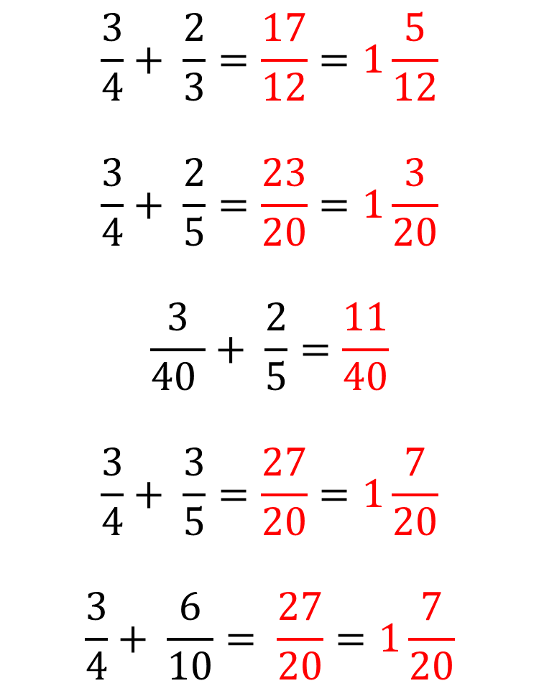
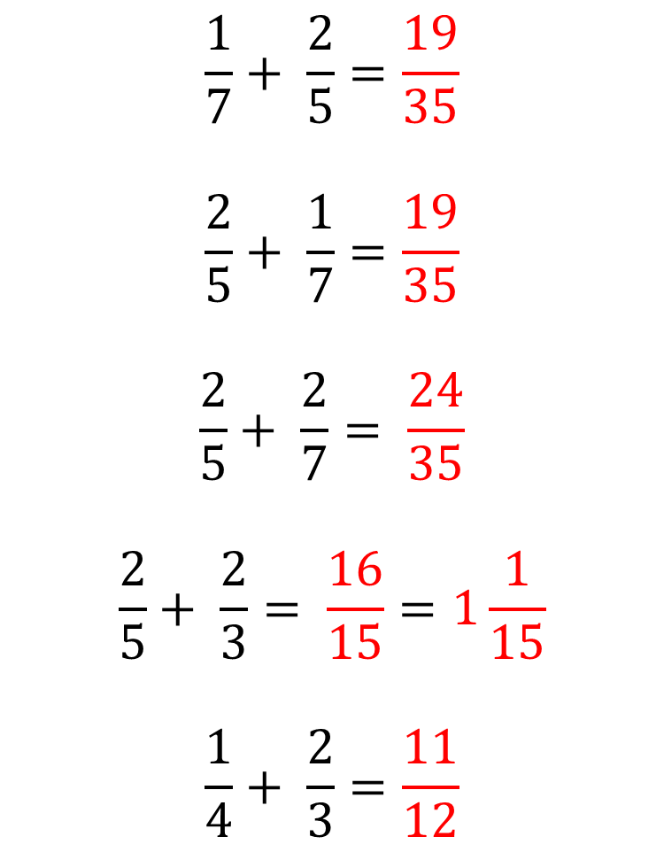
$$\frac{1}{7}+ \frac{2}{5}=\frac{19}{35}$$
$$\frac{2}{5}+ \frac{1}{7}=\frac{19}{35}$$
$$\frac{2}{5}+ \frac{2}{7}= \frac{24}{35}$$
$$\frac{2}{5}+ \frac{2}{3}= \frac{16}{15}=1\frac{1}{15}$$
$$\frac{1}{4}+ \frac{2}{3}=\frac{11}{12}$$
$$\frac{3}{4}+ \frac{2}{3}=\frac{17}{12}=1\frac{5}{12}$$
$$\frac{3}{4}+ \frac{2}{5}=\frac{23}{20}=1\frac{3}{20}$$
$$\frac{3}{40 }+ \frac{2}{5}=\frac{11}{40}$$
$$\frac{3}{4}+ \frac{3}{5}=\frac{27}{20}=1\frac{7}{20}$$
$$\frac{3}{4}+ \frac{6}{10}= \frac{27}{20}=1\frac{7}{20}$$

