Slide 1
Circles: Perimeter of part of a circle
Silent
Teacher
Intelligent Practice
Narration
Your Turn
Practice
For more videos visit mrbartonmaths.com/videos

Slide 2
Worked Example
Your Turn
6cm
12cm
@kgillies86

Slide 3
8cm
4cm
4cm
@kgillies86

Slide 4
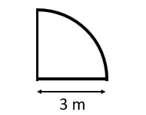
2cm
2cm
0.2cm
@kgillies86

Slide 5
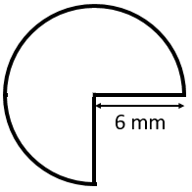
0.2cm
0.4cm
@kgillies86

Slide 6
20.57 cm
8cm
10.28 cm
4cm
20.57 cm
4cm
@kgillies86

Slide 7
10.28 cm
2cm
7.14 cm
2cm
0.71 cm
0.2cm
@kgillies86

Slide 8
1.34 cm
0.2cm
2.68 cm
0.4cm
@kgillies86

