Slide 1
Proportion: Direct proportion ($x^{2}$)
Silent
Teacher
Intelligent Practice
Narration
Your Turn
$$Find y when x=3$$
$$When y=50, x=5$$
$$Find y when x=2$$
$$When y=50, x=5$$
Practice

Slide 2
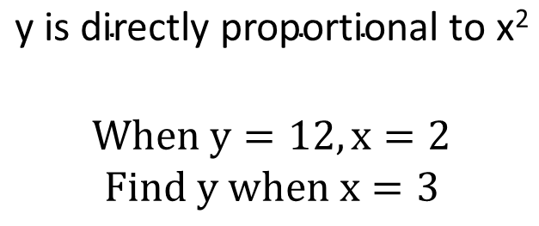
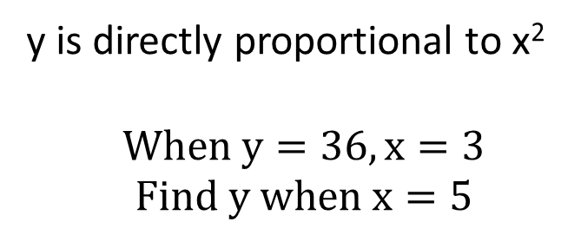
Worked Example
Your Turn
y is directly proportional to x²
$$When y=36, x=3$$
$$Find y when x=5$$
$$\text{y} \text{is} \text{directly} \text{proportional} \text{to} \text{x}\text{2}$$
$$When y=12, x=2$$
$$Find y when x=3$$

Slide 3
y is directly proportional to x²…
$$When y=50, x=5$$
$$Find y when x=3$$
$$When y=64, x=4$$
$$Find y when x=6$$
$$When y=50, x=5$$
$$Find y when x=2$$
$$When y=32, x=4$$
$$Find y when x=6$$
$$When y=48, x=4$$
$$Find y when x=2$$
$$When y=18, x=6$$
$$Find y when x=8$$
$$When y=48, x=4$$
$$Find y when x=6$$
$$When y=1, x=2$$
$$Find y when x=6$$

Slide 4
y is directly proportional to x²…
$$When y=50, x=5$$
$$Find y when x=3$$
$$When y=64, x=4$$
$$Find y when x=6$$
$$y=18$$
$$y=144$$
$$When y=50, x=5$$
$$Find y when x=2$$
$$When y=32, x=4$$
$$Find y when x=6$$
$$y=8$$
$$y=72$$
$$When y=48, x=4$$
$$Find y when x=2$$
$$When y=18, x=6$$
$$Find y when x=8$$
$$y=12$$
$$y=32$$
$$When y=48, x=4$$
$$Find y when x=6$$
$$When y=1, x=2$$
$$Find y when x=6$$
$$y=108$$
$$y=9$$

Slide 5
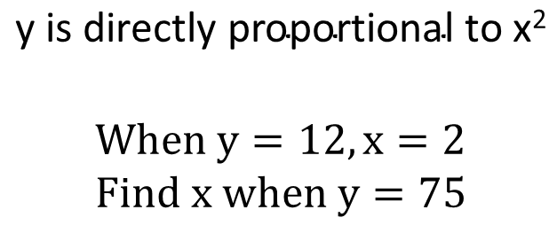
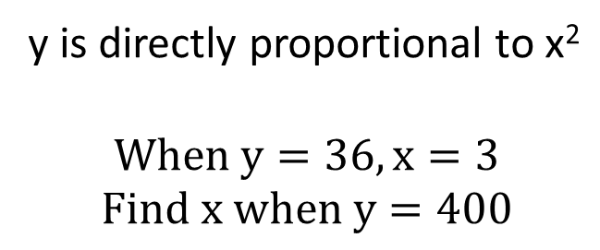
Worked Example
Your Turn
y is directly proportional to x²
$$When y=36, x=3$$
$$Find x when y=400$$
$$\text{y} \text{is} \text{directly} \text{proportional} \text{to} \text{x}\text{2}$$
$$When y=12, x=2$$
$$Find x when y=75$$

Slide 6
y is directly proportional to x²…
$$When y=75, x=5$$
$$Find x when y=3$$
$$When y=64, x=4$$
$$Find x when y=324$$
$$When y=75, x=5$$
$$Find x when y=27$$
$$When y=32, x=4$$
$$Find x when y=8$$
$$When y=80, x=4$$
$$Find x when y=125$$
$$When y=18, x=6$$
$$Find x when y=8$$
$$When y=80, x=4$$
$$Find x when y=500$$
$$When y=5, x=5$$
$$Find x when y=20$$

Slide 7


y is directly proportional to x²…
$$When y=75, x=5$$
$$Find x when y=3$$
$$When y=64, x=4$$
$$Find x when y=324$$
$$x=1$$
$$x=9$$
$$When y=75, x=5$$
$$Find x when y=27$$
$$When y=32, x=4$$
$$Find x when y=8$$
$$x=3$$
$$x=2$$
$$When y=80, x=4$$
$$Find x when y=125$$
$$When y=18, x=6$$
$$Find x when y=8$$
$$x=5$$
$$x=4$$
$$When y=80, x=4$$
$$Find x when y=500$$
$$When y=5, x=5$$
$$Find x when y=20$$
$$x=10$$
$$x=10$$

