Slide 1
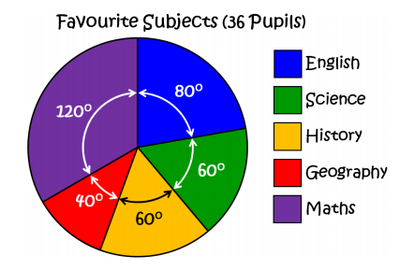
Worked example
Your Turn
Work out how many students
chose each subject
Work out how many students
chose each subject
(18 pupils)

Slide 2
Worked example
Your Turn
Work out how many students
chose each subject
Work out how many students
chose each subject
(18 pupils)
8
6
6
4
12
4
3
3
2
6

Slide 3
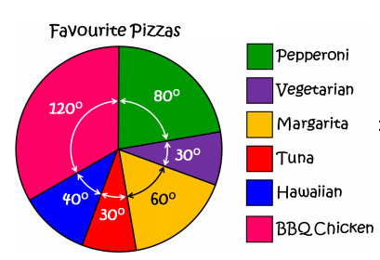
Intelligent Practise Task
Work out how many
students chose each
Pizza, if 360 people were
asked
Work out how many
students chose each
Pizza, if 36 people were
asked
Work out how many
students chose each
Pizza, if 72 people were
asked

Slide 4
Intelligent Practise Task - Answers
80
30
60
30
40
120
8
3
6
3
4
12
16
6
12
6
8
24
Work out how many
students chose each
Pizza, if 360 people were
asked
Work out how many
students chose each
Pizza, if 36 people were
asked
Work out how many
students chose each
Pizza, if 72 people were
asked

Slide 5
Worked example
Your Turn
Work out how many students
chose each subject if 60 people
chose Maths?
Work out how many students
chose each subject if 12 people
chose Geography?

Slide 6
Worked example
Your Turn
Work out how many students
chose each subject if 60 people
chose Maths?
Work out how many students
chose each subject if 12 people
chose Geography?
40
30
30
20
60
24
18
18
12
36

Slide 7
Intelligent Practise Task:
Work out how many
students chose each
Pizza, if 360 people were
asked
Work out how many
students chose each
Pizza, if 36 people like
margarita
Work out how many
students chose each
Pizza, if 72 people like
margarita

Slide 8
Intelligent Practise Task - Answers
80
30
60
30
40
120
8
3
6
3
4
12
16
6
12
6
8
24
Work out how many
students chose each
Pizza, if 360 people were
asked
Work out how many
students chose each
Pizza, if 36 people like
margarita
Work out how many
students chose each
Pizza, if 72 people like
margarita

Slide 9
Intelligent Practise Task:
Work out how many
students chose each
Pizza, if 12 people like
margarita
Work out how many
students chose each
Pizza, if 24 people like
margarita
Work out how many
students chose each
Pizza, if 6 people like
margarita

Slide 10
Intelligent Practise Task - Answers
16
6
12
6
8
24
8
3
6
3
4
12
32
12
24
12
16
48
Work out how many
students chose each
Pizza, if 12 people like
margarita
Work out how many
students chose each
Pizza, if 24 people like
margarita
Work out how many
students chose each
Pizza, if 6 people like
margarita

Slide 11
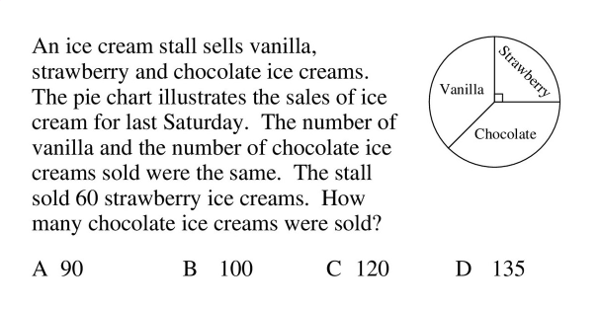
Expert Task:

Slide 12
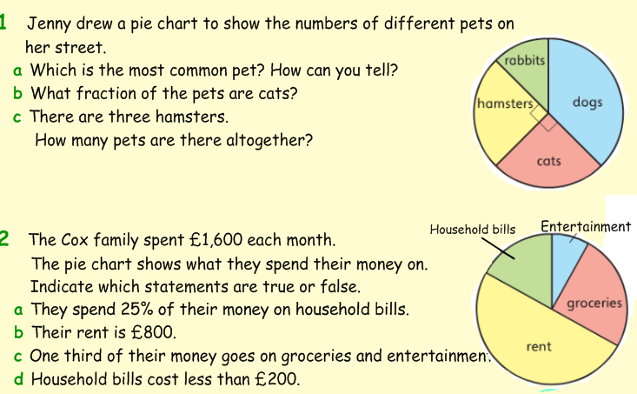
Expert Task:

Slide 13
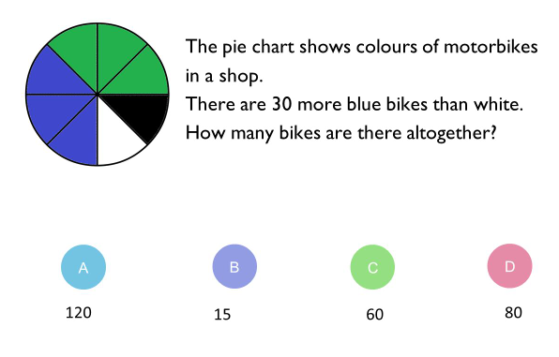
Time to wrap it up:

