Slide 1
Order of operations (BIDMAS): Roots
Silent
Teacher
Intelligent Practice
Narration
Your Turn
$$12+\sqrt{4×9}=$$
$$\sqrt{12+4}×9=$$
$$12+\sqrt{4}×9=$$
Practice

Slide 2
Worked Example
Your Turn
$$3×9−\sqrt{16}=$$
$$3×16−\sqrt{9}=$$
$$\sqrt{25}×2+14=$$
$$\sqrt{25×2+14}=$$
@kgillies86

Slide 3
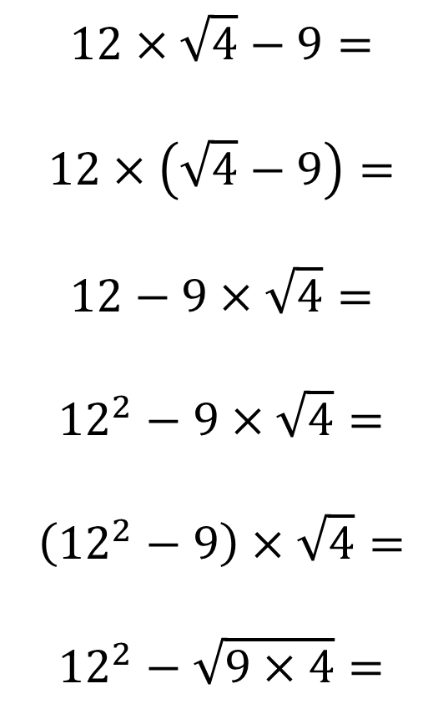
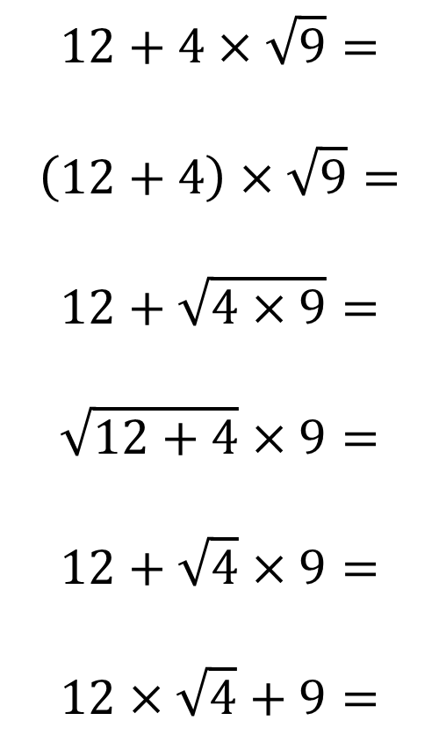
$$12+4×\sqrt{9}=$$
$$\left(12+4\right)×\sqrt{9}=$$
$$12+\sqrt{4×9}=$$
$$\sqrt{12+4}×9=$$
$$12+\sqrt{4}×9=$$
$$12×\sqrt{4}+9=$$
$$12×\sqrt{4}−9=$$
$$12×\left(\sqrt{4}−9\right)=$$
$$12−9×\sqrt{4}=$$
$${12}^{2}−9×\sqrt{4}=$$
$$\left({12}^{2}−9\right)×\sqrt{4}=$$
$${12}^{2}−\sqrt{9×4}=$$
@kgillies86

Slide 4
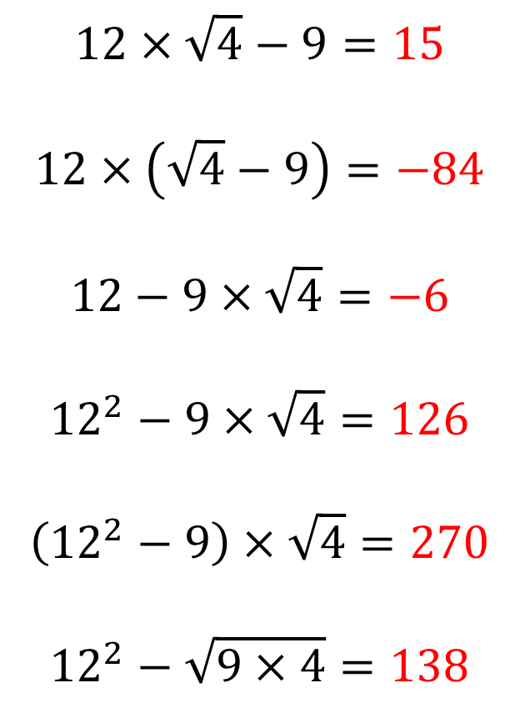
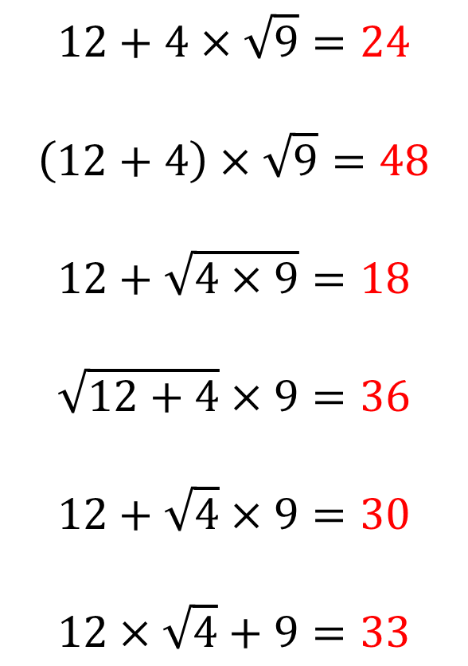
$$12+4×\sqrt{9}=24$$
$$\left(12+4\right)×\sqrt{9}=48$$
$$12+\sqrt{4×9}=18$$
$$\sqrt{12+4}×9=36$$
$$12+\sqrt{4}×9=30$$
$$12×\sqrt{4}+9=33$$
$$12×\sqrt{4}−9=15$$
$$12×\left(\sqrt{4}−9\right)=−84$$
$$12−9×\sqrt{4}=−6$$
$${12}^{2}−9×\sqrt{4}=126$$
$$\left({12}^{2}−9\right)×\sqrt{4}=270$$
$${12}^{2}−\sqrt{9×4}=138$$
@kgillies86

