Slide 1
Simplifying Expressions: Multiplying and dividing terms
Silent
Teacher
Intelligent Practice
Narration
Your Turn
$$m^{2}×m^{3}$$
$$m^{2}×m^{4}$$
$m^{2}×m^{2}$ $×m^{2}$
Practice

Slide 2
Worked Example
Your Turn
$$m^{4} x m^{4}$$
$$x^{4} x x^{4}$$
$$m^{6} x m^{4}$$
$$x^{6} x x^{4}$$

Slide 3
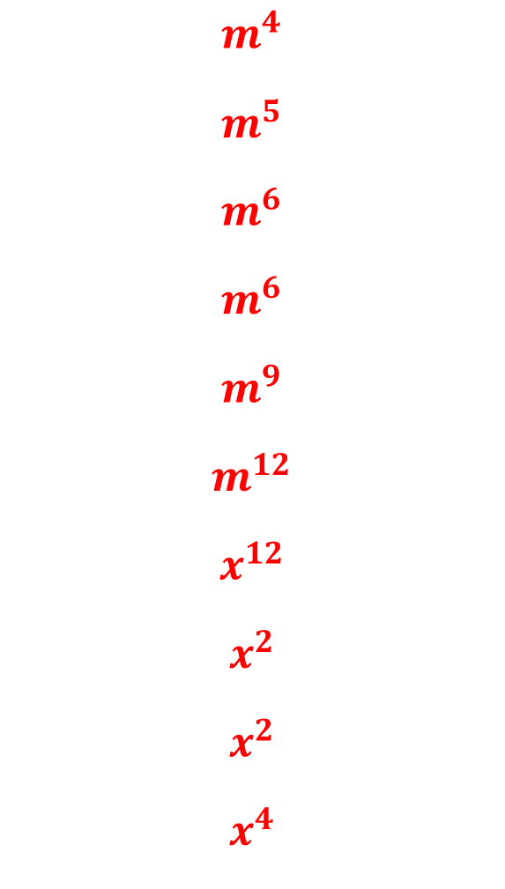
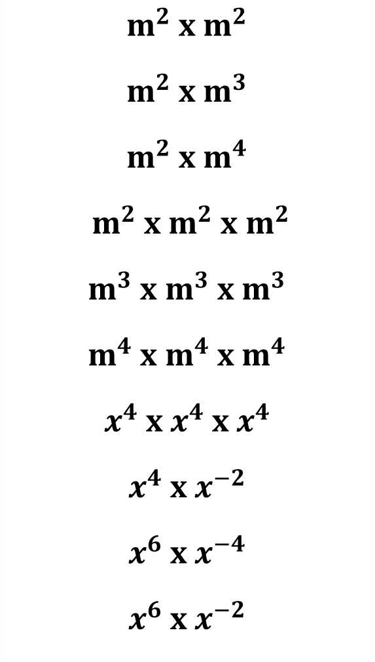
$$m^{2} x m^{2}$$
$$m^{2} x m^{3}$$
$$m^{2} x m^{4}$$
$$m^{2} x m^{2} x m^{2}$$
$$m^{3} x m^{3} x m^{3}$$
$$m^{4} x m^{4} x m^{4}$$
$$x^{4} x x^{4} x x^{4}$$
$$x^{4} x x^{−2}$$
$$x^{6} x x^{−4}$$
$$x^{6} x x^{−2}$$
$$m^{4}$$
$$m^{5}$$
$$m^{6}$$
$$m^{6}$$
$$m^{9}$$
$$m^{12}$$
$$x^{12}$$
$$x^{2}$$
$$x^{2}$$
$$x^{4}$$

Slide 4
Worked Example
Your Turn
$${3m}^{4} x m^{4}$$
$${2x}^{4} x x^{4}$$
$${2m}^{6} x {3m}^{4}$$
$${2x}^{6} x {4x}^{4}$$

Slide 5
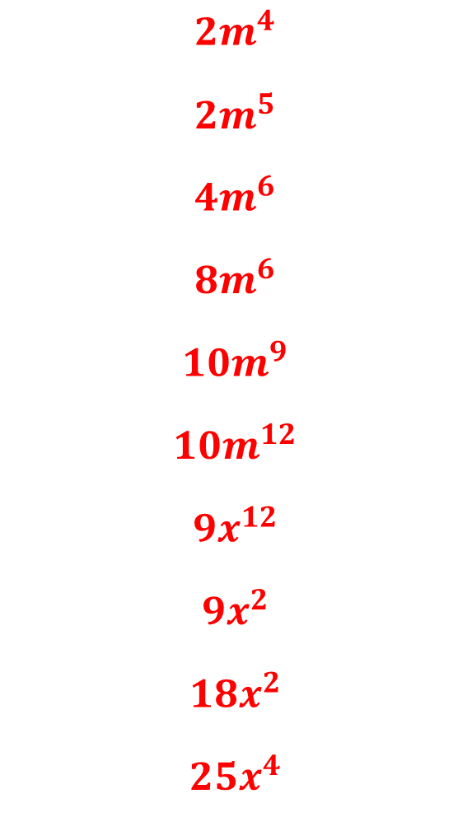
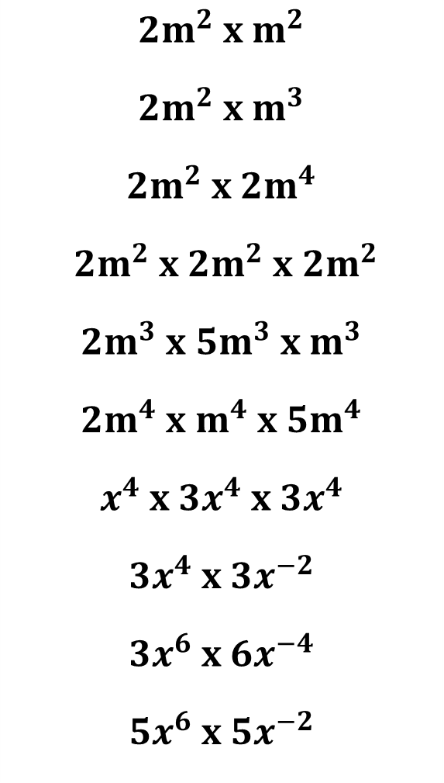
$${2m}^{2} x m^{2}$$
$$2m^{2} x m^{3}$$
$${2m}^{2} x {2m}^{4}$$
$${2m}^{2} x {2m}^{2} x {2m}^{2}$$
$$2m^{3} x {5m}^{3} x m^{3}$$
$${2m}^{4} x m^{4} x {5m}^{4}$$
$$x^{4} x {3x}^{4} x {3x}^{4}$$
$${3x}^{4} x {3x}^{−2}$$
$${3x}^{6} x {6x}^{−4}$$
$${5x}^{6} x {5x}^{−2}$$
$${2m}^{4}$$
$$2m^{5}$$
$${4m}^{6}$$
$${8m}^{6}$$
$${10m}^{9}$$
$${10m}^{12}$$
$${9x}^{12}$$
$$9x^{2}$$
$$18x^{2}$$
$${25x}^{4}$$

Slide 6
Worked Example
Your Turn
$$m^{8}÷ m^{2}$$
$$x^{6}÷ x^{2}$$
$$m^{8}÷ m^{8}$$
$$x^{6}÷ x^{6}$$

Slide 7
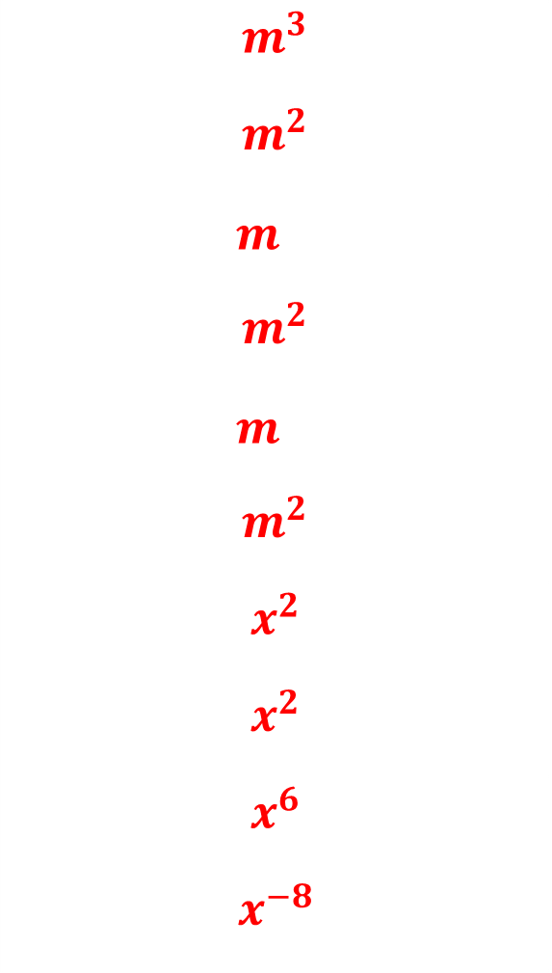
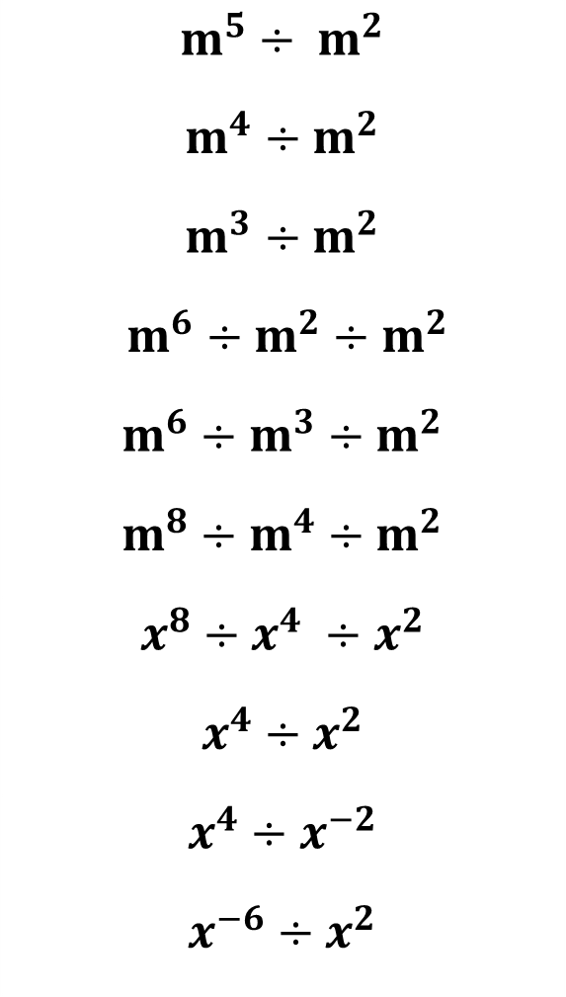
$$m^{5}÷ m^{2}$$
$$m^{4}÷m^{2}$$
$$m^{3}÷m^{2}$$
$$m^{6}÷m^{2}÷m^{2}$$
$$m^{6}÷m^{3}÷m^{2}$$
$$m^{8}÷m^{4}÷m^{2}$$
$$x^{8}÷x^{4} ÷x^{2}$$
$$x^{4}÷x^{2}$$
$$x^{4}÷x^{−2}$$
$$x^{−6}÷x^{2}$$
$$m^{3}$$
$$m^{2}$$
$$m^{}$$
$$m^{2}$$
$$m^{}$$
$$m^{2}$$
$$x^{2}$$
$$x^{2}$$
$$x^{6}$$
$$x^{−8}$$

Slide 8
Worked Example
Your Turn
$$6m^{8}÷ {2m}^{2}$$
$${4x}^{6}÷ {2x}^{2}$$
$${6m}^{8}÷ {3m}^{8}$$
$${8x}^{6}÷ {2x}^{6}$$

Slide 9
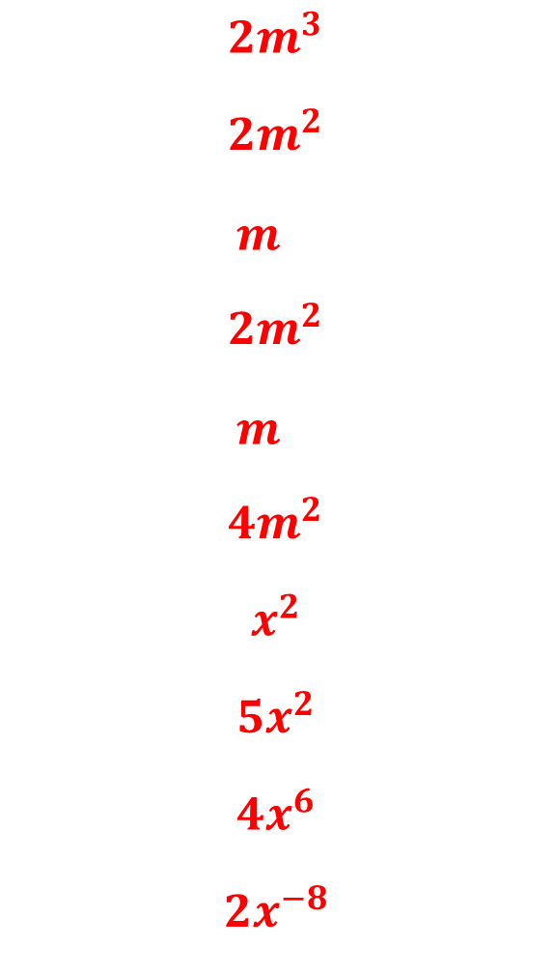
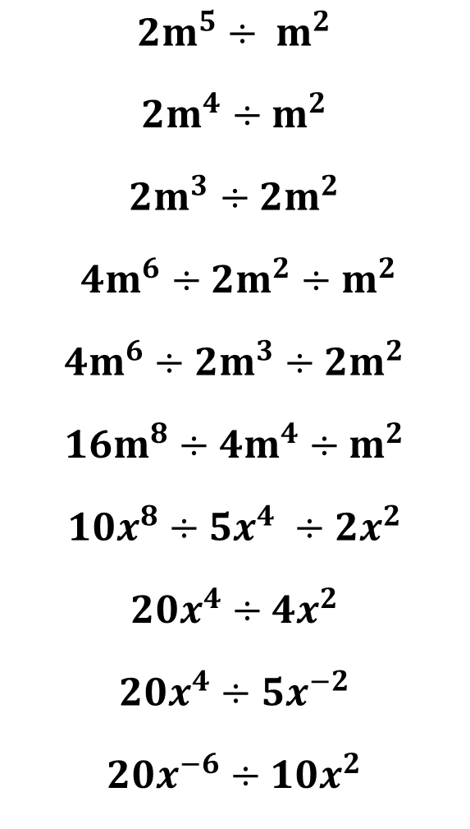
$${2m}^{5}÷ m^{2}$$
$${2m}^{4}÷m^{2}$$
$${2m}^{3}÷{2m}^{2}$$
$${4m}^{6}÷{2m}^{2}÷m^{2}$$
$${4m}^{6}÷{2m}^{3}÷{2m}^{2}$$
$${16m}^{8}÷{4m}^{4}÷m^{2}$$
$${10x}^{8}÷{5x}^{4} ÷{2x}^{2}$$
$$20x^{4}÷{4x}^{2}$$
$$20x^{4}÷{5x}^{−2}$$
$${20x}^{−6}÷{10x}^{2}$$
$${2m}^{3}$$
$$2m^{2}$$
$$m^{}$$
$${2m}^{2}$$
$$m^{}$$
$${4m}^{2}$$
$$x^{2}$$
$${5x}^{2}$$
$${4x}^{6}$$
$${2x}^{−8}$$

