Slide 1
Surds: Adding
Silent
Teacher
Intelligent Practice
Narration
Your Turn
$$2\sqrt{3}+5\sqrt{3}$$
$$2\sqrt{3}+5\sqrt{6}$$
$$2\sqrt{3}+5\sqrt{12}$$
Practice

Slide 2
Worked Example
Your Turn
$$2\sqrt{5}+5\sqrt{5}$$
$$2\sqrt{6}+5\sqrt{6}$$
$$2\sqrt{20}+5\sqrt{5}$$
$$2\sqrt{54}+5\sqrt{6}$$
$$2\sqrt{20}+5\sqrt{10}$$
$$2\sqrt{20}+5\sqrt{15}$$
@fortyninecubed

Slide 3
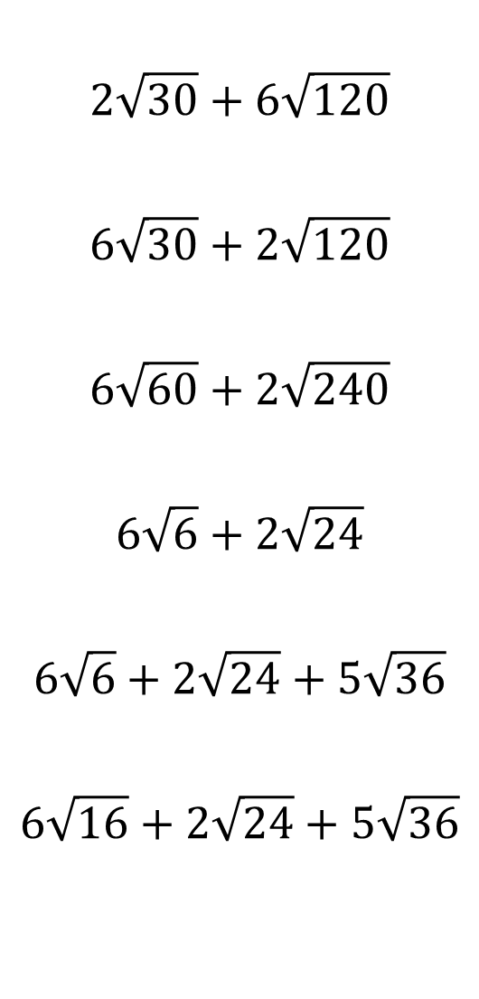
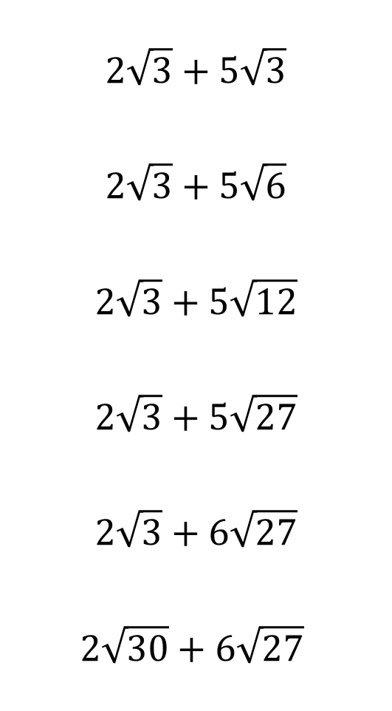
Simplify your answers, where possible:
$$2\sqrt{30}+6\sqrt{120}$$
$$6\sqrt{30}+2\sqrt{120}$$
$$6\sqrt{60}+2\sqrt{240}$$
$$6\sqrt{6}+2\sqrt{24}$$
$$6\sqrt{6}+2\sqrt{24}+5\sqrt{36}$$
$$6\sqrt{16}+2\sqrt{24}+5\sqrt{36}$$
$$2\sqrt{3}+5\sqrt{3}$$
$$2\sqrt{3}+5\sqrt{6}$$
$$2\sqrt{3}+5\sqrt{12}$$
$$2\sqrt{3}+5\sqrt{27}$$
$$2\sqrt{3}+6\sqrt{27}$$
$$2\sqrt{30}+6\sqrt{27}$$
@fortyninecubed

Slide 4


Simplify your answers, where possible:
$$2\sqrt{30}+6\sqrt{120}$$
$$6\sqrt{30}+2\sqrt{120}$$
$$6\sqrt{60}+2\sqrt{240}$$
$$6\sqrt{6}+2\sqrt{24}$$
$$6\sqrt{6}+2\sqrt{24}+5\sqrt{36}$$
$$6\sqrt{16}+2\sqrt{24}+5\sqrt{36}$$
$$2\sqrt{3}+5\sqrt{3}$$
$$2\sqrt{3}+5\sqrt{6}$$
$$2\sqrt{3}+5\sqrt{12}$$
$$2\sqrt{3}+5\sqrt{27}$$
$$2\sqrt{3}+6\sqrt{27}$$
$$2\sqrt{30}+6\sqrt{27}$$
$$14\sqrt{30}$$
$$10\sqrt{30}$$
$$20\sqrt{15}$$
$$10\sqrt{6}$$
$$30+10\sqrt{6}$$
$$54+4\sqrt{6}$$
$$7\sqrt{3}$$
$$2\sqrt{3}+5\sqrt{6}$$
$$12\sqrt{3}$$
$$17\sqrt{3}$$
$$20√3$$
$$2\sqrt{30}+18\sqrt{3}$$
@fortyninecubed

