Slide 1
Factorising Quadratics where the coefficient of x² is not 1
Silent
Teacher
Intelligent Practice
Narration
Your Turn
$$2x^{2}+3x+1$$
$$2x^{2} − 5x+2$$
$$4x^{2}−3x −1$$
Practice

Slide 2
Worked Example
Your Turn
$$3x^{2}+10x+8$$
$$3x^{2}+14x+8$$

Slide 3


$$2x^{2}+3x+1$$
$$2x^{2} − 3x+1$$
$$2x^{2} − 3x −2$$
$$2x^{2}+3x −2$$
$$2x^{2}+5x+2$$
$$2x^{2} − 5x+2$$
$$2x^{2} −5x+3$$
$$2x^{2}+5x+3$$
$$2x^{2} −x−3$$
$$2x^{2}+x −3$$
$$2x^{2}+x −1$$
$$2x^{2} −x −1$$
$$4x^{2} − 1$$
$$4x^{2}+4x+1$$
$$4x^{2} −4x+ 1$$
$$4x^{2}+5x+1$$
$$4x^{2} −5x+1$$
$$4x^{2}+3x −1$$
$$4x^{2}−3x −1$$
$$4x^{2}−3x+2$$

Slide 4
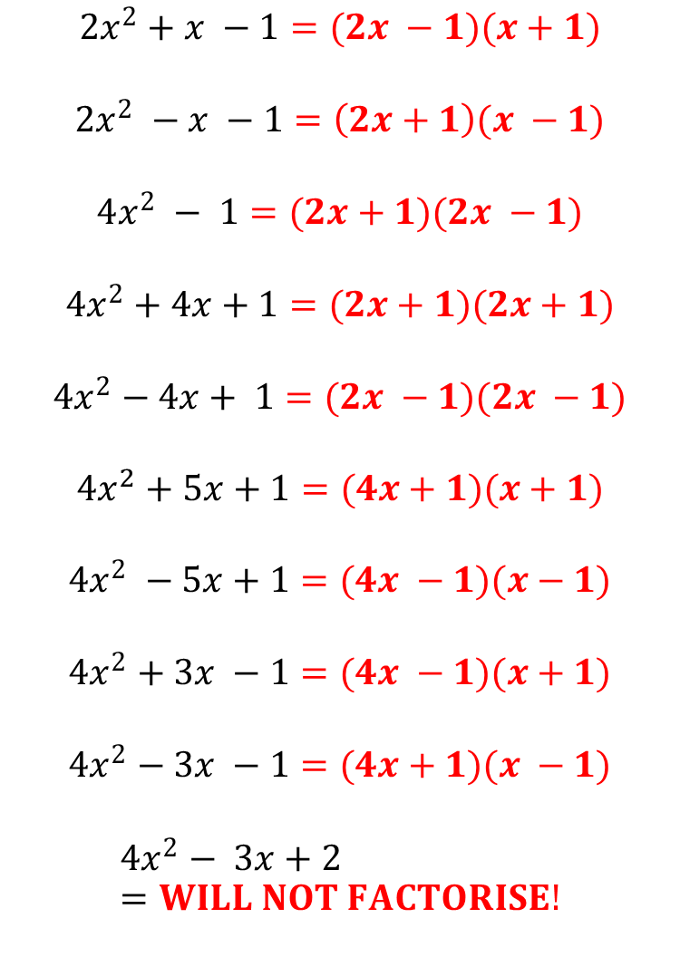
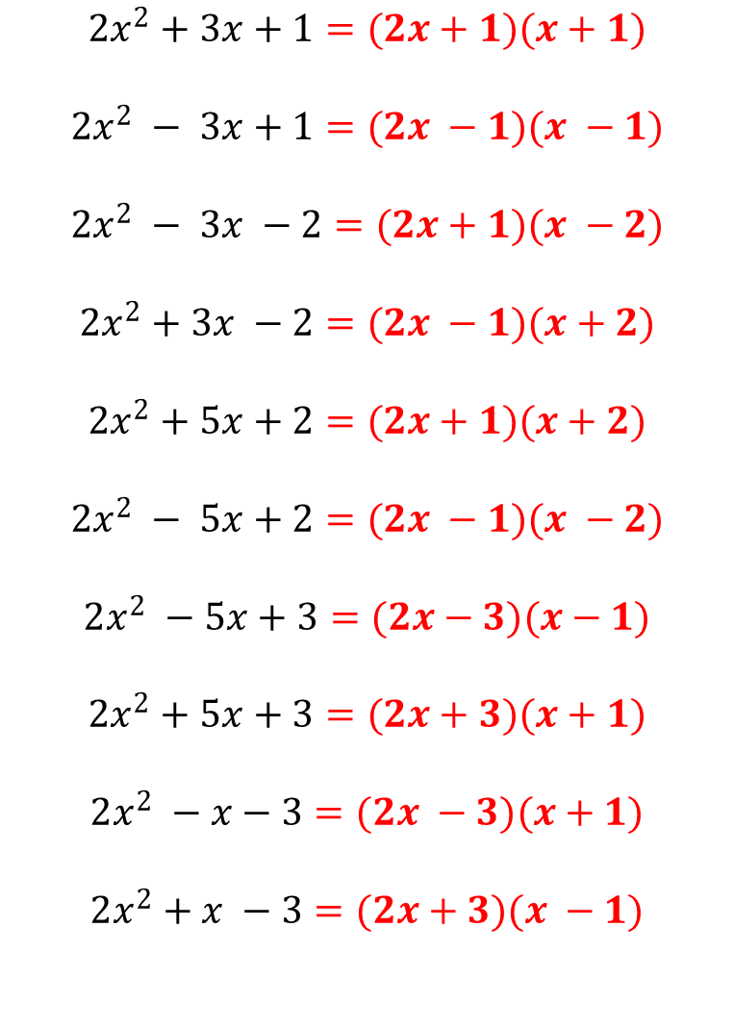
$$2x^{2}+3x+1=(2x+1)(x+1)$$
$$2x^{2} − 3x+1=(2x −1)(x −1)$$
$$2x^{2} − 3x −2=(2x+1)(x −2)$$
$$2x^{2}+3x −2=(2x −1)(x+2)$$
$$2x^{2}+5x+2=(2x+1)(x+2)$$
$$2x^{2} − 5x+2=(2x −1)(x −2)$$
$$2x^{2} −5x+3=(2x−3)(x−1)$$
$$2x^{2}+5x+3=(2x+3)(x+1)$$
$$2x^{2} −x−3=(2x −3)(x+1)$$
$$2x^{2}+x −3=(2x+3)(x −1)$$
$$2x^{2}+x −1=(2x −1)(x+1)$$
$$2x^{2} −x −1=\left(2x+1\right)(x −1)$$
$$4x^{2} − 1=(2x+1)(2x −1)$$
$$4x^{2}+4x+1=(2x+1)(2x+1)$$
$$4x^{2}−4x+ 1=(2x −1)(2x −1)$$
$$4x^{2}+5x+1=(4x+1)(x+1)$$
$$4x^{2} −5x+1=(4x −1)(x−1)$$
$$4x^{2}+3x −1=(4x −1)(x+1)$$
$$4x^{2}−3x −1=(4x+1)(x −1)$$
$$4x^{2}− 3x+2=WILL NOT FACTORISE!$$

