Slide 1
Surds: Multiplying
Silent
Teacher
Intelligent Practice
Narration
Your Turn
$$\sqrt{5}×\sqrt{3}$$
$$\sqrt{6}×\sqrt{3}$$
$$\sqrt{24}×\sqrt{3}$$
Practice

Slide 2
Worked Example
Your Turn
$$\sqrt{5}×\sqrt{6}$$
$$\sqrt{5}×\sqrt{7}$$
$$\sqrt{3}×\sqrt{6}$$
$$\sqrt{3}×\sqrt{8}$$
@fortyninecubed

Slide 3
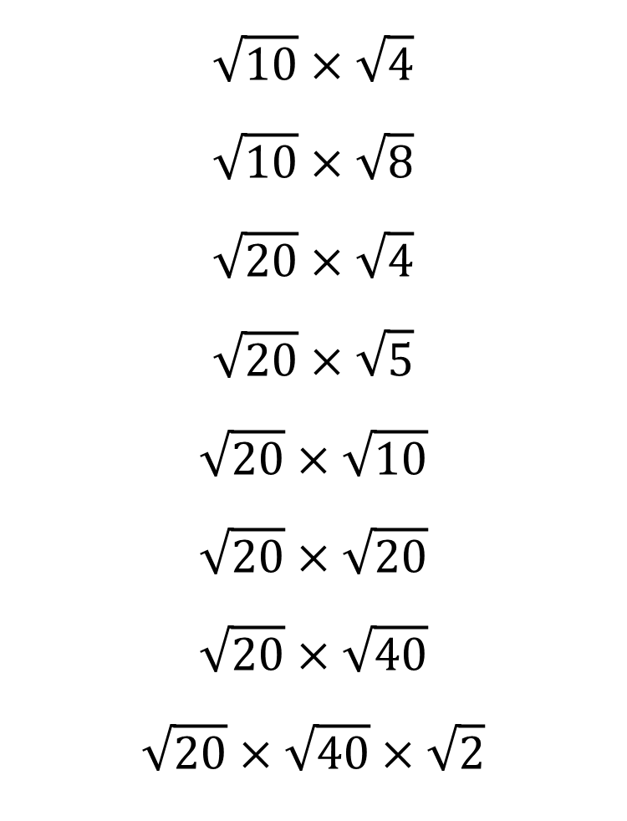
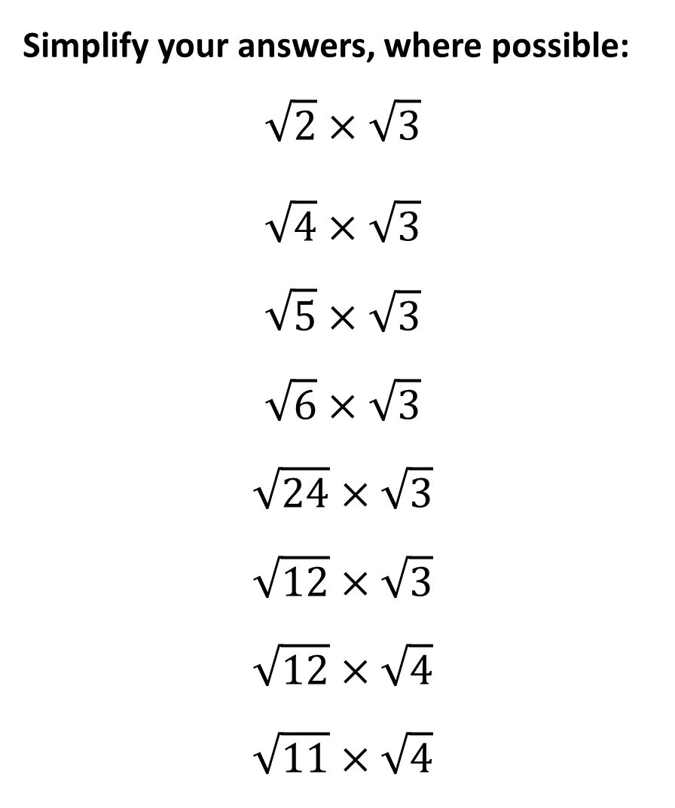
Simplify your answers, where possible: $$\sqrt{2}×\sqrt{3}$$
$$\sqrt{4}×\sqrt{3}$$
$$\sqrt{5}×\sqrt{3}$$
$$\sqrt{6}×\sqrt{3}$$
$$\sqrt{24}×\sqrt{3}$$
$$\sqrt{12}×\sqrt{3}$$
$$\sqrt{12}×\sqrt{4}$$
$$\sqrt{11}×\sqrt{4}$$
$$\sqrt{10}×\sqrt{4}$$
$$\sqrt{10}×\sqrt{8}$$
$$\sqrt{20}×\sqrt{4}$$
$$\sqrt{20}×\sqrt{5}$$
$$\sqrt{20}×\sqrt{10}$$
$$\sqrt{20}×\sqrt{20}$$
$$\sqrt{20}×\sqrt{40}$$
$$\sqrt{20}×\sqrt{40}×\sqrt{2}$$
@fortyninecubed

Slide 4

Simplify your answers, where possible: $$\sqrt{2}×\sqrt{3}$$
$$\sqrt{4}×\sqrt{3}$$
$$\sqrt{5}×\sqrt{3}$$
$$\sqrt{6}×\sqrt{3}$$
$$\sqrt{24}×\sqrt{3}$$
$$\sqrt{12}×\sqrt{3}$$
$$\sqrt{12}×\sqrt{4}$$
$$\sqrt{11}×\sqrt{4}$$
$$2\sqrt{10}$$
$$4\sqrt{5}$$
$$4\sqrt{5}$$
$$10$$
$$10√2$$
$$20$$
$$20\sqrt{2}$$
$$40$$
$$\sqrt{10}×\sqrt{4}$$
$$\sqrt{10}×\sqrt{8}$$
$$\sqrt{20}×\sqrt{4}$$
$$\sqrt{20}×\sqrt{5}$$
$$\sqrt{20}×\sqrt{10}$$
$$\sqrt{20}×\sqrt{20}$$
$$\sqrt{20}×\sqrt{40}$$
$$\sqrt{20}×\sqrt{40}×\sqrt{2}$$
$$\sqrt{6}$$
$$2\sqrt{3}$$
$$\sqrt{15}$$
$$3√2$$
$$6\sqrt{2}$$
$$6$$
$$4√3$$
$$2\sqrt{11}$$
@fortyninecubed

